Slide 1
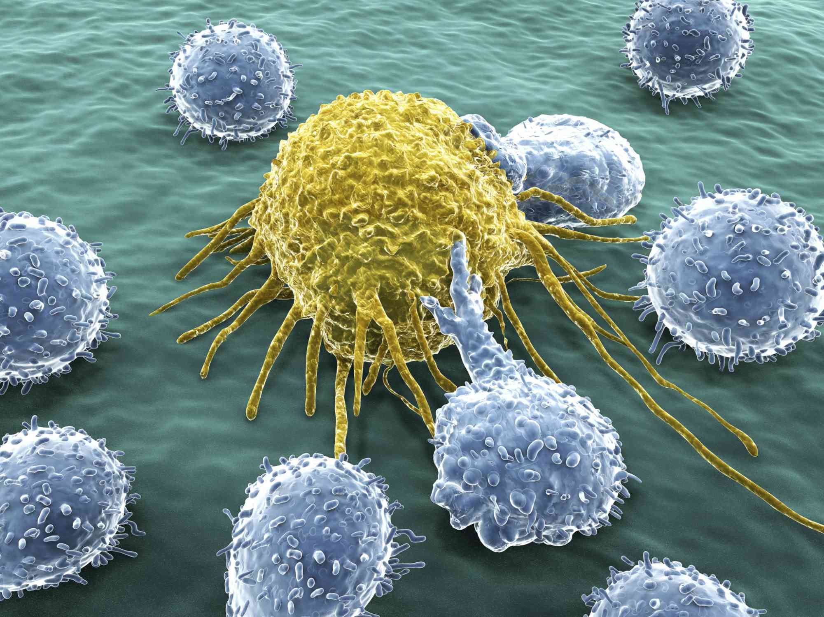
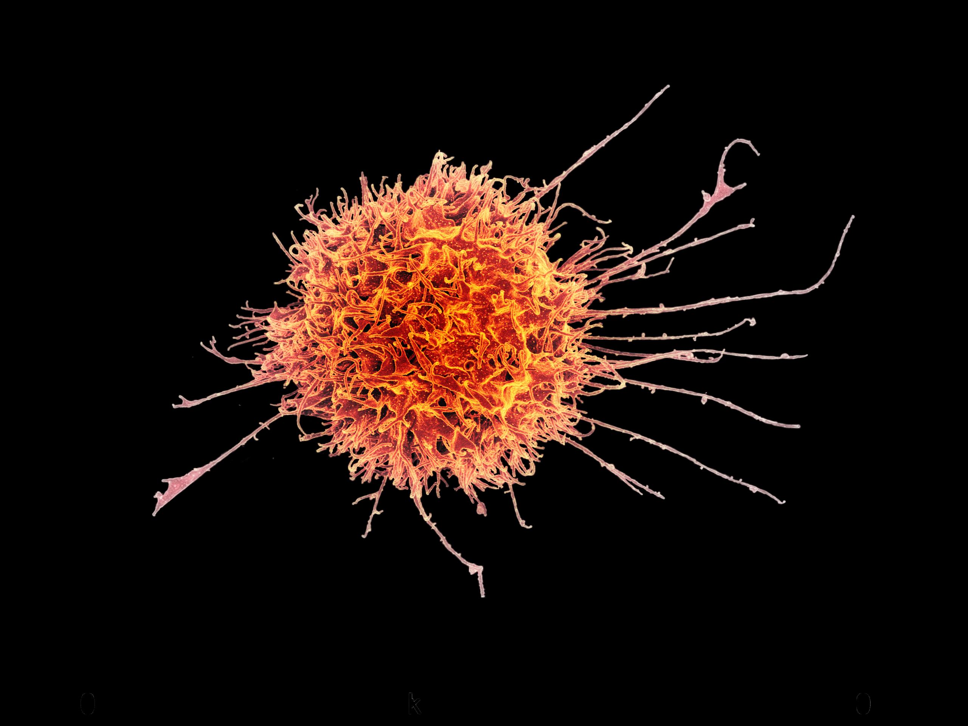
A cancer immunology primer
By Leah Weber*
*Disclaimer: I am not a biologist/immunologist, I don’t play one on TV and I did not stay in a Holiday Inn Express last night.

Slide 2
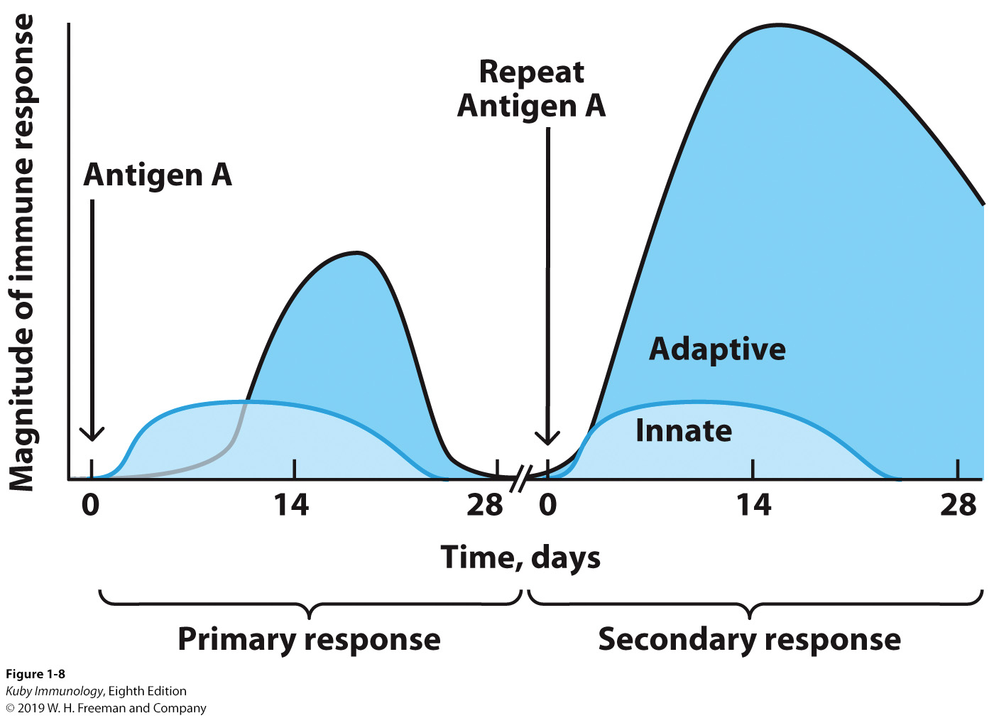
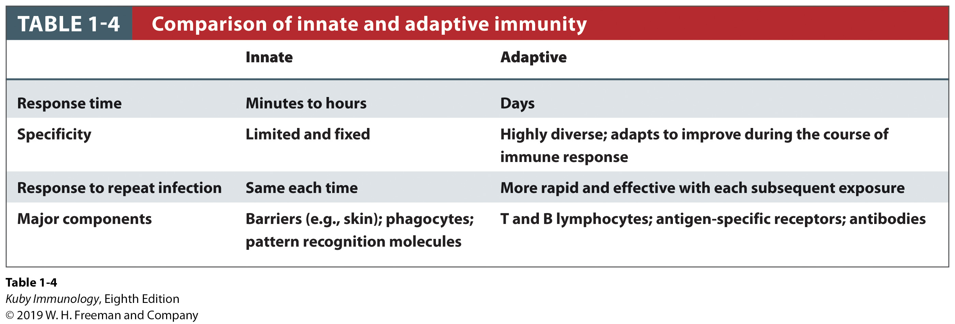
Innate versus Adaptive Immune Responses
Immune System is comprised of two main systems:
Innate (faster & general response)
Adaptive (slower & specific response)

Slide 3
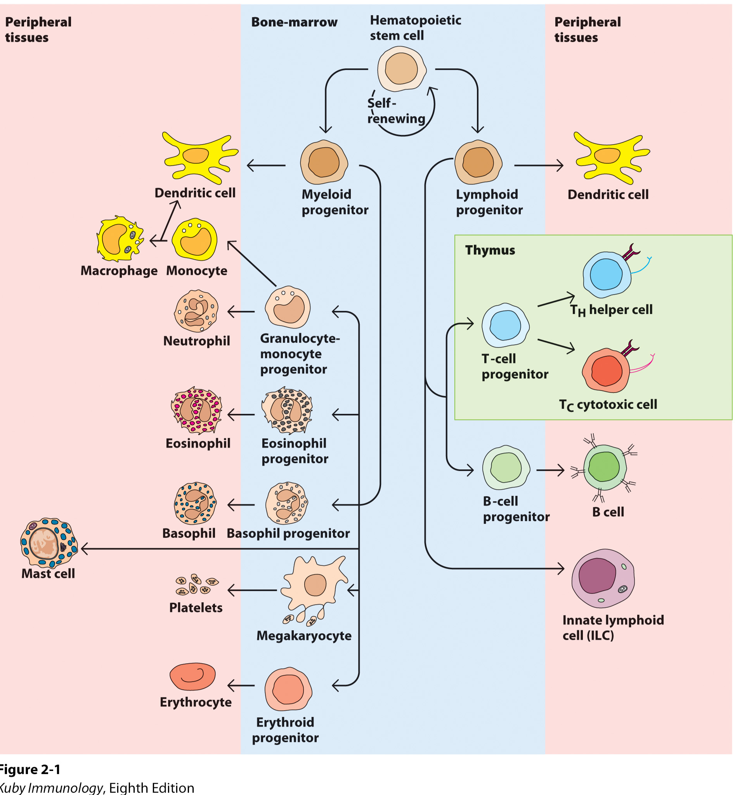
Immune Cell Types
Innate Immune Cells
Adaptive Immune Cells

Slide 4
Immune Cell Types
Antigen Presenting Cells
(APCs)
Performs phagoctyosis
Can display MHC I and MHC II fragments

Slide 5
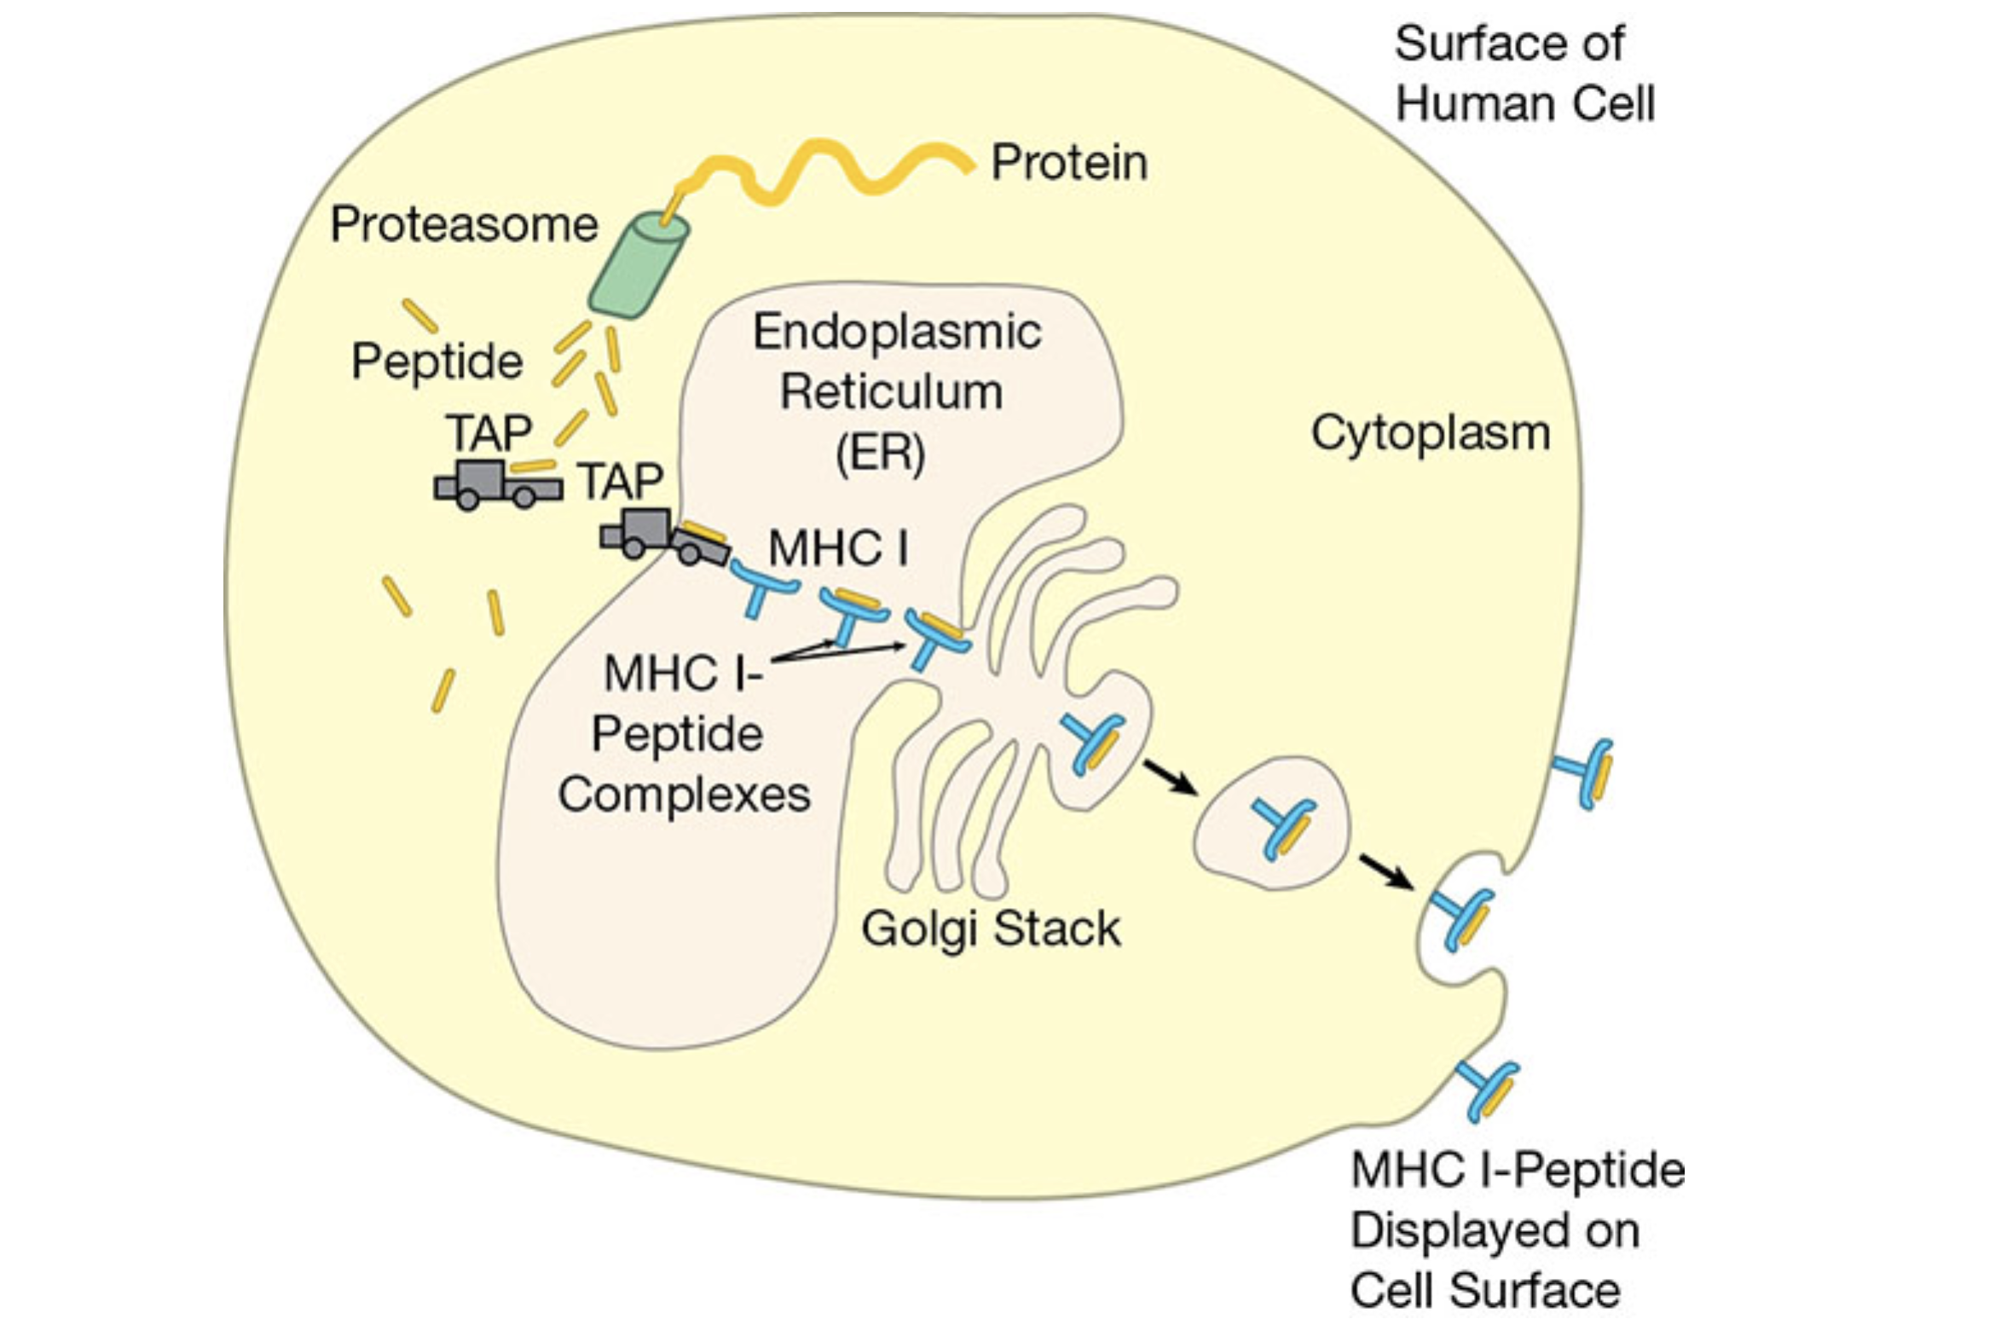
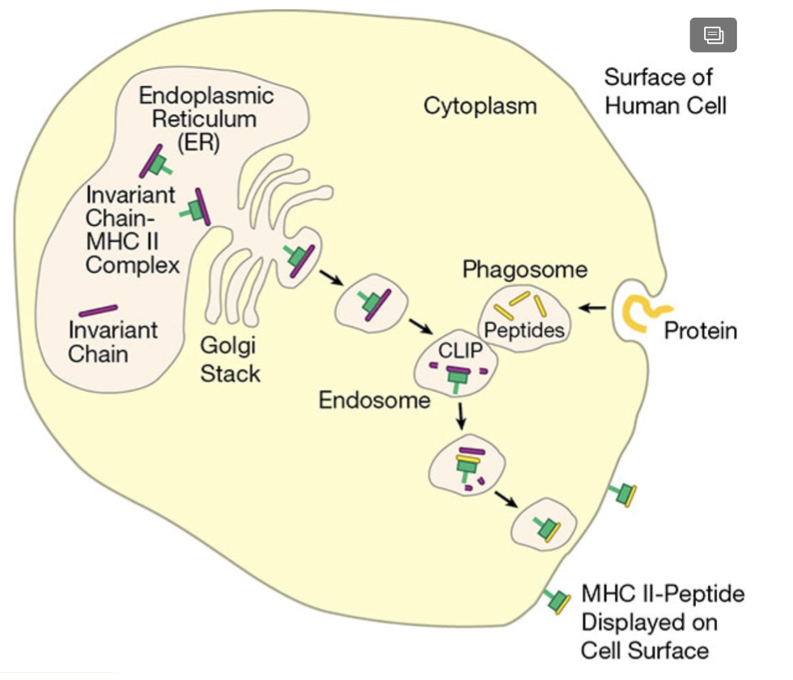
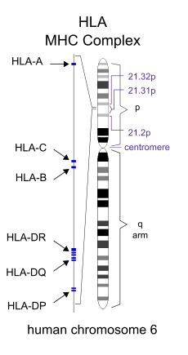
MHC & HLA
Major histocompatibility complex (MHC) is a large locus in vertebrate DNA containing a set of closely linked polymorphic genes that code for cell surface proteins essential for adaptive immunity.
Human Leukocyte Antigen (HLA) is the human version of MHC
All cells present MHC I with peptides originating from inside the cell
Only APCs present MHC II with peptides that originate from outside of the cell

Slide 6
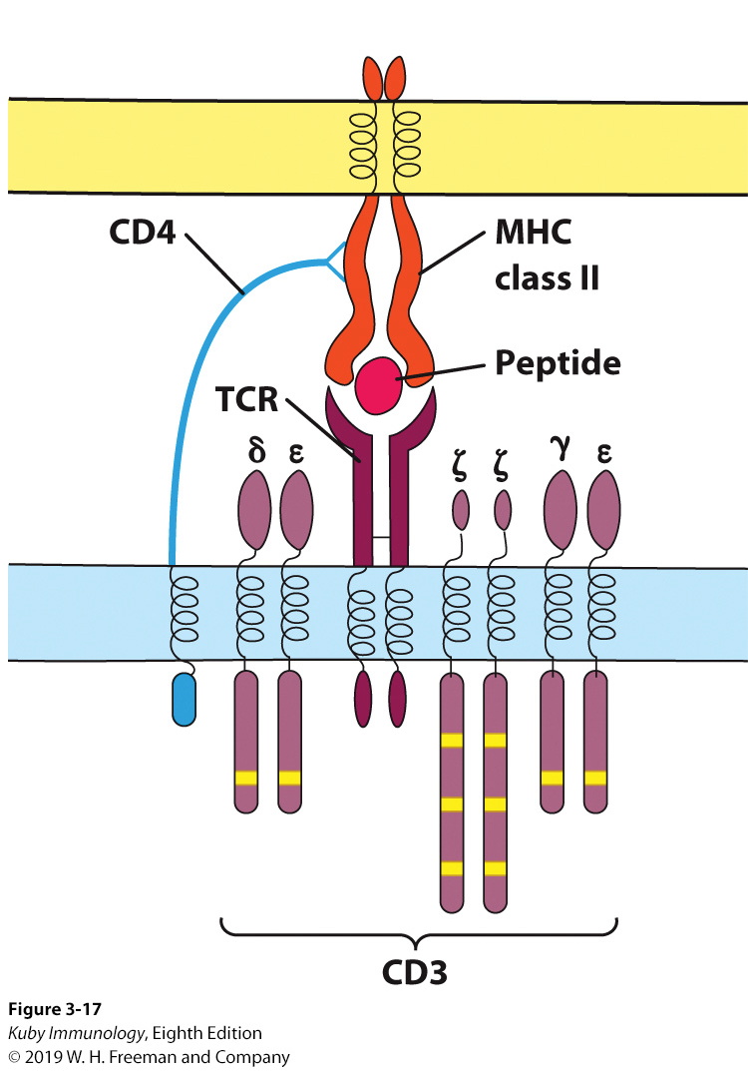
Immune Cell Types
Each T-cell has a custom designed T-cell receptor (TCR), that recognizes a single unique antigen.
Hyperdiversity of TCRs and B-cell receptors (BCRs) is the magic sauce that allows our immune system to defend against a massive number of pathogens.
T-cells come in two main flavors:
T helper cells (CD4)
Cytotoxic T-cells (CD8)
CD8 binds to MHC I
CD4 binds to MHC II

Slide 7
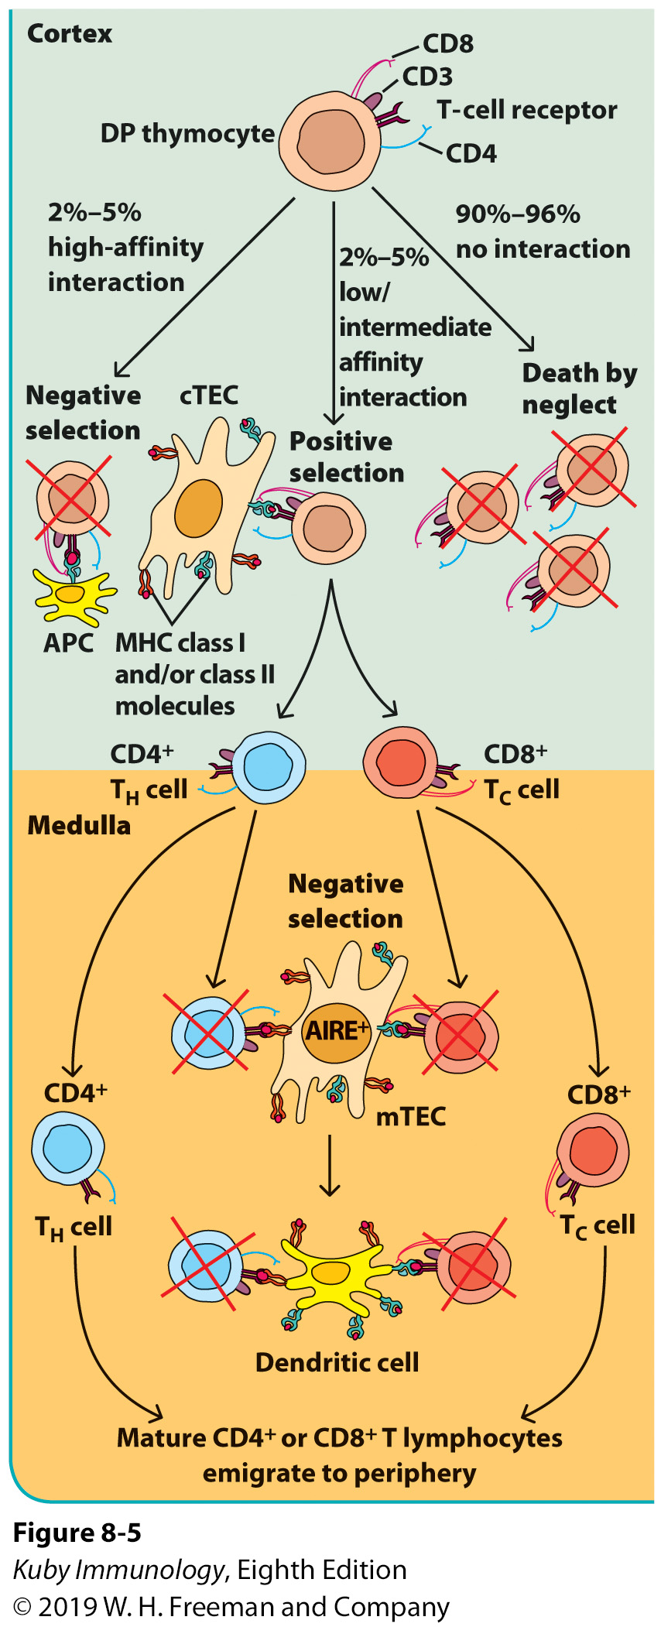
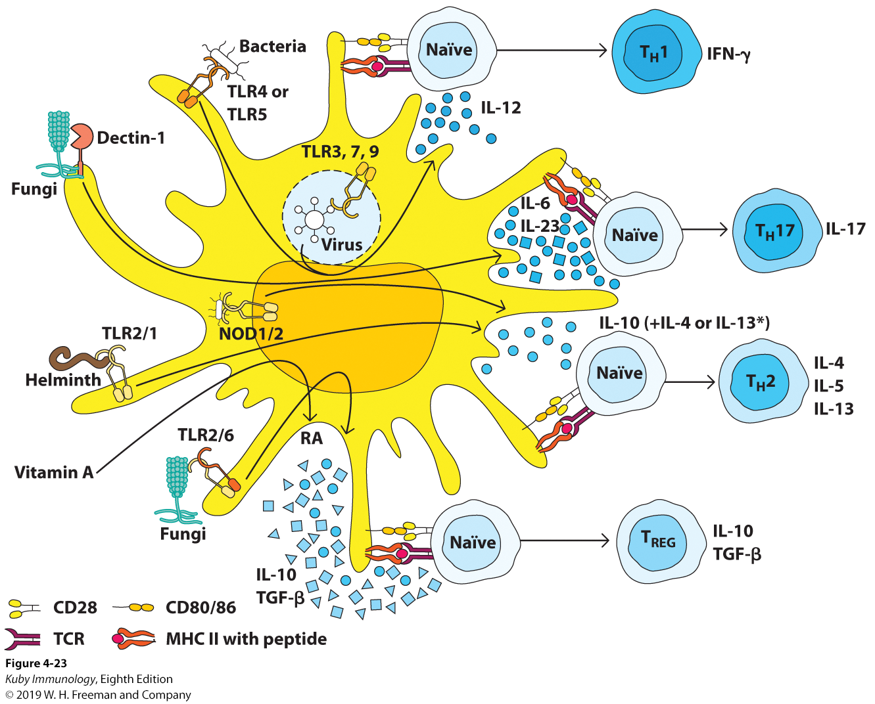
Selection and Differentiation of T-cells
In addition to receptor signals, differentiation and proliferation (clonal expansions) depends
on cytokines
In addition to TCR binding, costimulatory receptor binding is required for activation

Slide 8
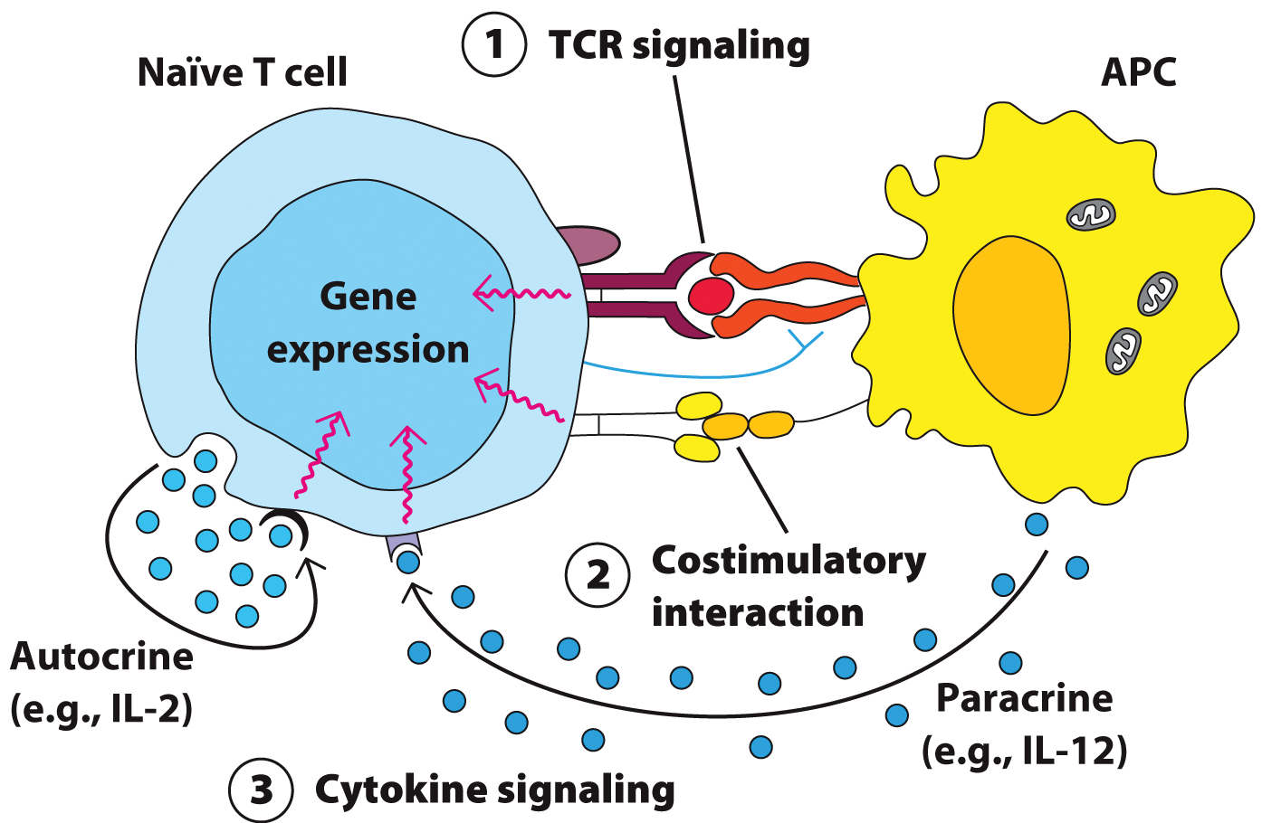
A closer look at TCR binding

Slide 9
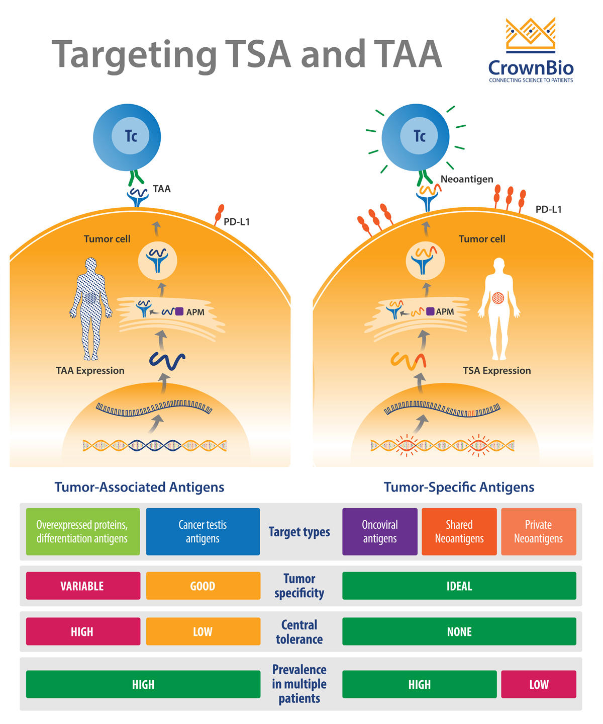
Tumor Specific Antigens (TSA)
Tumor Associated
Antigens (TAA)
A TAA is an antigen overexpressed in tumor cells but also present in other cells
Often recognized as self due to central tolerance
AKA Neoantigens
Causes
Point mutations (SNVs)
Indels
Gene fusions
Viral proteins (oncoviruses)
https://blog.crownbio.com/targeting-tumor-associated-antigens-and-tumor-specific-antigens

Slide 10
Important receptors/ligands
Whoa, sneaky!

Slide 11
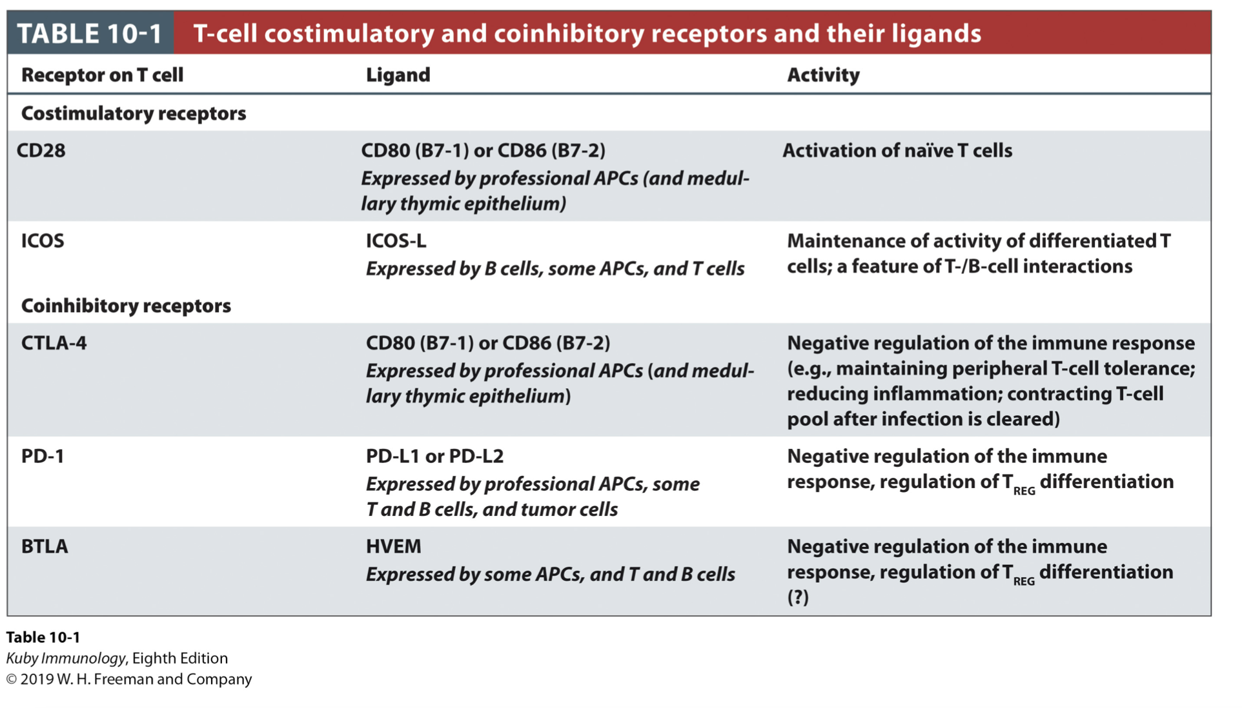
Important receptors/ligands
Whoa, sneaky!

Slide 12
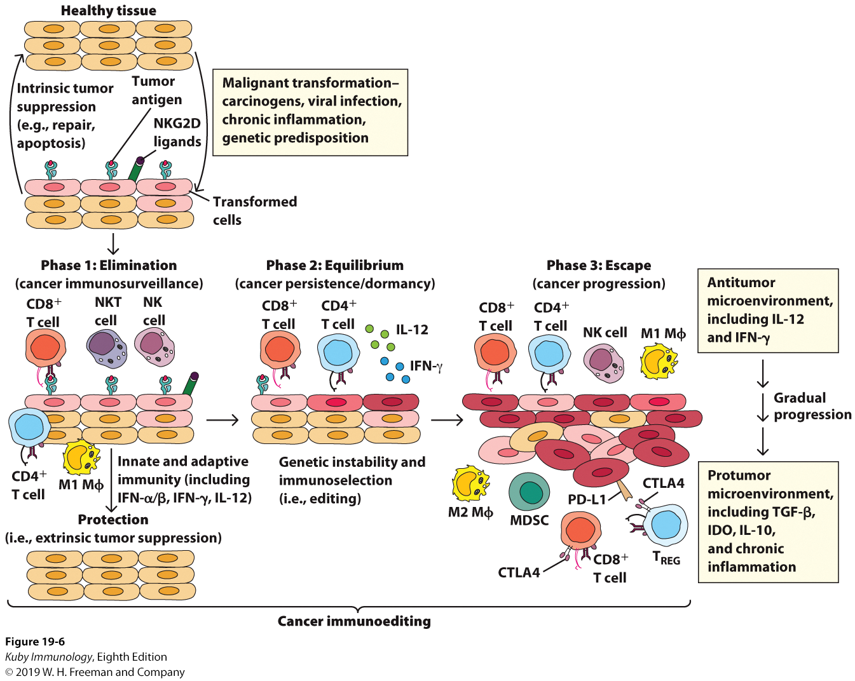
Immunoediting
Three Phase Process
Elimination – abnormal/malignant cells are recognized and eliminated
Equilibrium – strong/best cells survive but remain under control by immune system
Escape – even weak cells survive and proliferate, immune system is dominated by inhibitory responses
Immune escape is one of the hallmarks of cancer

Slide 13
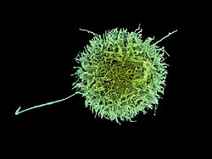
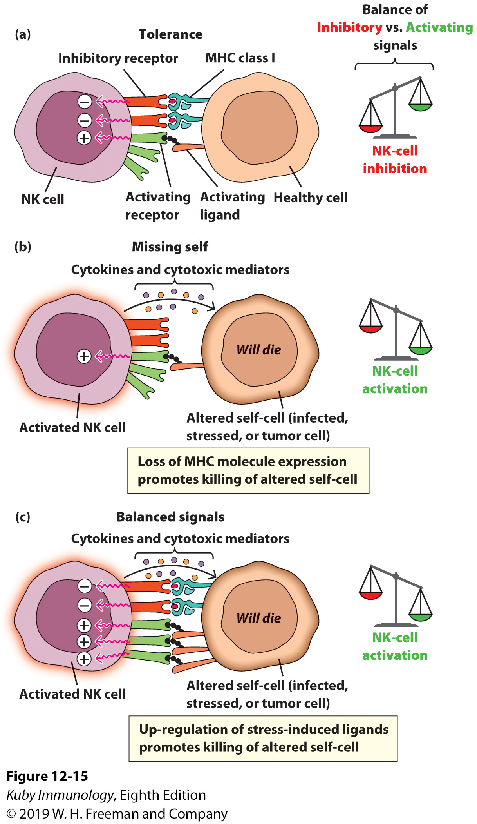
Natural Killer cells (NK cells)
Lack antigen specific receptors
Considered part of the innate response
Similar function to Cytotoxic T-cells
Play a key role in immune surveillance and killing of tumor cells
Looks for cytokines signaling, stress induced ligands and LACK of MHC as indication of altered self

Slide 14
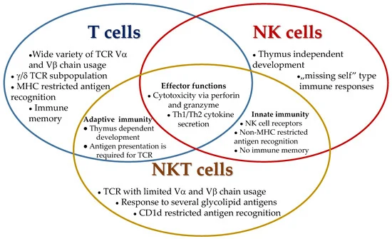
Natural Killer T-Cells (NKT cells)
Essentially the love child of NK cells and Cytotoxic T-cells
Functions as part of both the innate and adaptive immune systems to play a key role in immune surveillance
Has an antigen specific receptor
But also express molecular markers associated with NK cells
Make up approximately 1% of peripheral blood T-cells
https://www.mdpi.com/2227-9059/9/12/1901/htm

Slide 15
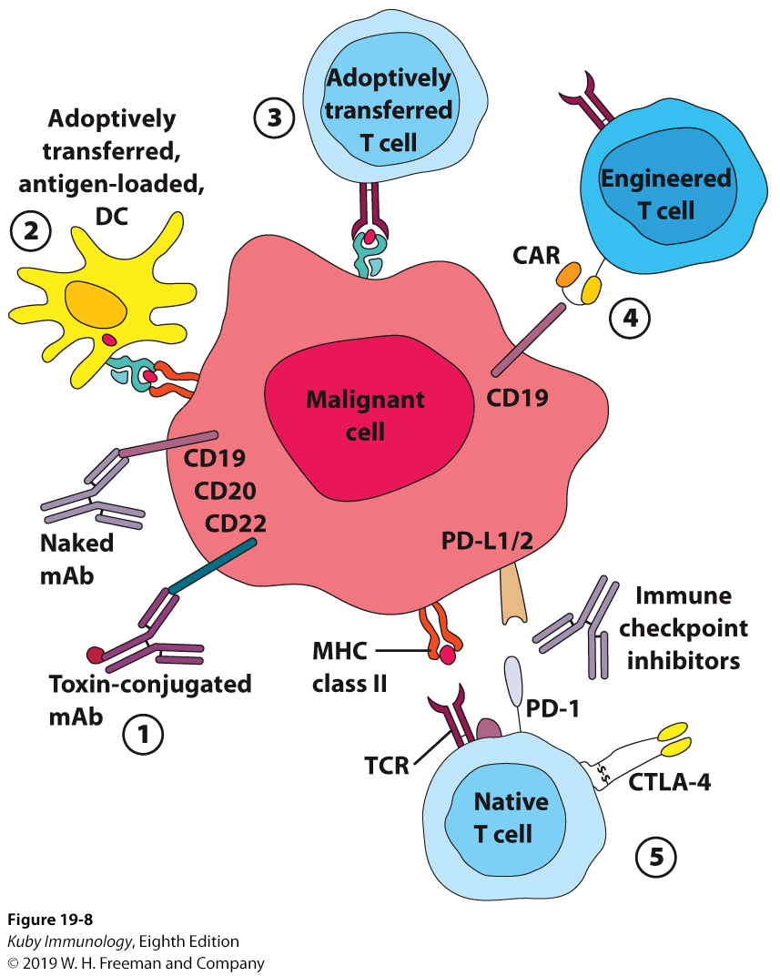
Immunotherapies
”Reversing immune escape” and stimulating an appropriate immune response
Immune checkpoint inhibitor
Engineered T-cells
Cancer vaccines

Slide 16
Immunotherapies

Slide 17
Immune checkpoint blockade monoclonal antibodies (mAB)

Slide 18
Monoclonal antibodies
In addition to targeting inhibitory receptors, monoclonal antibodies can also be used against other receptors, such as HER2 (an epidermal growth factor receptor) in breast cancer.

Slide 19
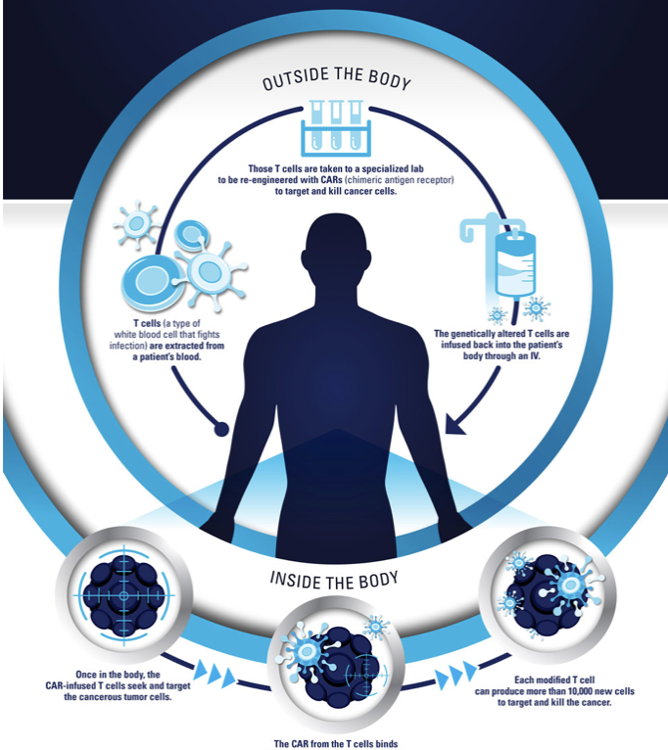
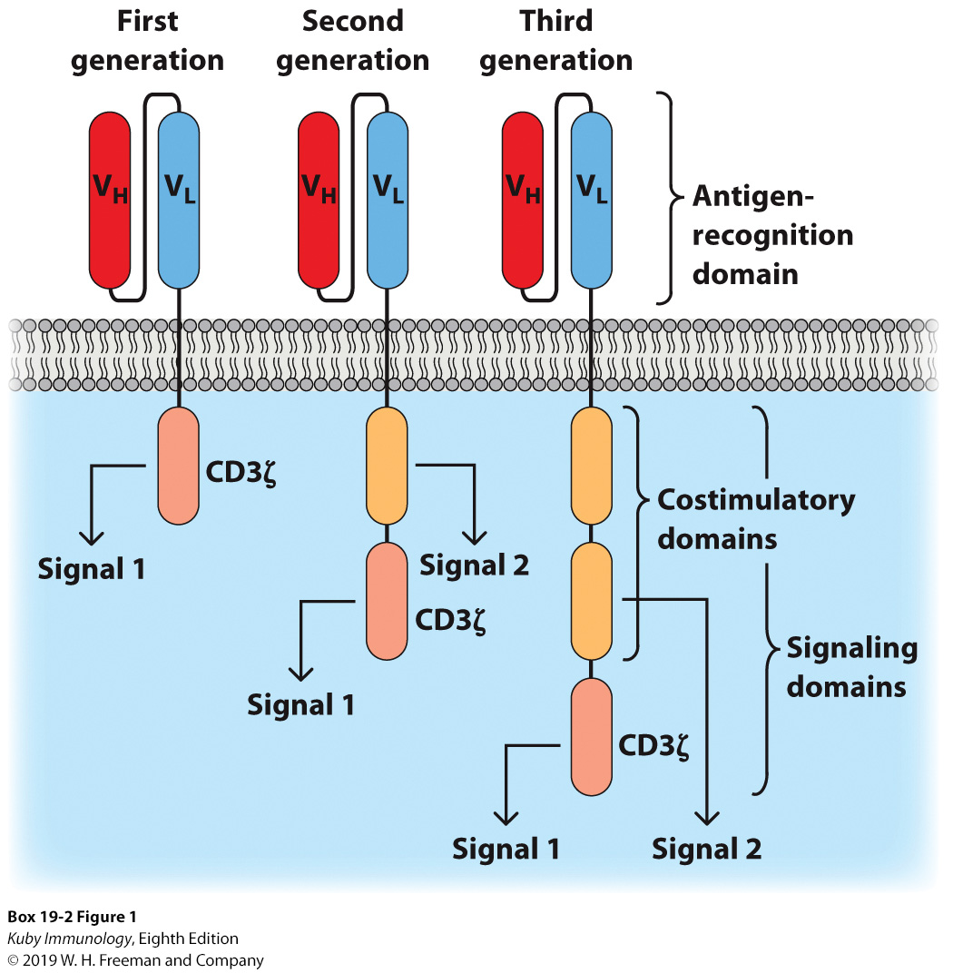
Adoptively transferred and Engineered T-cells
Tumor-specific T cells can be expanded and reintroduced into patients (in some cases after being transfected with modifications)
Cells taken from tumor, tumor draining nodes, blood
Expanded ex vivo using cytokines to “reenergize” the T-cell
Patient depleted of lymphocytes to create a nice for modified T-cells
T-cells injected back into the patient
Chimeric antigen receptor (CAR) is essentially a BCR domain fused to TCR signal transduction machinery

Slide 20
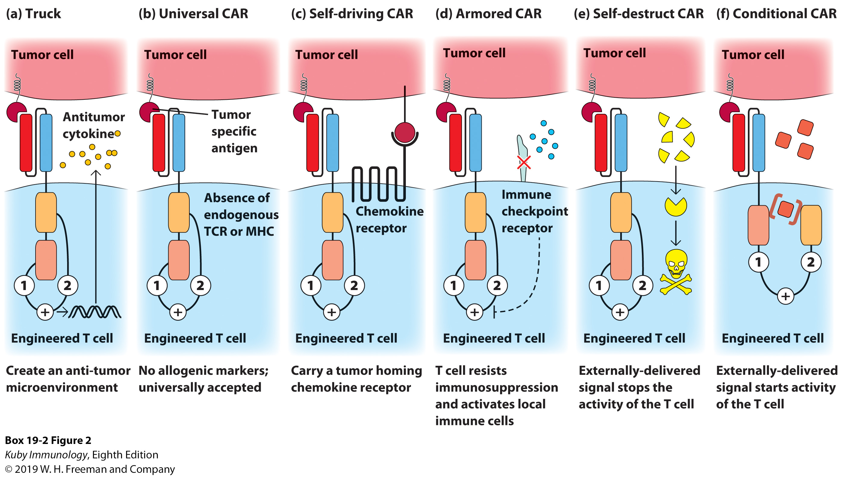
Engineered T-cells (CAR-T)

Slide 21
Cancer Vaccines

Slide 22
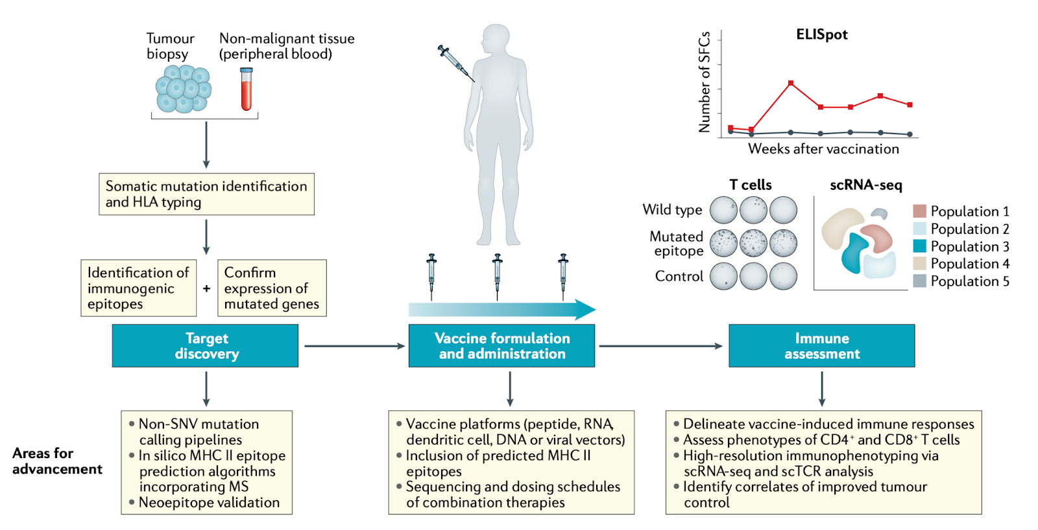
Vaccine Pipeline

Slide 23
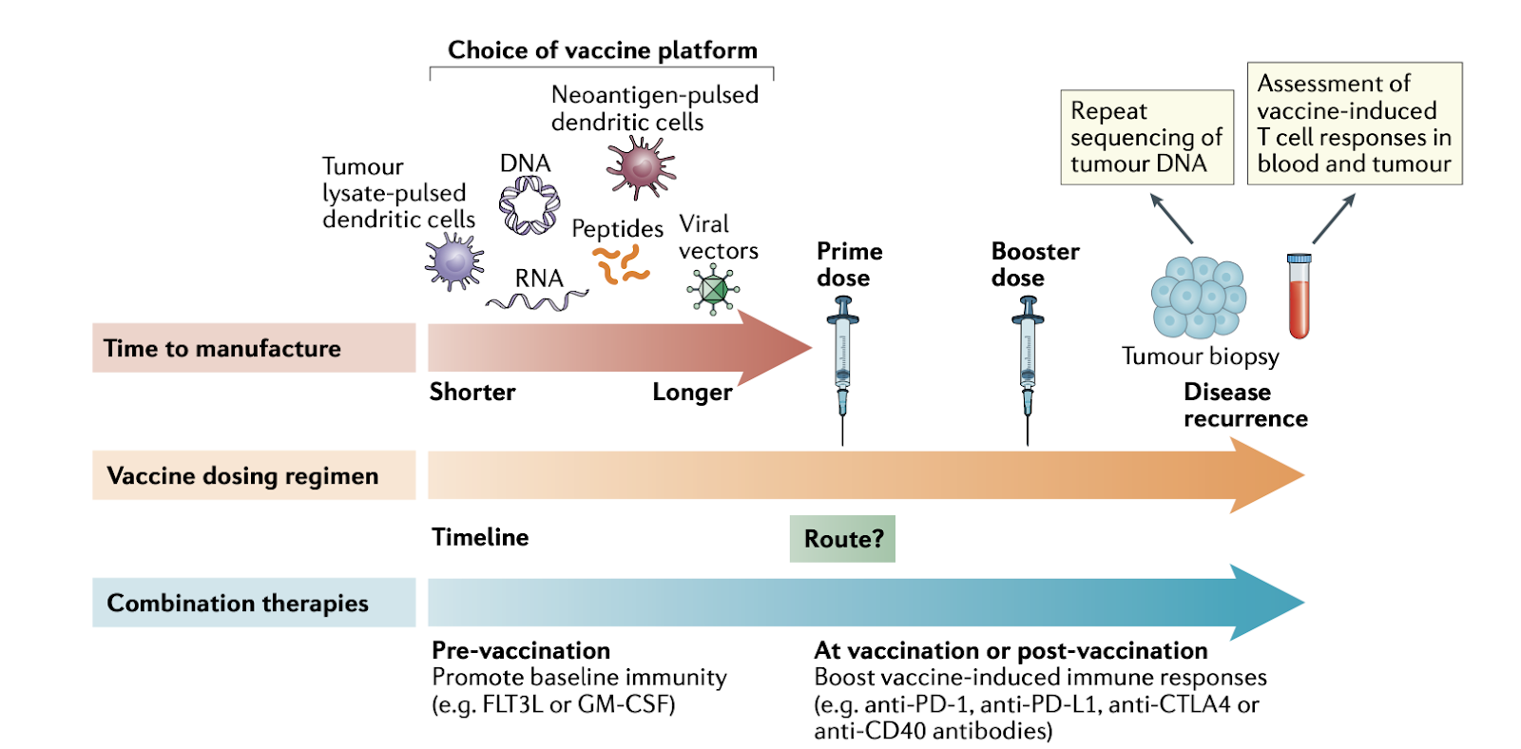
Key decisions

Slide 24
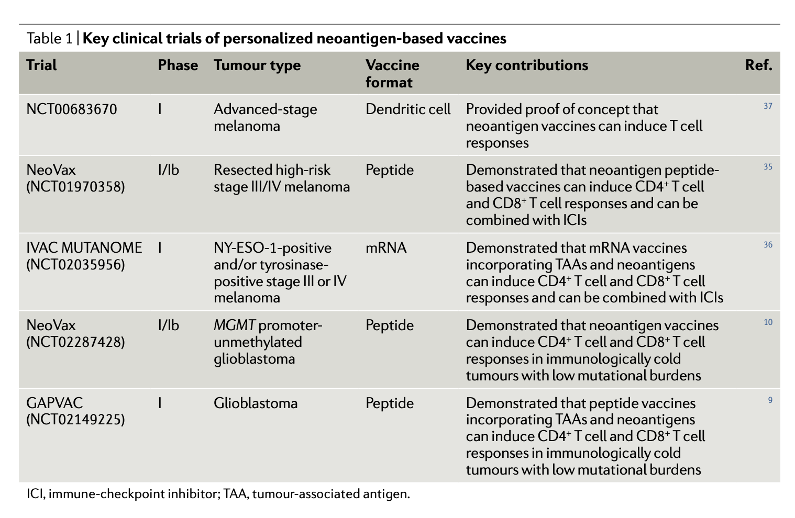
Cancer vaccines do increase T-cell diversity/responses

Slide 25
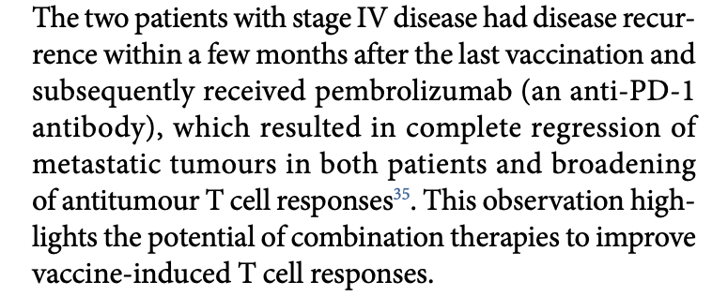
Cancer vaccines do increase T-cell diversity/responses

Slide 26
Cancer vaccines do increase T-cell diversity/responses
No improvement in survival metrics for glioblastoma trials

Slide 27
Conclusions
This is just the tip of the iceberg when it comes to cancer immunology, there is so much more cool stuff to learn!
Immunotherapies have produced some of the greatest advancements in cancer treatment over the last decade, but there is still so much we don’t understand about how, why and when they work.
Given the recent advancements in mRNA vaccines, cancer vaccines seem promising but current results are mixed.

Slide 28
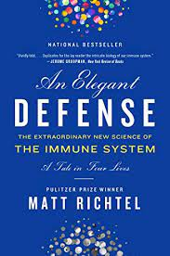
Suggested reading for popular science lovers and those who hate getting bogged down by gratuitous use of abbreviations

Slide 29
References
Kuby Immunology 8th Edition by Jenni Punt, Sharon Stranford, Patricia Jones and Judy Owen
Lectures slides from MCB408: Immunology taught by Dr. Beth Stadtmueller
Wikipedia
https://en.wikipedia.org/wiki/Major_histocompatibility_complex
https://en.wikipedia.org/wiki/Human_leukocyte_antigen
https://en.wikipedia.org/wiki/Chimeric_antigen_receptor_T_cell
Blass E, Ott PA. Advances in the development of personalized neoantigen-based therapeutic cancer vaccines. Nature Reviews Clinical Oncology. 2021 Apr;18(4):215-29.

Slide 30
Cancer immunology

