Slide 1
Analysis of the solution to Copy-Number Triplet Problem
Yinfei Zhu

Slide 2
Goal
This project aims to analyze the published methods for Copy-Number Triplet Problem (CN3):
Dynamic Programming: DP-Alg1
Improved Dynamic Programming: DP-Alg2
Linear Integer Programming: ILP

Slide 3
Copy Number Aberration
Copy number aberrations (CNAs) are a common type of mutation:
Includes segmental deletions and amplifications
Alters the number of copies of genomic regions along a chromosome
Important in predicting disease progression and the outcome of medical interventions

Slide 4
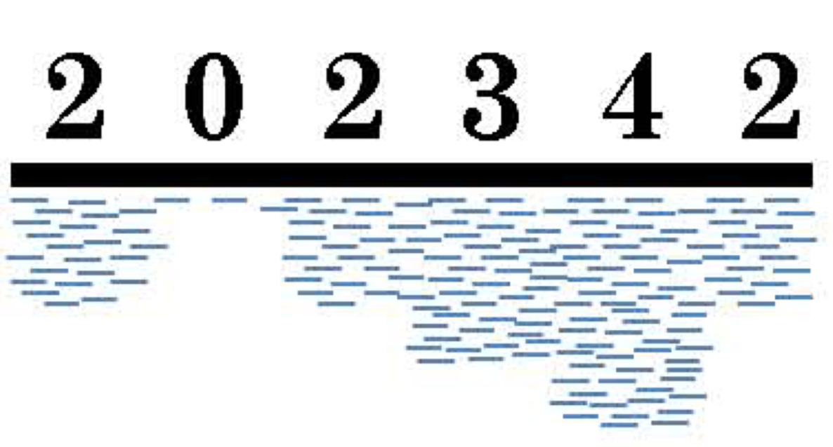
Copy Number Profile
Copy number profiles encode the number of copies of genomic regions:
As vectors of integers
Each entry represents the copy number state of a position

Slide 5
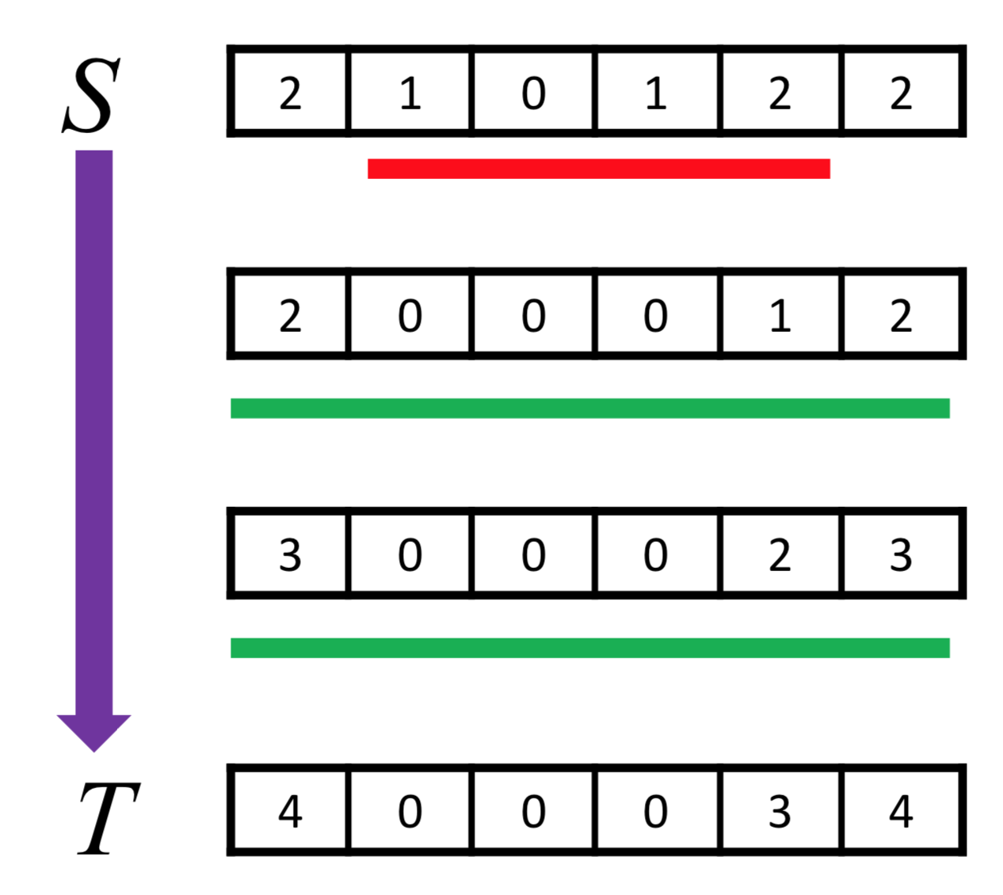
Events on Profiles
Segmental deletions and amplifications
A zero in a position can no longer be altered
Cost is defined as the magnitude of the change in copy number

Slide 6
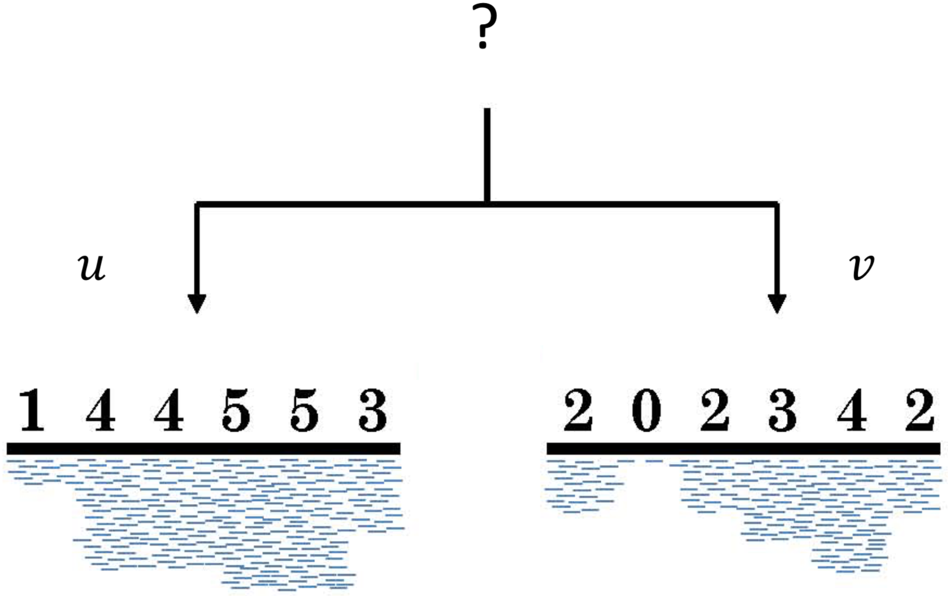
Copy Number Triplet Problem (CN3)
Given two profiles u and v, find a parent file minimizing the sum of cost from the parent file to u and v.

Slide 7
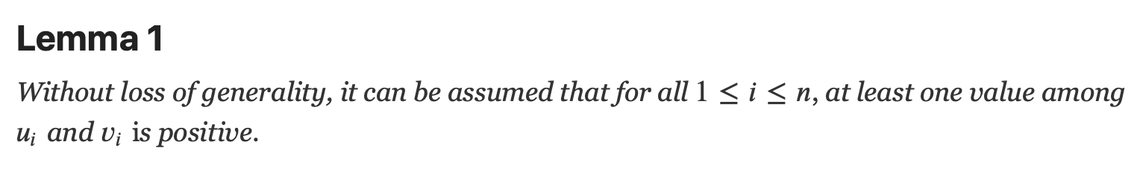
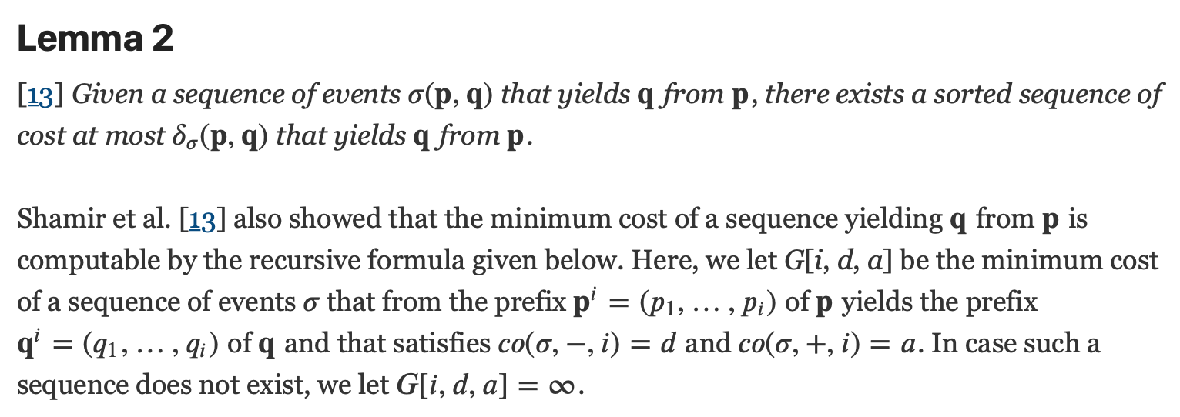

Slide 8
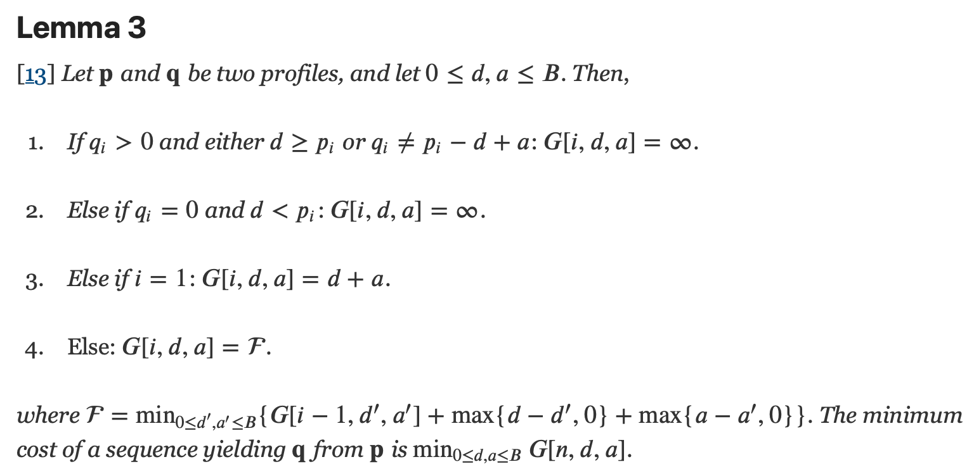

Slide 9
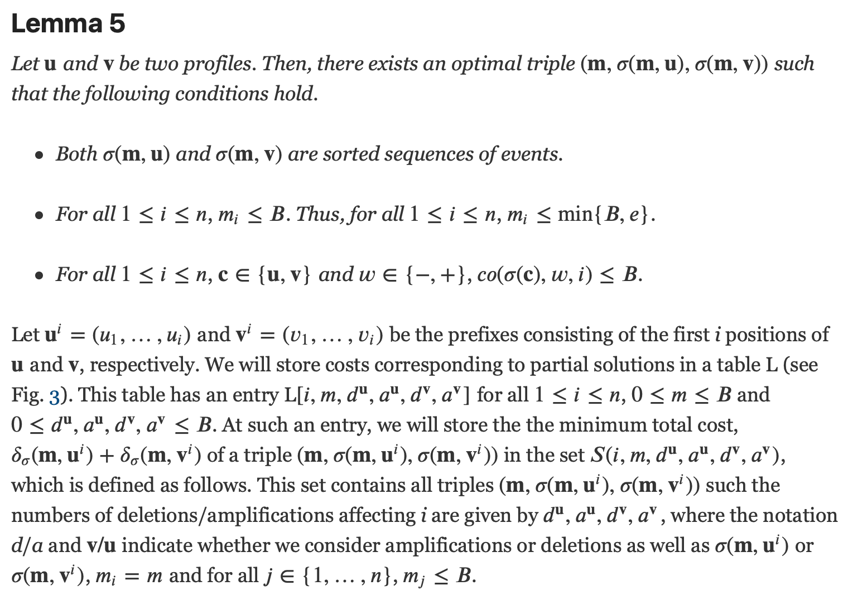

Slide 10
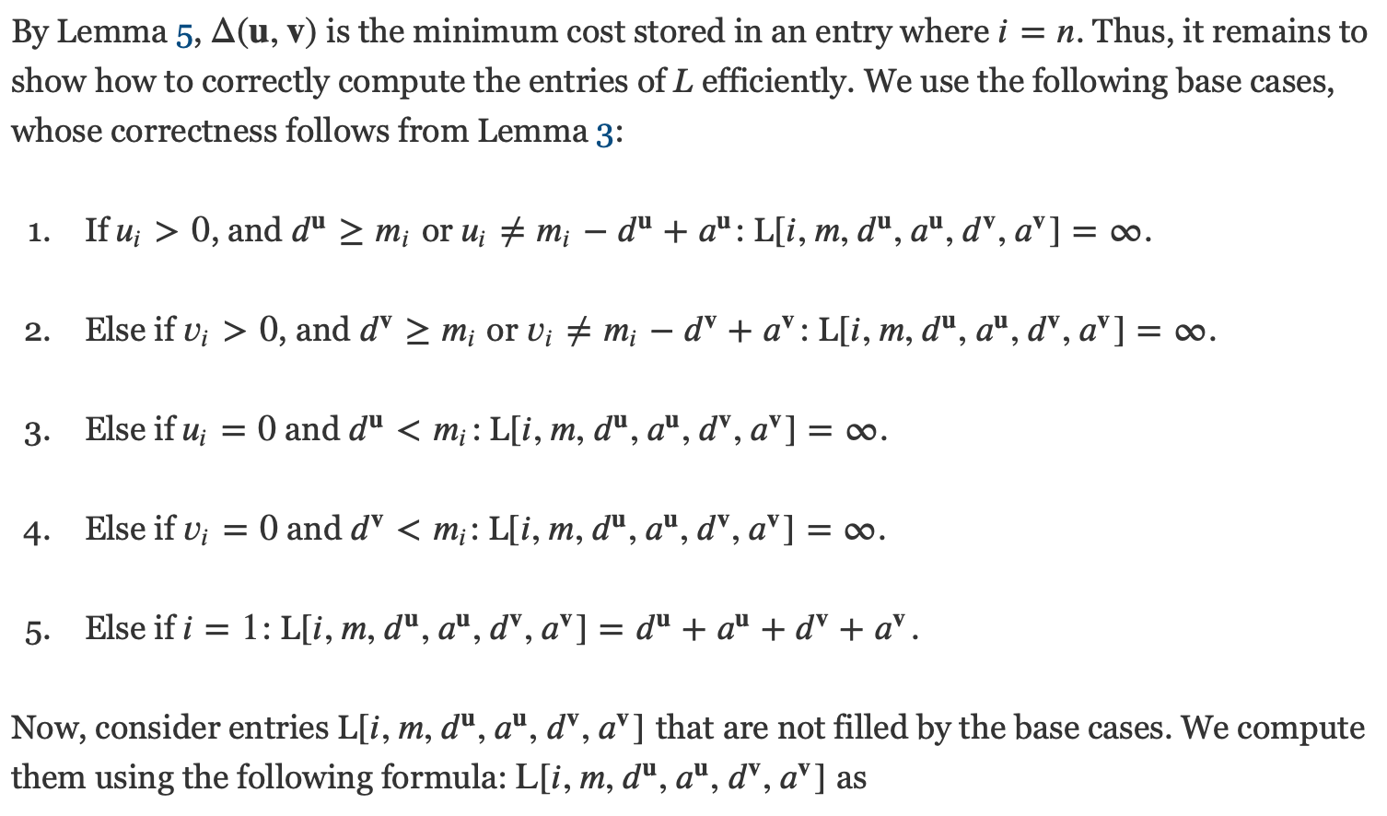

Slide 11
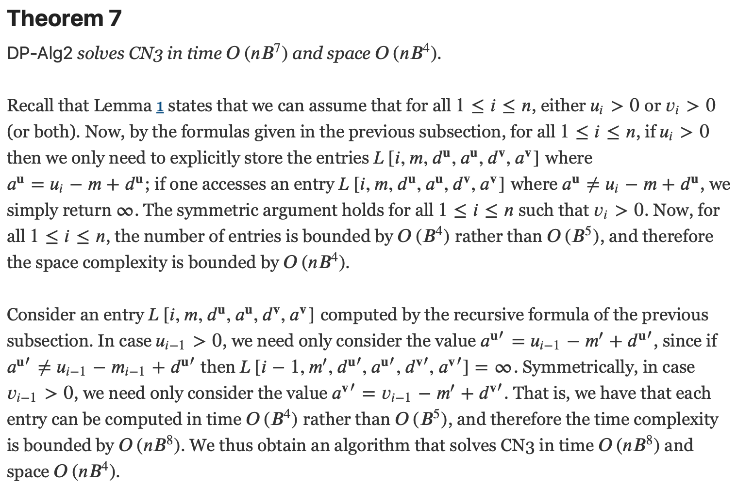

Slide 12
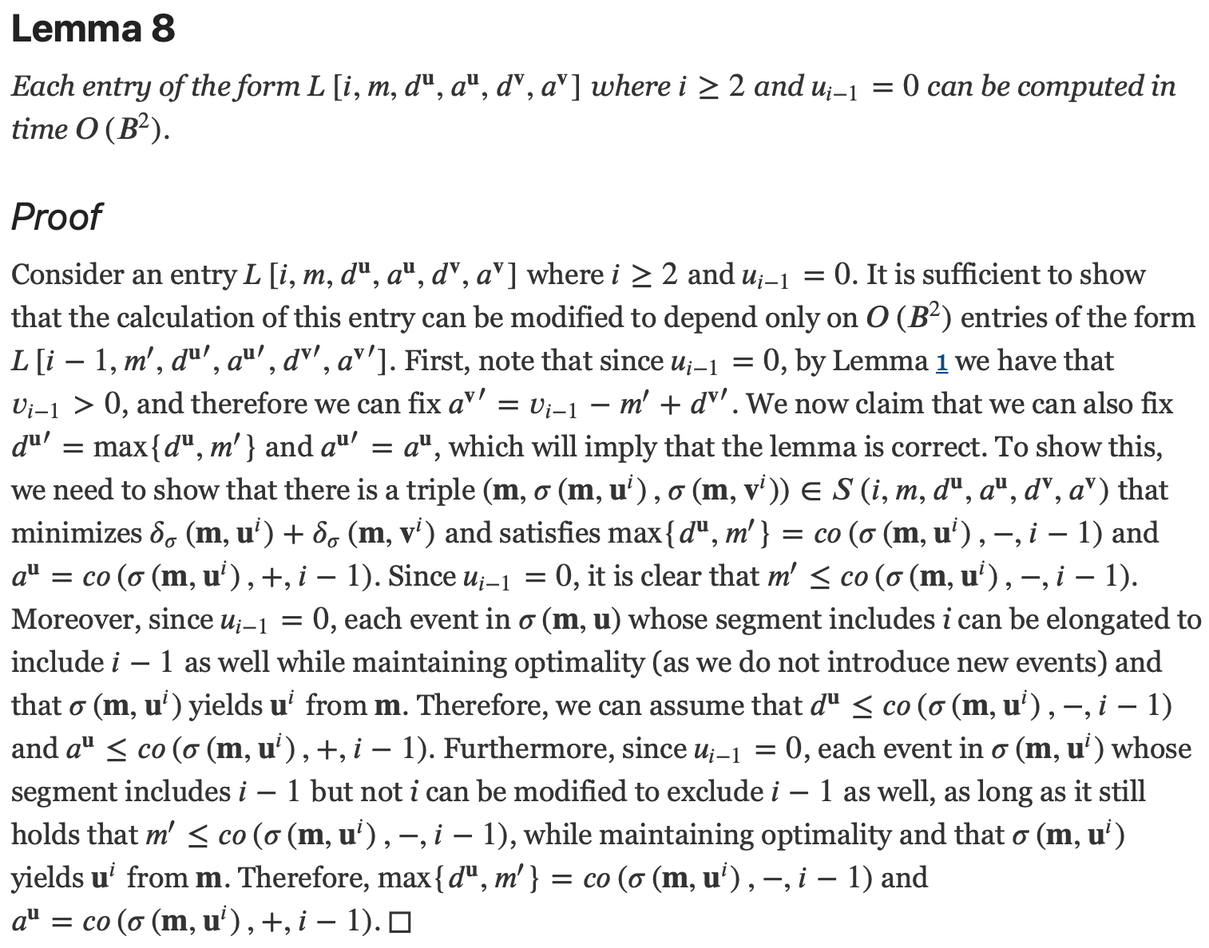

Slide 13
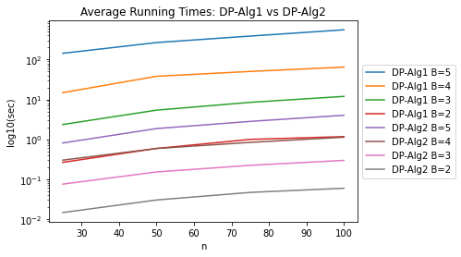
Results

