Slide 1
Gaussian embedding for large-scale gene set analysis
Sheng Wang, Emily R. Flynn & Russ B. Altman

Slide 2
Gene sets
Come from many sources
Boost the signal-to-noise ratio and increase explanatory power
Used in various downstream analyses:
disease signature identification
drug pathway association prediction
survival analysis
drug response prediction

Slide 3
Gene sets
Bottlenecks:
Averaging embedding fails to distinguish different gene sets
Existing methods require fixed-length vectors as input
High quality compact vectors are needed to avoid overfitting

Slide 4
Network embedding
Molecular interaction networks provide novel insights
Network embedding is a powerful network analysis approach
Generates a highly informative and compact vector representation
Regularizes high-dimensional network data
Represents each gene as a fixed-length vector
Low-dimensional continuous vector space
Typically much smaller dimension than the original data

Slide 5
Gaussian embedding
Simple aggregation methods such as averaging may not be sufficiently expressive
Gene sets can be arbitrarily large
Genes in the same set frequently have different functions and are involved in multiple biological processes
Gaussian embedding to model the uncertainty of nodes
Represents each node as a multivariate Gaussian distribution

Slide 6
Set2Gaussian
Input: biological networks and a collection of gene sets
Each gene is represented as a single point
Each gene set is represented as a multivariate Gaussian distribution
The mean vector describes the joint contribution of genes in this gene set
The covariance matrix characterizes the agreement among individual genes in each dimension

Slide 7
Set2Gaussian
Problem definition

Slide 8
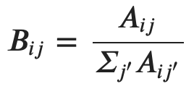
Set2Gaussian
Random walk with restart (RWR) captures fine-grained topological properties that lie beyond direct neighbours
RWR can correct the noise from missing and spurious genes using network neighbours
Define transition matrix B, which represents the probability of a transition from gene i to gene j
Define u_{i}S_{i}^{t} as an n-dimensional distribution vector in which each entry j contains the probability of gene j being visited from gene i after t steps
Define Q_{k}^{t} as an n-dimensional distribution vector in which each entry contains the probability of a gene being visited from gene set k after t steps

Slide 9
Set2Gaussian
Optimizes two criteria to find the low-dimensional representation
Genes with similar diffusion states should be close to each other in the low-dimensional space
Genes in a given gene set in the network should have higher probabilities in the Gaussian distribution of that gene set
The loss function is defined as L := Lgene + Lset
Lgene and Lset represent the loss function based on the above two criteria

Slide 10
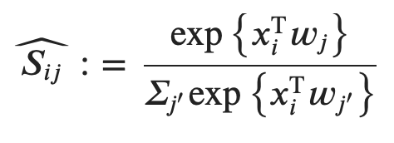
Set2Gaussian
where D_{KL} is the Kullback–Leibler (KL) divergence and
where xi is the representation of gene i in the low-dimensional space and wj is the context feature describing the network topology of gene j
Now relax the constraint that the entries in Ŝ_{i} sum to one by dropping the normalization factor
Use the sum of squared errors instead of KL divergence because Ŝ_{i} is no longer an n-dimensional probability simplex

Slide 11
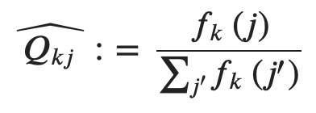
Set2Gaussian
f_{k} is the multivariate Gaussian probability density function and f_{k}(j) is the probability density of gene j
Note: Mahalanobis distance of gene j from the mean and covariance matrix

Slide 12
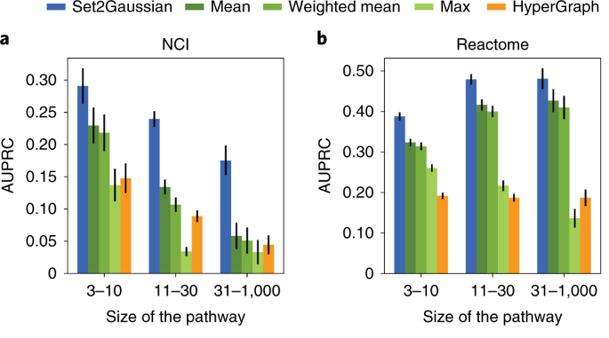
Results
Gene set member identification
Set2Gaussian significantly outperformed the proposed baseline gene set representation approaches and hypergraph embedding on identifying gene set members in all three datasets at all size categories (P < 0.05; Wilcoxon signed-rank test)

Slide 13
Results
Tumour stratification and subnetwork identification in sarcoma
Set2Gaussian’s subtypes had significantly different survival in sarcoma across groups, whereas subtypes from the other three approaches did not

Slide 14
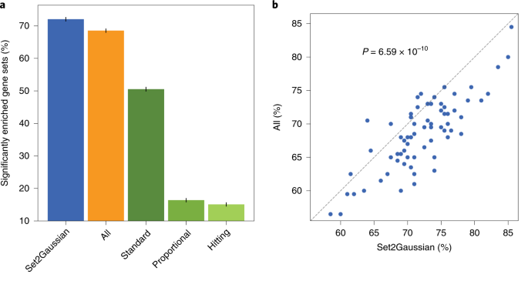
Results
Downsize existing previously defined gene sets in GSEA
For all cell lines, Set2Gaussian enriched for more gene sets in comparison to Standard. For 60 of 69 cell lines, Set2Gaussian enriched for more gene sets in comparison to All.

