Slide 1
MEDALT: single-cell copy number lineage tracing enabling gene discovery
Authors: Fang Wang, Qihan Wang, Vakul Mohanty, Shaoheng Liang, Jinzhuang Dou, Jincheng Han, Darlan Conterno Minussi, Ruli Gao, Li Ding, Nicholas Navin and Ken Chen
Presentation by: Payam Dibaeinia
CS598 MEB
Spring 2021
Wang, Fang, et al. "MEDALT: single-cell copy number lineage tracing enabling gene discovery." Genome biology 22.1 (2021): 1-22.

Slide 2
Background
Conventional phylogenetics approaches ignore non-linear nature of evolutions
Infinite Site Assumption (ISA)
  Reality: A site can be changed multiple times by CNAs
Genomic sites evolve independently
  Not true in reality
Use Euclidean or Hamming distance between CNPs
  Does not capture above non-linearities

Slide 3
Background
Novel phylogenetics approaches
MED distance
  Minimum number of evolutionary events to convert one CNP to another
Example: MEDICC
  Challenge:
    NP-hard
    not scalable to single-cell copy number (SCCN) datasets with thousands of cells
Schwarz, Roland F., et al. "Phylogenetic quantification of intra-tumour heterogeneity." PLoS Comput Biol 10.4 (2014): e1003535.

Slide 4
Goals of MEDALT
MEDALT is a cells’ evolutionary history inference algorithm from SCCN data
Goals:
  Developing a polynomial time algorithm for MED calculation and tree inference that scales to large SCCN datasets
  Developing a statistical method to identify CNAs/genes significantly related to the evolution (Fitness-Associated Alterations; FAA)

Slide 5
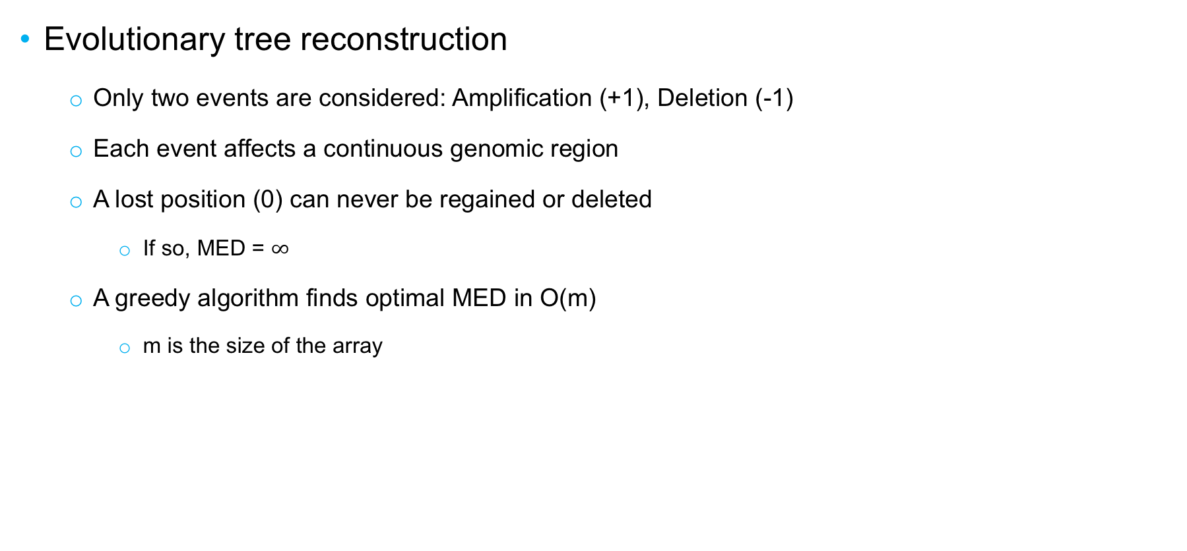
MEDALT
Evolutionary tree reconstruction
  Only two events are considered: Amplification (+1), Deletion (-1)
  Each event affects a continuous genomic region
  A lost position (0) can never be regained or deleted
    If so, MED = $∞$
  A greedy algorithm finds optimal MED in O(m)
    m is the size of the array

Slide 6
MEDALT
Evolutionary tree (MEDALT) inference:
  MEDALT: is a rooted directed minimum spanning tree (RDMS) with smallest number of CNAs
  Edmond’s algorithm is used to infer RDMS
  Theoretically runs in ~O(n³)
    n is the number of single-cells
    In practice: ~O(n)

Slide 7

FAA detection: Lineage Speciation Analysis (LSA)
CFL (cumulative fold change) Calculation:
  Start from root of MEDALT, remove edges iteratively to get a subset of cells (lineage)
  For lineage $i$ and CNA event $j$, sum copy number levels of all cells in $i$:
  $$CFL_{ij}=\sum_{k}{CN_{ijk}}$$
  At each region, CFLs for amplification and deletion are computed separately

Slide 8

FAA detection: Lineage Speciation Analysis (LSA)
Compute a background distribution of CFLs:
  SCCN Data is randomly permuted 1000 times (entire chromosomes are shuffled between cells)
  Each time a MEDALT is computed (i.e. permuted MEDALTs)
  For each permuted MEDALT, $CFL_{ij}$ is computed similar to real data
  For each lineage in the real MEDALT, we select all the lineages with the same size from random MEDALTs

Slide 9

FAA detection: Lineage Speciation Analysis (LSA)
Compute an empirical p-value for each CNA event
  Empirical p-value:
  $$p=\frac{\sum_{r=1}^{R}{I\left(S_{r}>S_{0}\right)+1}}{R+1}$$
  $R$: total number of background lineages with proper size
  $S_{r}$: CFL of the CNA event in permuted data
  $S_{0}$: CFL of the CNA event in real data

Slide 10
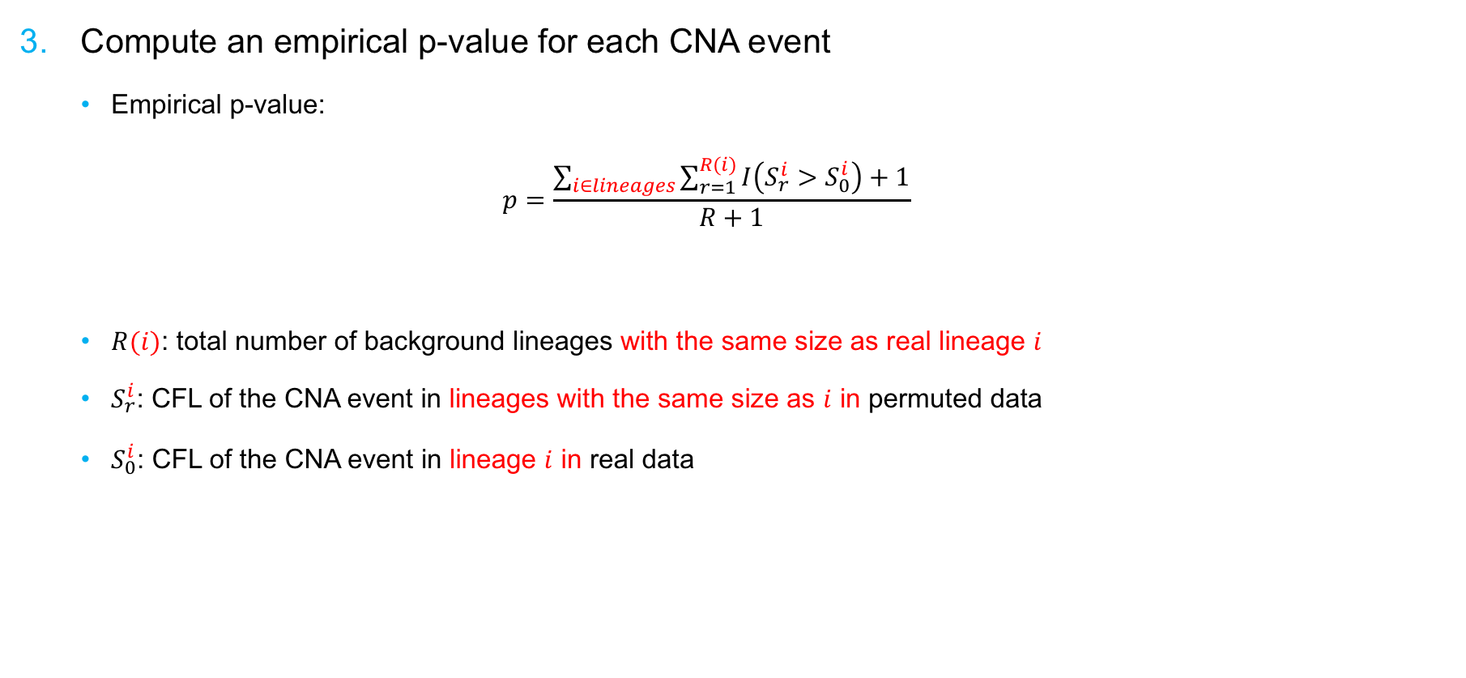
FAA detection: Lineage Speciation Analysis (LSA)
Compute an empirical p-value for each CNA event
  Empirical p-value:
  $$p=\frac{\sum_{i∈lineages}{\sum_{r=1}^{R(i)}{I\left(S_{r}^{i}>S_{0}^{i}\right)+1}}}{R+1}$$
  $R(i)$: total number of background lineages with the same size as real lineage $i$
  $S_{r}^{i}$: CFL of the CNA event in lineages with the same size as $i$ in permuted data
  $S_{0}^{i}$: CFL of the CNA event in lineage $i$ in real data

Slide 11
Two Additional LSAs
Cohort-level LSA:
  For a cohort data containing multiple individuals
  Detect CNAs that non-randomly occur in many individuals
  Idea:
    Form meta-lineages by merging lineages obtained from different individuals
    Compute CFLs and p-values for meta lineages
Parallel evolutions (PLSA):
  Detect CNAs that occur independently in many parallel lineages
  Idea:
    A similar statistical LSA analysis
    Instead of examining lineages independently, the algorithm works on multiple parallel lineages

Slide 12
Results: in-silico evaluations
Simulated data:
  Various CNA mechanisms: genome doubling, breakage-fusion-bridge, tandem duplication and …
  100 synthetic SCCN data each containing ~200 cells
  Ground truth: list of functional CNAs
Analysis: FAA detection
  LSA + MEDALT
  LSA + [Maximum Likelihood, Maximum Parsimony, Neighbor Joining]
  GISTIC

Slide 13
Results: in-silico evaluations

Slide 14
Results: real data evaluations
A cohort of 20 breast cancer patients
Patient-level analysis:
  Parallel lineages have different mutation rates
  Attributed to variable degree of DNA damage repair loss (DDR)

Slide 15
Results: real data evaluations
Cohort-level analysis:
  Cohort level LSA on MEDALT and MP
  GISTIC
  Ground truth: Literature survey for CNAs functionally associated with breast cancer development

Slide 16
Results: real data evaluations
Cohort-level analysis:
  Cohort level LSA at gene resolution focusing on 448 genes
  LSA+MEDALT: 197 genes identified; 109 AMP, 88 DEL
  LSA+MP: 130 genes identified; 82 AMP, 48 DEL
  GISTIC: 60 genes identified, 33 AMP, 27 DEL
  Ground Truth: CRISPR knockout effect scores
Meyers, Robin M., et al. "Computational correction of copy number effect improves specificity of CRISPR–Cas9 essentiality screens in cancer cells." Nature genetics 49.12 (2017): 1779-1784.

Slide 17
Results: real data evaluations
Parallel evolution analysis (PLSA):
  PLSA+MEDALT: 107 genes identified; 65 AMP
  PLSA+MP: 355 genes identified; 252 AMP
  PLSA+MEDALT:
    Loss of FAAP24 in two lineages in one patient
    Associated with worse progression-free survival (PFS) in TCGA data

Slide 18
Conclusion
Linear run time of MEDALT allows for running it on thousands of permuted data sets
This enables a fast statistical fitness-associated analysis (LSA) for functional CNA detection
LSA + MEDALT proved to be significantly more accurate than other baseline approaches
MEDALT uses a simplified MED distance, but proved to be accurate on data simulated with various types of CNA mechanisms
Future directions:
  Improving data permutation and estimation of background CFL distribution
  Improving MED distance calculation by including more complex mechanisms
    Especially if a more efficient background distribution estimation is available

