Slide 1
Reconstructing tumor evolutionary histories and clone trees in polynomial-time with
SubMARine
Slides and presentation by Palash for CS598 course on April 1st 2021
Authors: Linda K. Sundermann, Jeff Wintersinger, Gunnar Ra¨tsch, Jens Stoye, Quaid Morris

Slide 2
Please don’t hesitate to interrupt if something is not clear
Please stop me if I say something wrong
Please jump in if you have any comments

Slide 3
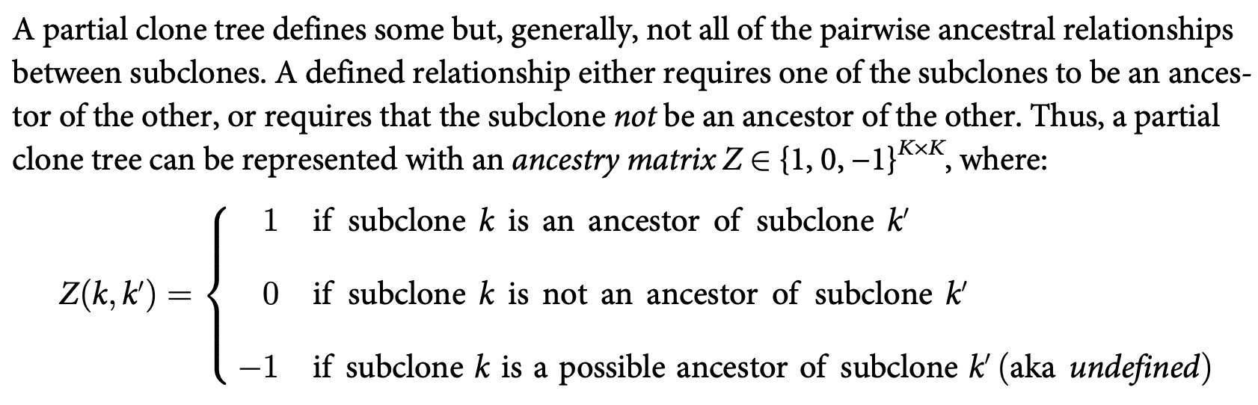
What is a Partial Clone Tree?

Slide 4
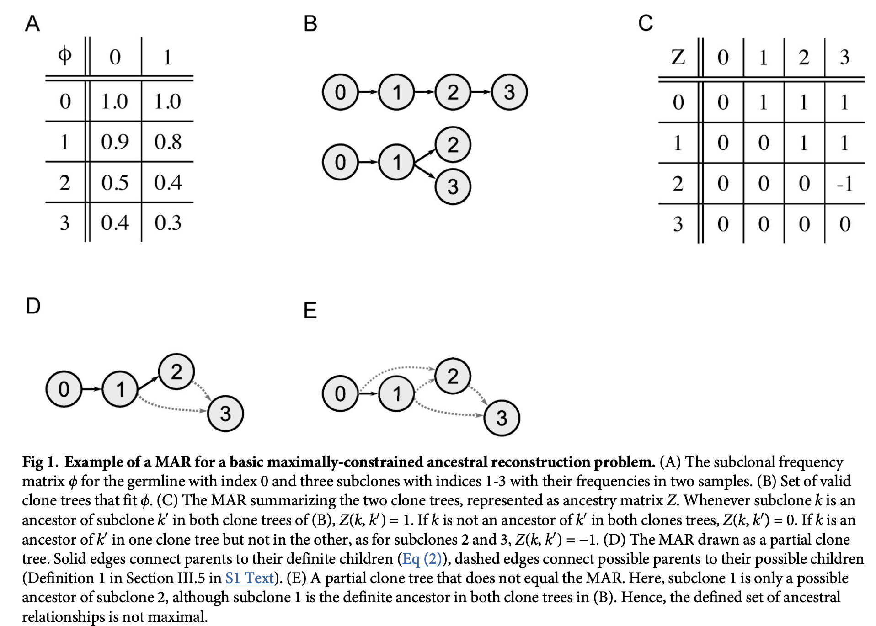

Slide 5
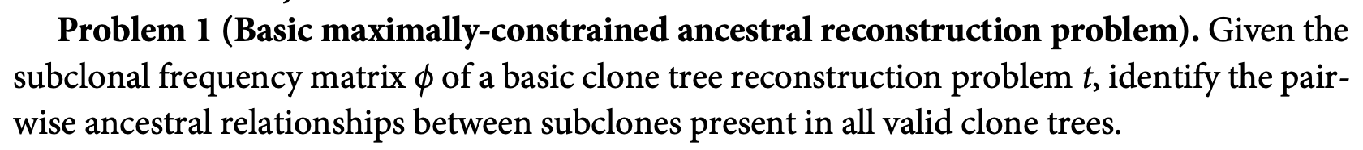
Problem Statement
Only consider subclonal SNVs and clonal CNAs for now
Solid edges are ‘AND’ clause and dashed edges are ‘OR’ clause

Slide 6
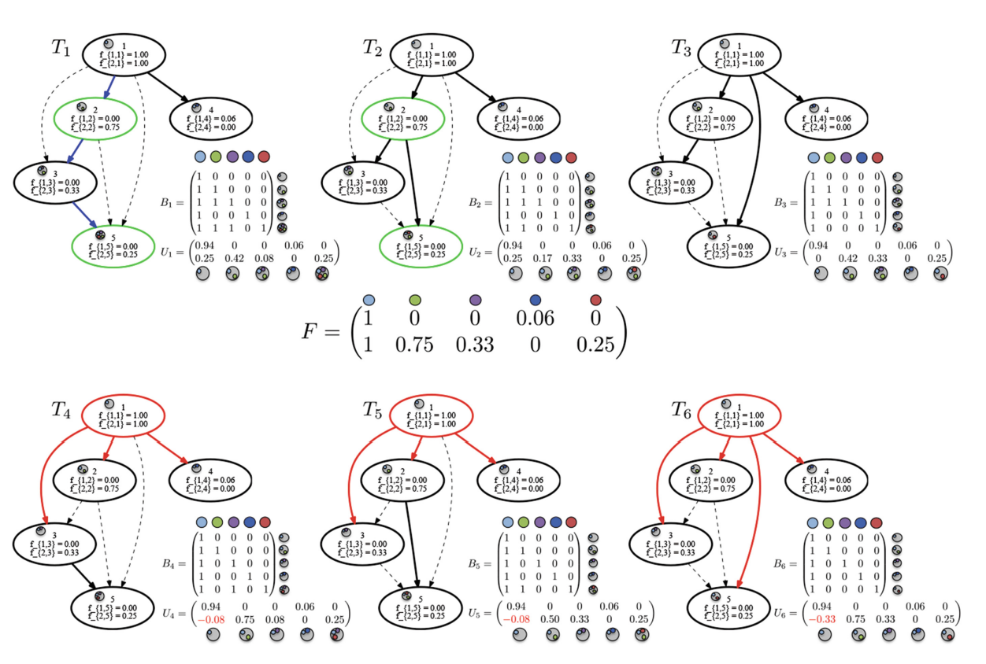
Connection to Ancestry Graph
What can we say about in-degree of partial and complete edges in the partial clone tree?
How are they different?
How would the maximal partial clone tree in this example look like?
Why should MAR be a DAG?

Slide 7
How to build a MAR?
In this example it just so happens that all arborescence
of the MAR are valid solutions. But this is not always
the case (I think)
1
2
4
3
5
maximal set of all ancestral relationships
shared by the solution set of clone tree

Slide 8
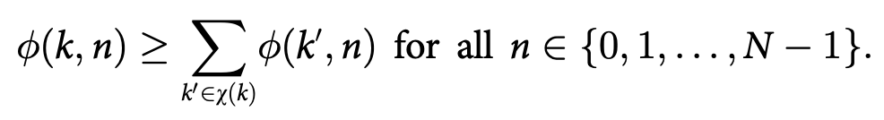
Validity constraints for a partial clone tree
A partial clone tree that satisfies these constraints is called a valid partial clone tree
Germline Constraint
  Normal is the root!
Partial Tree Constraint
  Transitivity: given that subclones k=1,K-1 are sorted by subclonal frequency
Generalized Sum Constraint
  Sum condition

Slide 9
Approximating the MAR
MAR is a partial clone tree that is defined by the maximal set of all of the ancestral relationships shared by the solution set of clone tree
SubMARine approximates MAR by constructed a subMAR
Properties of subMAR:
  subMAR is a partial clone tree
  It is unique
  The defined ancestral relationships are a subset of those in the MAR
  All valid clone trees are completion of the subMAR (follows from definition of MAR)
  But all completions of subMAR are not valid clone trees!

Slide 10
Recap
Definitions
  Partial clone tree
  Ancestry graph
  Valid partial clone tree
  MAR
  subMAR
  Completion of a partial clone tree

Slide 11
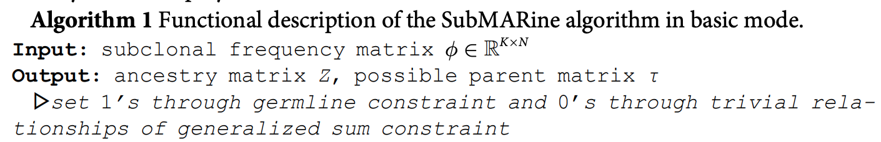
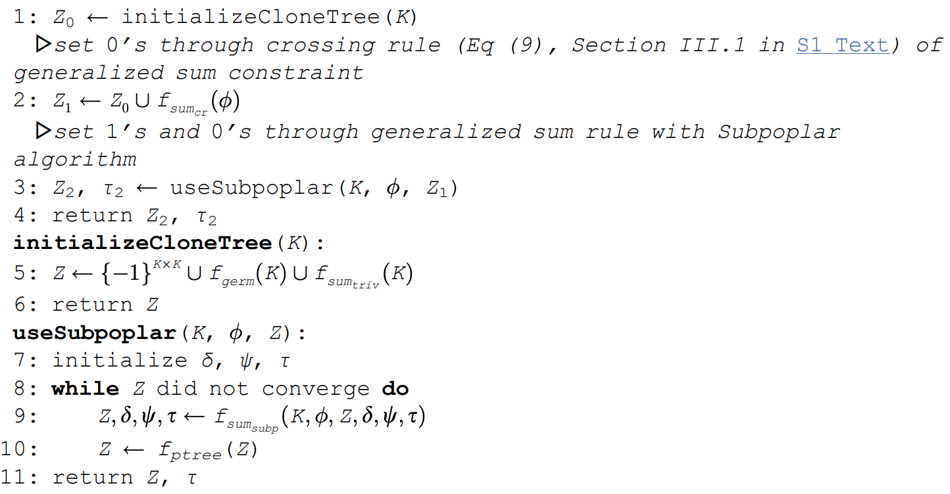
Germline Constraint
Partial Tree Constraint
Sum Constraint
Subpoplar
Initial matrix has all -1 entries
Each iteration converts -1s
to 0s and 1s
Crossover Rule

Slide 12
Subpoplar Function
Z(k, k’) = 0 if the following condition is violated when k’ was a child of k and has no other (possible) descendants that are possible parents of k’
k
k’
k’’

Slide 13
Subpoplar Function
Z(k, k’) = 1 if the following condition is not violated when k’ was a child of k and k’ has no other possible parent
k
k’
k’’

Slide 14
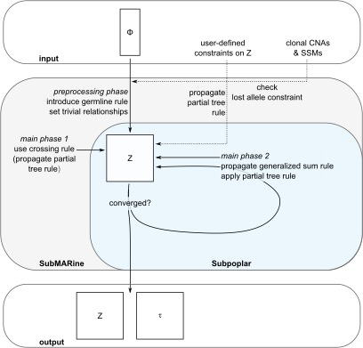
Overview of the subMARine algorithm

Slide 15
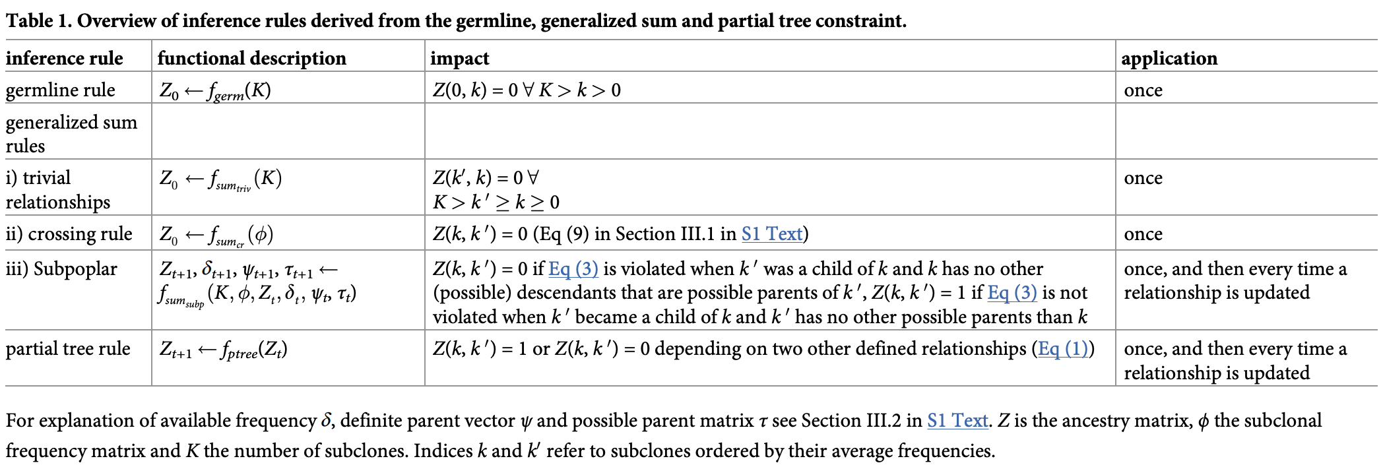
Steps of the submarine algorithm

Slide 16
Extending subMARine to subclonal CNAs
Until now we talked about subclonal SNVs in terms of binary presence/absence and all clone trees were equivalent
This setting is fine when we are dealing with only clonal CNAs
However, subclonal CNAs change the VAF of SNVs resulting in different observations
The extension includes subclonal CNAs as well as provides equivalent clone trees that generate the same set of VAFs for the subclonal SNVs

Slide 17
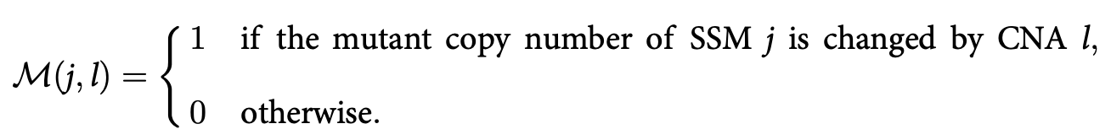
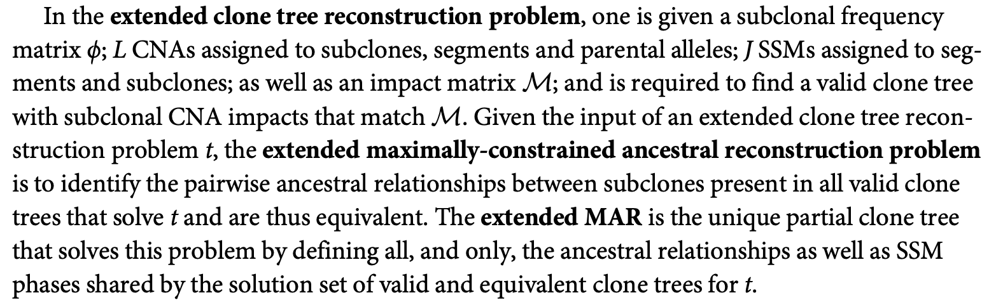
Extending subMARine to subclonal CNAs

Slide 18
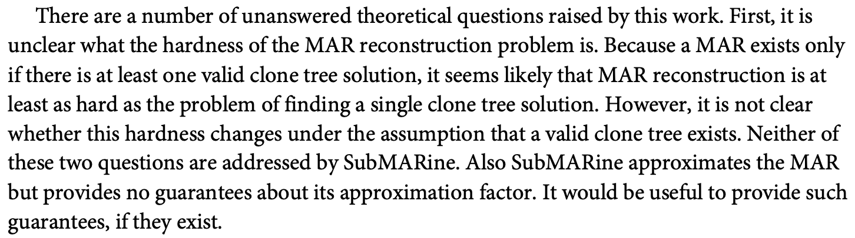
Theoretical questions
Hardness?
Approximation factor?

Slide 19
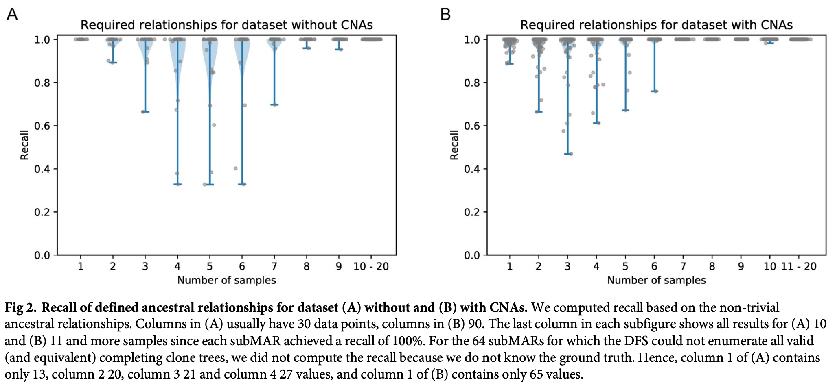
Recall on clean simulated data
Notes:
On average, increasing the number of samples or decreasing the number of subclones decreases uncertainty in a clone tree

Slide 20
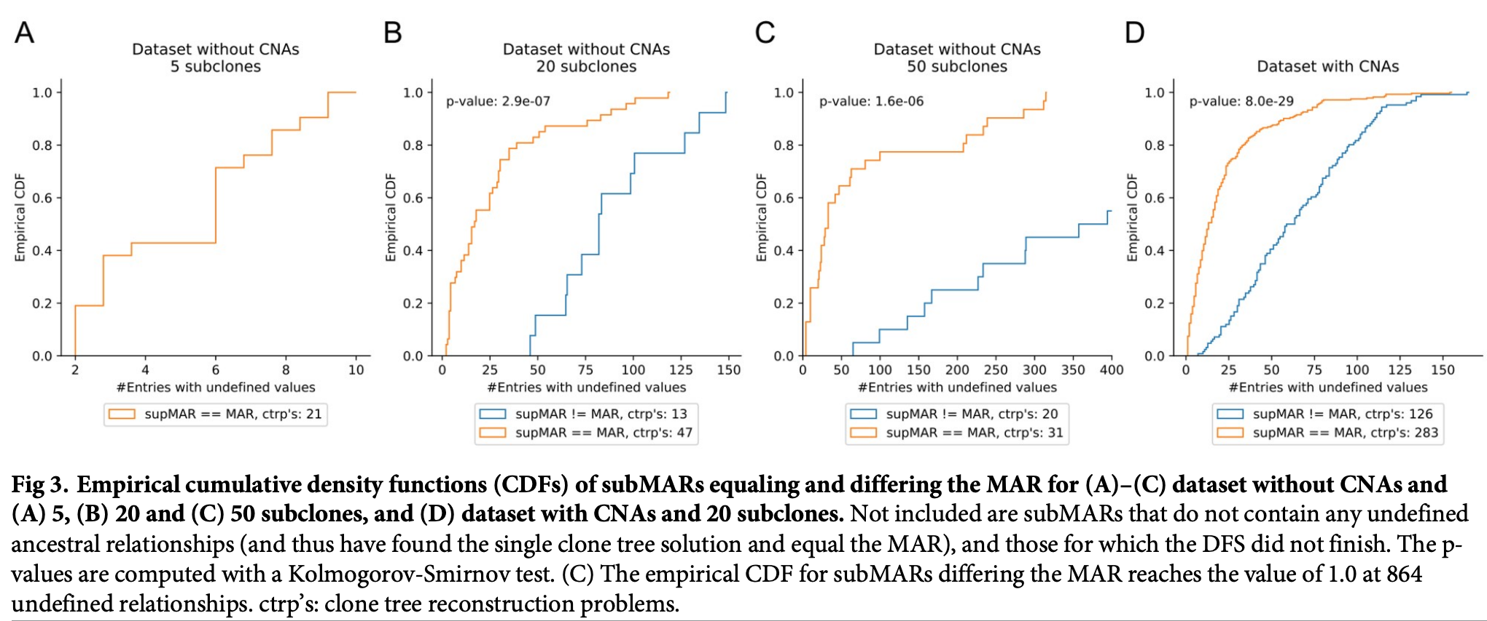

Slide 21
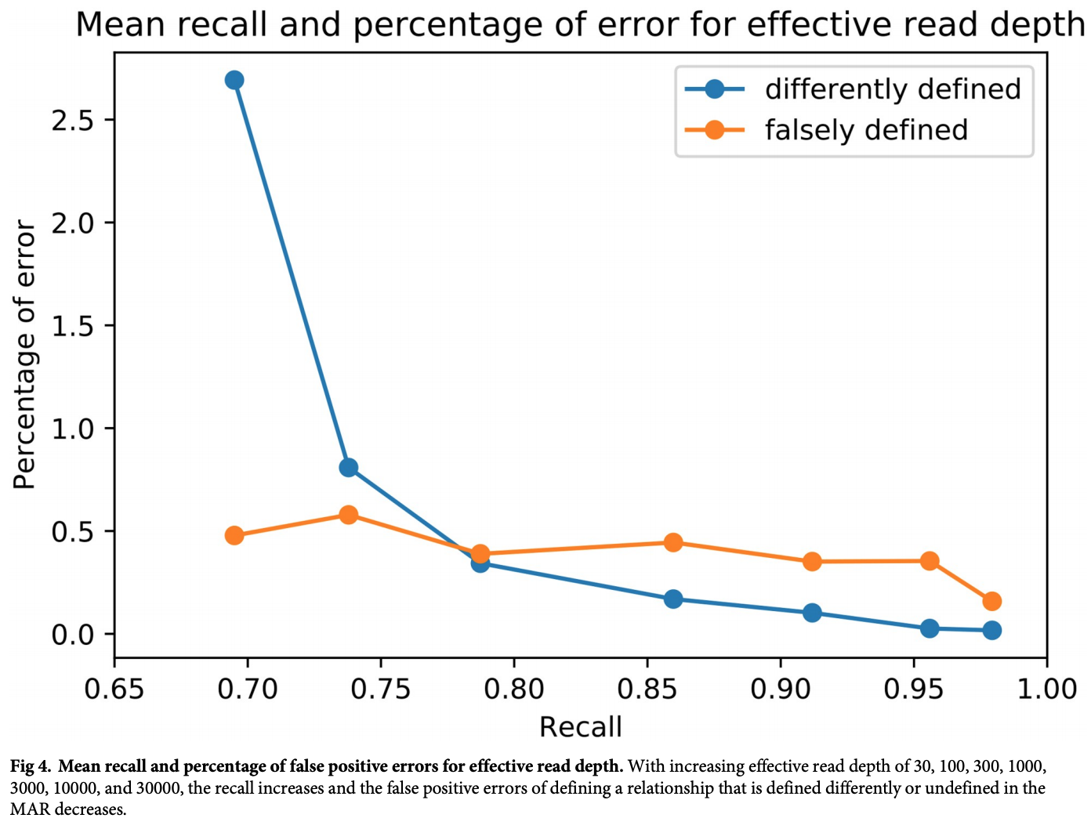
Recall in noisy simulated data
precision-recall curve
Actual error is the sum of these two errors
Falsely defined is when the corresponding ancestor-descendant relationship in the noise-free MAR is undefined
Differently defined is when the ancestor-descendant relationship is defined differently

Slide 22
Results on real data

