Slide 1
Tumor Phylogeny Reconstruction with both single-cell and bulk sequencing data
PhISCS modification
Chengze Shen

Slide 2
Brief Introduction
Intra-tumor heterogeneity (ITH) casts profound impacts on cancer treatment effects, therefore it is crucial to understand tumor evolutionary history for designing effective treatments.
There exist some methods studying ITH via single-cell sequencing (SCS) data (e.g., SCITE) or via both SCS and bulk sequencing data (e.g., B-SCITE, ddClone).
PhISCS studies ITH with both SCS and bulk sequencing data, accounts for infinite site assumption (ISA), and builds a tumor mutation phylogeny as one of the outputs.
Notes:
PhISCS bulk sequencing data is optional; it can build the tumor mutation phylogeny with only SCS data.

Slide 3
Overview
PhISCS-I (the ILP version of PhISCS)
Incorporating SCS data with ISA violation
Addition of bulk sequencing data
Potential improvements on PhISCS
ISA penalty
Few SCS data points
Ambiguous SCS data points

Slide 4
Overview
PhISCS-I (the ILP version of PhISCS)
Incorporating SCS data with ISA violation
Addition of bulk sequencing data
Potential improvements on PhISCS
ISA penalty
Few SCS data points
Ambiguous SCS data points

Slide 5
Incorporating SCS data with ISA violation
Input (SCS data)
 | Mut 1 | Mut 2 | Mut 3 | Mut 4
Cell 1 | 0 | 0 | 1 | 1
Cell 2 | 0 | 1 | 1 | 0
Cell 3 | 0 | ? | 0 | 1
Cell 4 | ? | ? | 1 | 1
 | Mut 1 | Mut 2 | Mut 3 | Mut 4
Cell 1 | 0 | 0 | 1 | 1
Cell 2 | 0 | 1 | 1 | 1
Cell 3 | 0 | 0 | 0 | 1
Cell 4 | 1 | 0 | 1 | 1
Bit assignment
&
Bit flipping
Ternary matrix I
This “corrected” matrix provides perfect phylogeny (PP)
I(i,j) = 0 means the absence of mutation j in single cell i;
I(i,j) = 1 means the presence;
I(i,j) = ? means the status is unknown (missing entries).
* Green box here marks an ISA violation
Notes:
Perfect phylogeny indicates that the three-gametes rule holds (indicated by the purple box)
Bit assignment: the assignment of missing entries in the input matrix I
Bit flipping: flipping 1 to 0 or 0 to 1. It is due to the assumption that some entries are false positives or false negatives.

Slide 6
Incorporating SCS data with ISA violation
Let matrix Y be the true status matrix for the SCS data → Y(i,j) is the true status of mutation j in cell i.
Assume we have as the FN rate, and as the FP rate for the SCS data. Then we have
We can further combine the terms for I(i,j) and obtain

Slide 7
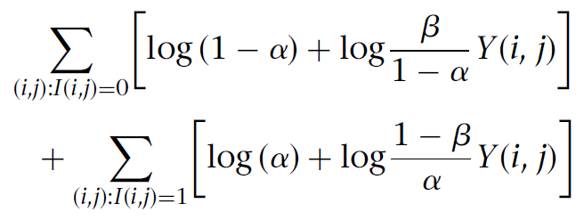
Incorporating SCS data with ISA violation
The objective is to maximize the conditional probability P(I | Y), assuming the missing entries are non-informative
Plug in the expressions from last slide, we want to maximize the following

Slide 8
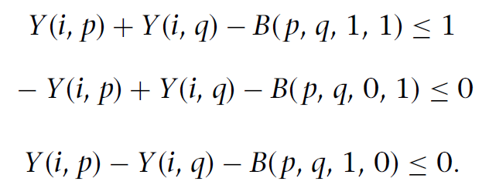
Incorporating SCS data with ISA violation
The authors add the following constraints to maintain the property of a newly introduced matrix B
B(p,q,a,b) = 1 indicates there exists a single cell r, such that its mutation p and q are a and b, correspondingly.
And the following constraint to enforce the three-gametes rule
Notes:
The matrix B keeps track of any pair of mutation (p,q) and whether there exists a row (a single cell) such that (p,q) has mutation (a,b) accordingly.

Slide 9
Incorporating SCS data with ISA violation
If we consider ISA violation, we introduce another variable K to keep track of the mutations we eliminate (loss of heterogeneity).
Therefore, we can modify our three-gamete-rule constraint as
… and the objective function to consider ISA violation

Slide 10
Overview
PhISCS-I (the ILP version of PhISCS)
Incorporating SCS data with ISA violation
Addition of bulk sequencing data
Potential improvements on PhISCS
ISA penalty
Few SCS data points
Ambiguous SCS data points

Slide 11
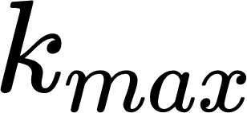
Potential improvement - ISA penalty
In PhISCS, since the objective function includes whether we eliminate a mutation q using K(q), naively we can set all K(q)=1 so the objective is maximized.
PhISCS prevents this from happening by having a user-defined upper bound for number of eliminations, as .
Instead, we could incur a penalty term based on mutation q, so that we do not need to explicitly set how many mutations we want to eliminate.
I tried the most naive case
where is a constant.

Slide 12
Potential improvement - ISA penalty
Test case
0
0
0,1
0,3
4
3
0,1,2
0,3,5
6
5
Lost 1
0,2,4
0,1,2,4
Lost 2
0,4,6
7 mutations, and two sets of ISA violations. 12 single cells generated from the left figure (all nodes are covered).

Slide 13
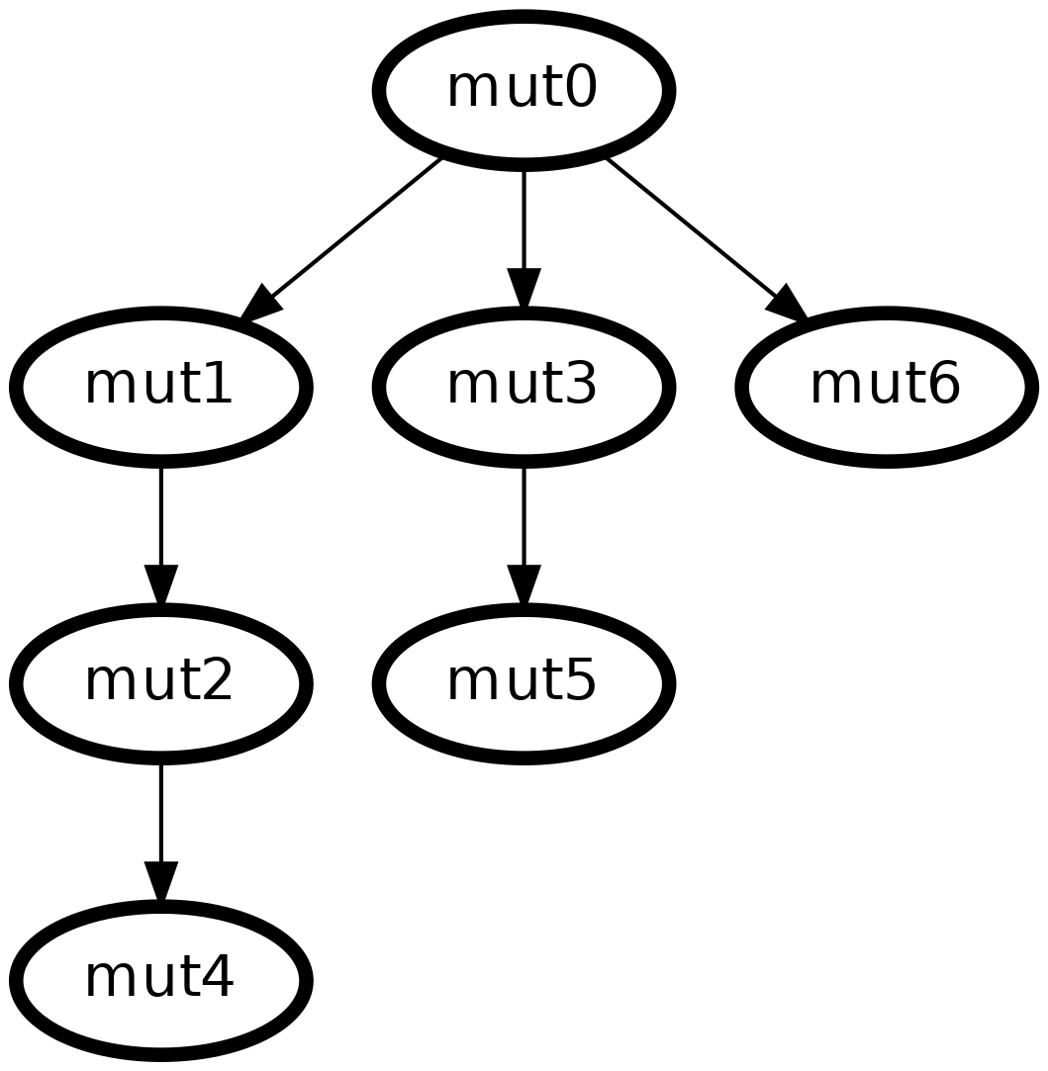
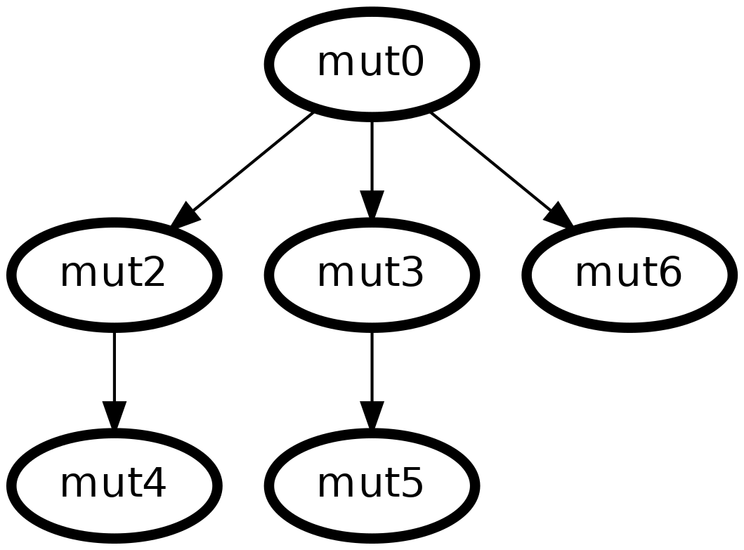
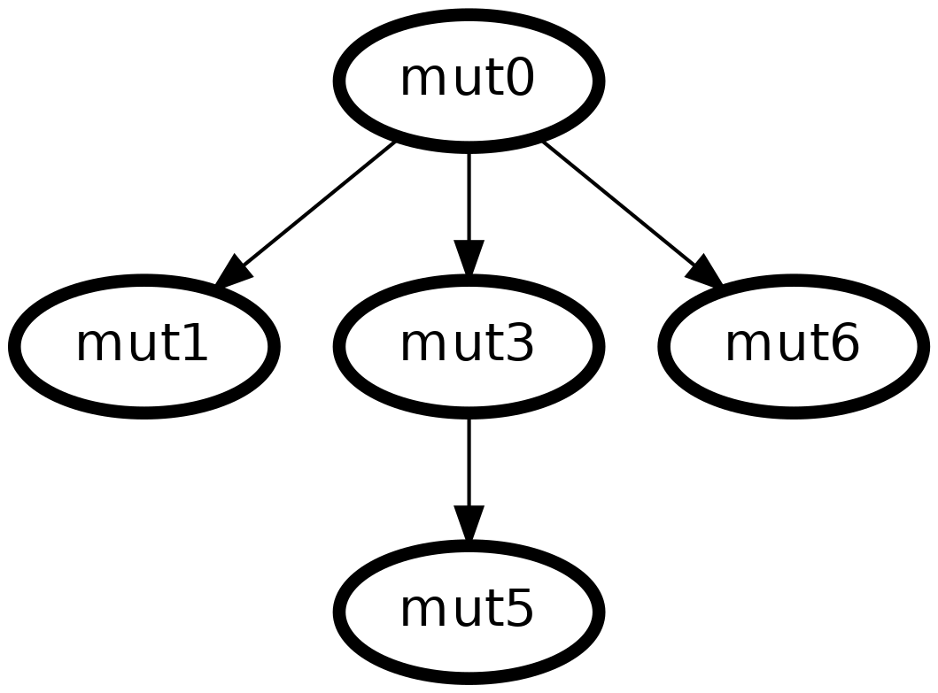
Potential improvement - ISA penalty
PhISCS, setting numbers of mutation eliminations
kmax=0
kmax=1
Eliminated mut1
kmax=2
Eliminated mut2, mut4

Slide 14
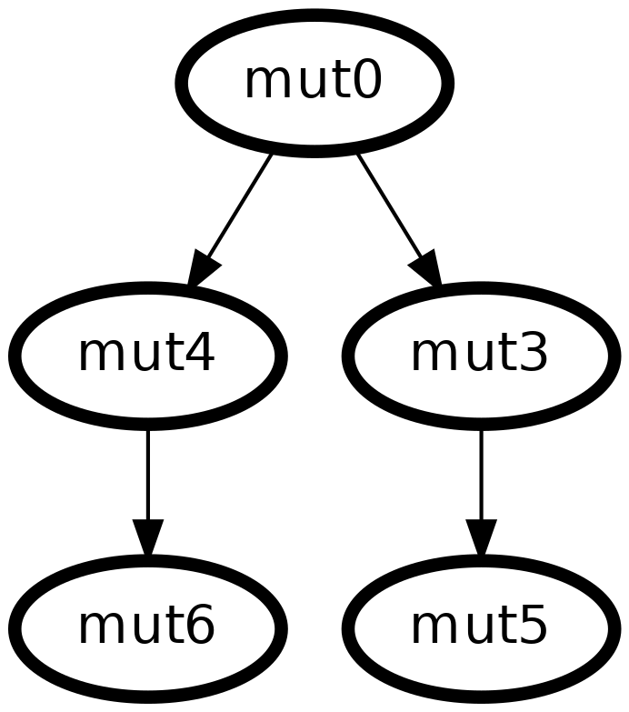
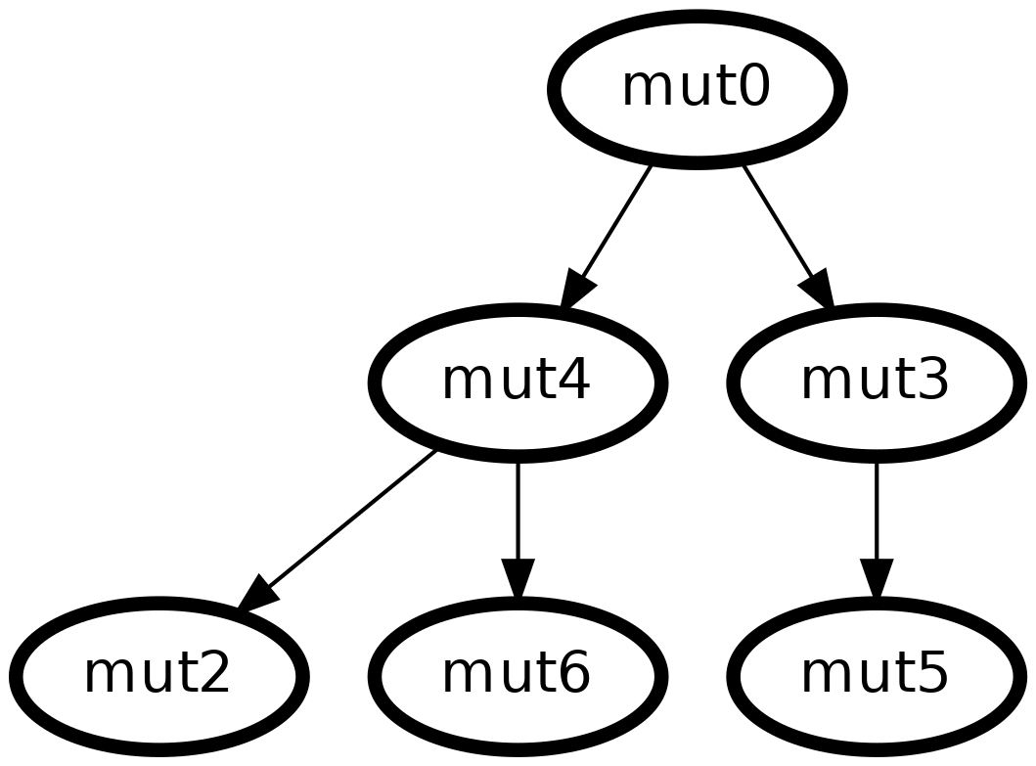
Potential improvement - ISA penalty
Modified PhISCS, = 1
Also tried = 15
And = 50
Very intuitive: higher the penalty term, fewer eliminations incurred. A simple gamma suffices to find the correct tree in this testing case. The gamma should be chosen such that it is related to the FN/FP rates.

Slide 15
Potential improvement - ISA penalty
More testing cases are run on sim1a studied in PhyDOSE [2]. A total of 10 replicates are run, and each replicate contains 100 subsampled cells with 7 mutations.
Currently calculating average RF errors for the estimated mutation evolutionary tree.

Slide 16
Potential improvement - ISA penalty
Further thing to try to penalize ISA violation would involve using a more complex penalty term that takes other information into account:
Mutation prevalence
Mutation uncertainty
Notes:
(how many single cells have the mutation)
(how many single cells are missing the entries)

Slide 17
Overview
PhISCS-I (the ILP version of PhISCS)
Incorporating SCS data with ISA violation
Addition of bulk sequencing data
Potential improvements on PhISCS
ISA penalty
Few SCS data points
Ambiguous SCS data points

Slide 18
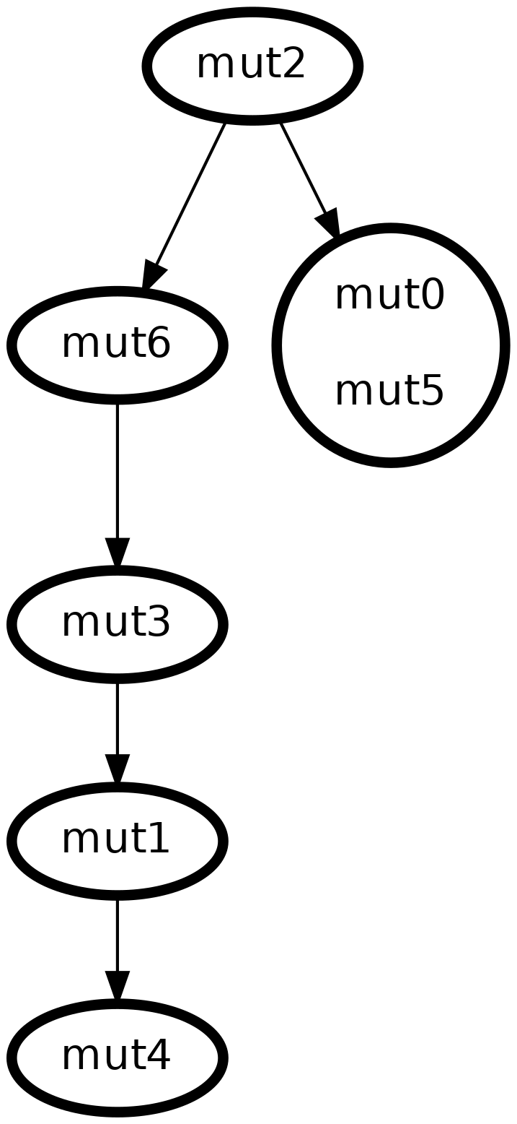
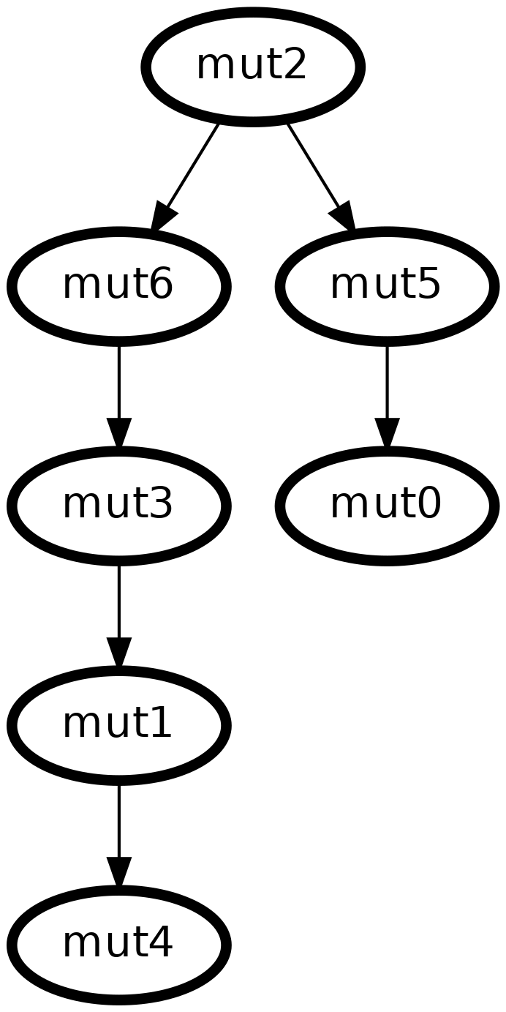
Few SCS data points
When SCS data points are few, how/how much is the output tree impacted?
* Test case, no error, no missing entries
2
6
5
3
0
1
4
20 single cells
100 single cells

Slide 19
Few SCS data points
It really depends on the single-cell sampling process and how we can utilize the (optional) bulk sequencing data to fill in the missing information.
Not done yet :(

Slide 20
Overview
PhISCS-I (the ILP version of PhISCS)
Incorporating SCS data with ISA violation
Addition of bulk sequencing data
Potential improvements on PhISCS
ISA penalty
Few SCS data points
Ambiguous SCS data points

Slide 21
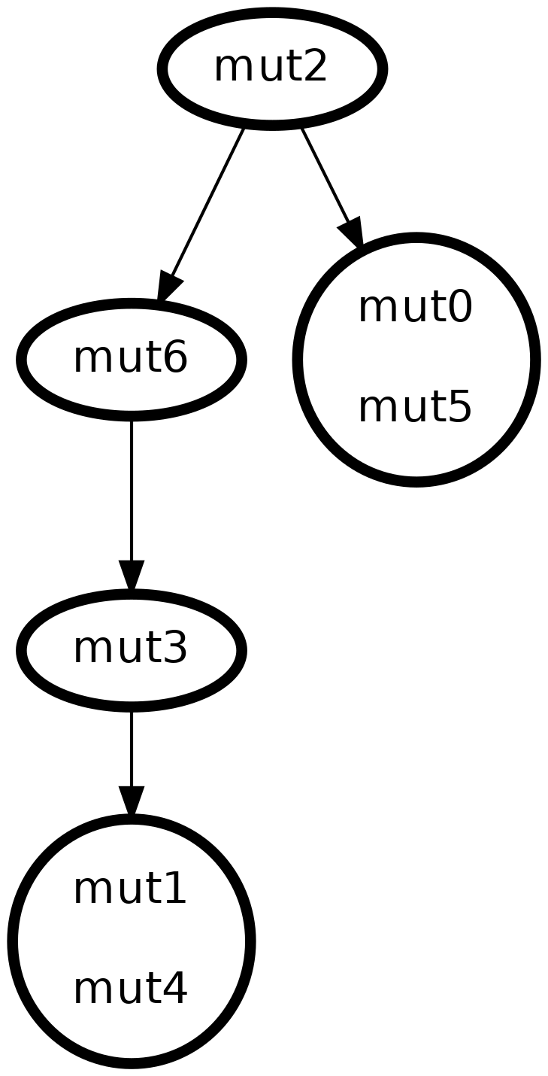
Ambiguous SCS data points
When SCS data points contain many missing entries, how/how much is the output tree impacted?
* Test case, 100 single cells, no error
2
6
5
3
0
1
4
No missing entries
50% missing entries

Slide 22
Coming up
Benchmark results on datasets with errors.
Calculate RF error rate for the predicted phylogeny tree versus the true evolutionary tree.
Finish improvement #2 and #3.

Slide 23
References
Malikic S, Mehrabadi FR, Ciccolella S, Rahman MK, Ricketts C, Haghshenas E, Seidman D, Hach F, Hajirasouliha I, Sahinalp SC. PhISCS: a combinatorial approach for subperfect tumor phylogeny reconstruction via integrative use of single-cell and bulk sequencing data. Genome Res. 2019 Nov;29(11):1860-1877. doi: 10.1101/gr.234435.118. Epub 2019 Oct 18. PMID: 31628256; PMCID: PMC6836735.
Weber LL, Aguse N, Chia N, El-Kebir M (2020) PhyDOSE: Design of follow-up single-cell sequencing experiments of tumors. PLoS Comput Biol 16(10): e1008240. https://doi.org/10.1371/journal.pcbi.1008240
Notes:
Thanks Leah for providing me with the datasets (used in PhyDOSE)

