Slide 1

B-SCITE:
Integrative inference of subclonal tumour evolution from single-cell and bulk sequencing data
Presenter: Chengze Shen

Slide 2

Motivations
Cancer rapidly introduces mutations, leading to complex tumor-cell populations and distinct clones.
Such complexity could lead to different responses to cancer therapies, and could be the cause for treatment failure.
Thus, it is critical to understand the underlying evolution history of the cancer for effective and targeted cancer treatment.

Slide 3
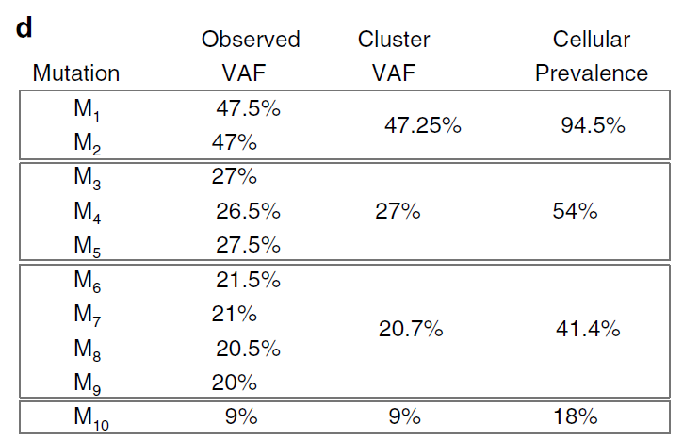
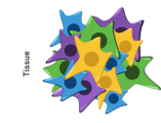
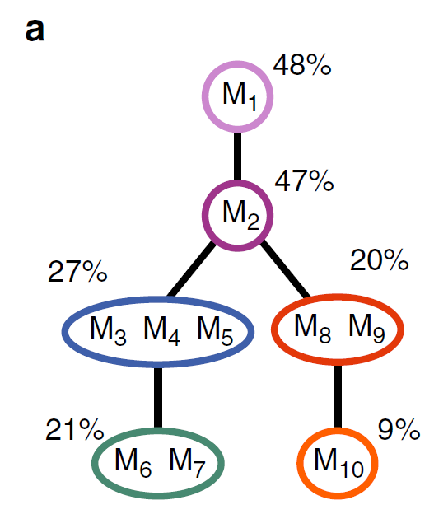
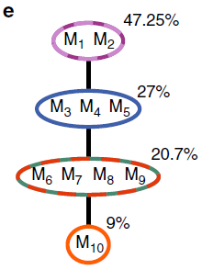
Current Approach - Bulk Sequencing
Figure credit: Sheila-10x genomics
Variant allele frequencies (VAFs)
Sample & Bulk sequencing
True clonal tree
Clonal tree
Pros: Very accessible and provide indirect measurement of subclonal mutation composition.
Cons: statistically underdetermined, may lead to incorrect phylogenies.
Notes:
A solution: sample multiple samples from the same tumor -> improve robustness and reduce the effect of error -> but is not always predictable.

Slide 4
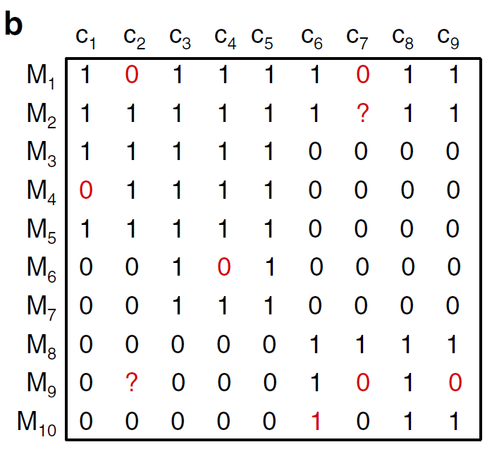
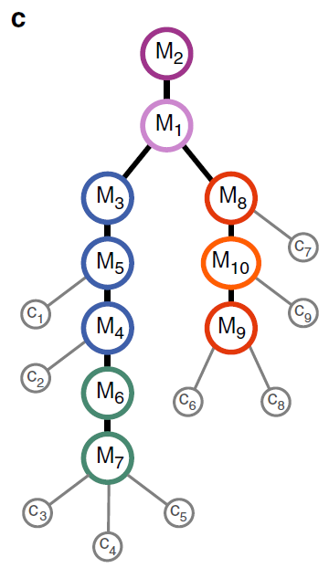
Alternative Approach - Single-Cell Sequencing (SCS)
Figure credit: Sheila-10x genomics
Sequence & Profile
Mutation tree
Pros: Direct inference of phylogeny given sufficient data.
Cons: High noise -> false positive (FP) signals; early allelic dropout -> false negative (FN) signals.
Notes:
A solution: sample multiple samples from the same tumor -> improve robustness and reduce the effect of error -> but is not always predictable.

Slide 5
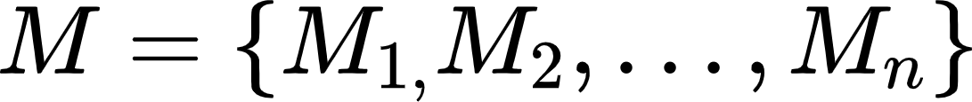
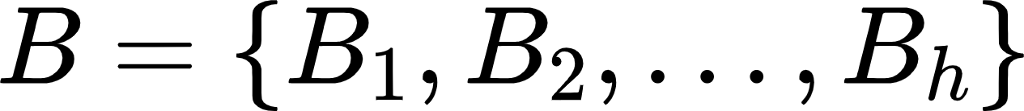


What does B-SCITE want to solve?
B-SCITE wants to incorporate bulk sequencing and SCS data to improve the inference of tumor phylogenies, using a probabilistic approach.
Inputs: 1) heterozygous somatic mutations
2) bulk sequencing data
3) SCS data
Outputs: Mutation tree that maximizes some scoring scheme (defined later).
Procedure: search through possible trees using MCMC (will discuss later).
Assumptions: Infinite site assumption.

Slide 6

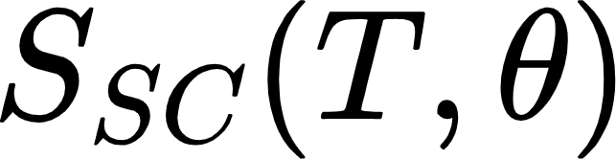



Tree scoring
Candidate mutation tree T is scored based on both bulk sequencing data and SCS data.
> Let tree score from the bulk sequencing on T be:
> Let tree score from the SCS on T be:
( is the sequencing error profile)
> We have the joint score as:
Then, we want to find the tree T and error profile such that
Notes:
In the paper, it seems that the authors fix theta, and only search through solution spaces by changing T

Slide 7

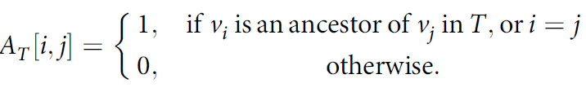
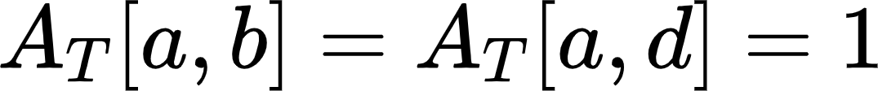
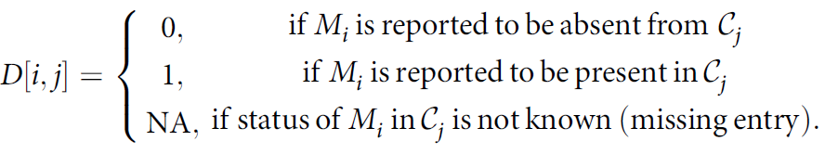
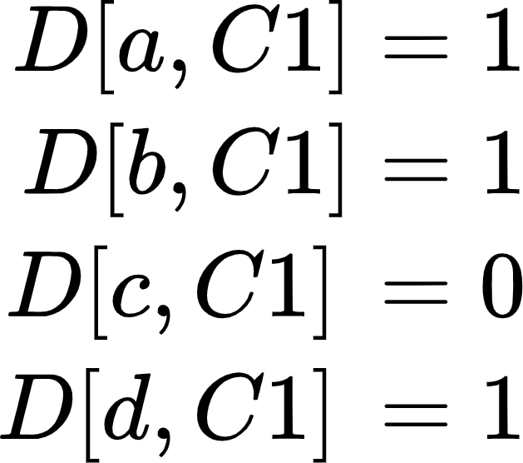
Some definitions
>Mutation a first occurs here
(1) represents ancestry state between two nodes in T.
Example tree
a
>Mutation a still presents
>Mutation b first occurs here
b
c
e.g.
C1
(2) There are s nodes in the tree T, and we can assume we will solve for a mutation tree, where s=n (the number of mutations/SNVs).
d
(3) Mutation matrix D representing presence of each mutation in each single-cell data.
e.g. single-cell data C1 has mutations a, b and d, so:
Notes:
A_T is a s by s matrix
D is a n by m matrix

Slide 8







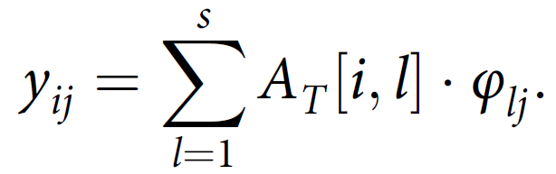


Tree scoring - Bulk sequencing
Assume we are given a mutation tree T with s=n (same number of mutation to nodes in the tree).
Nodes (Cell types) in T
...
Sum to 1
...
Fraction of population of cell type i in the bulk data
We can then infer the fraction of cells with mutation in bulk sample as:
1
2
3
4
5
e.g. M2 (i=2) in some bulk sample B

Slide 9




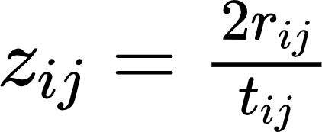
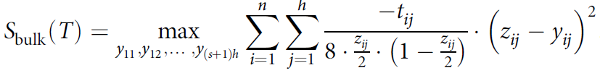
Tree scoring - Bulk sequencing cont.
Assume we sequence a bulk sample , get reads in which reads support mutation .
If the true fraction of cells in that have mutation is y, then the actual probability that a read support is y/2 (heterozygous cell).
Using this information and high coverage from the bulk sample (high number of reads t), we can model variant reads using a binomial distribution, and approximate it with a Gaussian distribution log likelihood:
z=2r/t. We can obtain the log-likelihood of the whole bulk data for all mutations by summing over all and approximate with . Finally (skipping a lot of steps) we have:
Notes:
Z is bulk-sequencing data-based fraction of cells harbouring mutation M, based on the assumption that M is from a diploid region
Solving S_bulk, there exists commercial quadratic program (QP) that can do it efficiently. Q: why can’t we take the derivative and use linear programming to solve for 0?

Slide 10
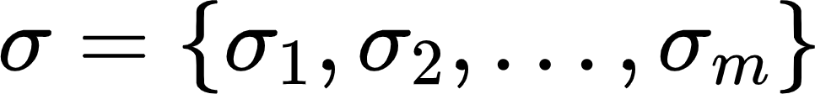
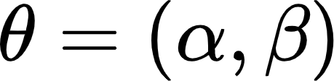



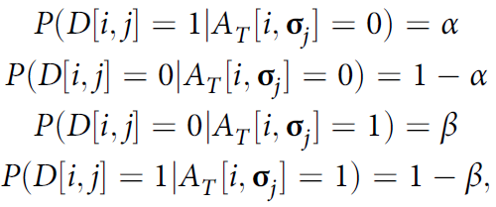
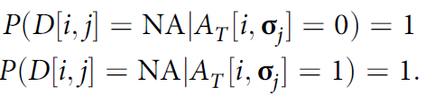
Tree scoring - SCS
Let be attachments of single cell to the tree T. For example, C1 attaches to node d (C1 contains mutation a, b, d).
a
Since SCS has errors, both FP and FN, we can model the error profile as
b
c
where denotes the FP rate and denotes the FN rate. We can then represent the observational data + tree information probability as:
C1
d
Notes:
RAxML: is a maximum likelihood method for estimating trees given a multiple sequence alignment. It is a widely used software, despite that it is slow, its results are shown to be robust.
In this case, we give RAxML both the alignments and the starting tree, so RAxML can reestimate the branch lengths.
SATe-II: is a fast and efficient divide-and-conquer method to compute a phylogeny tree, and it is particularly useful if initial alignment is not perfect.
P-distance: measures the “distance-ness” of two aligned sequences, the proportion of sites where two sequences are different.
16S.B.ALL: a biogical dataset: a large bacterial dataset from Gutell lab. It has a curated alignment based on secondary structures and is highly reliable. It also has a reliable curated tree.
M2, M3, M4: simulated nucleotide datasets with 1000 taxa each. Models evolve at different rates (insertion, deletion, substitution), and M2 has the highest rate. All 3 have medium gap length distribution
To produce the reads, sequences are used as templates, and long fragments (250bp +- 60) and short fragments (100bp +- 20) are drawn for the simulated dataset, 10 fragments per sequence.
For the biological one, each sequence generates a long or short fragment.

Slide 11


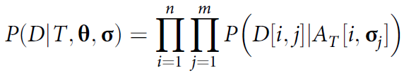

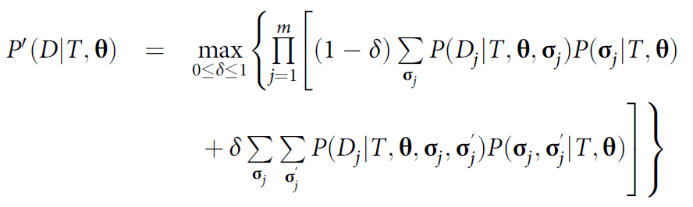

Tree scoring - SCS cont.
Thus, we can obtain the likelihood function of the SCS data given tree T, error profile and attachment as
If we only focus on the tree and error profile information, then we have:
By considering a weighted mixture of singlet and doublet (accidentally sequenced two cells together) data, we have:
And our final scoring from SCS data is the log likelihood of P’ as:
Notes:
RAxML: is a maximum likelihood method for estimating trees given a multiple sequence alignment. It is a widely used software, despite that it is slow, its results are shown to be robust.
In this case, we give RAxML both the alignments and the starting tree, so RAxML can reestimate the branch lengths.
SATe-II: is a fast and efficient divide-and-conquer method to compute a phylogeny tree, and it is particularly useful if initial alignment is not perfect.
P-distance: measures the “distance-ness” of two aligned sequences, the proportion of sites where two sequences are different.
16S.B.ALL: a biogical dataset: a large bacterial dataset from Gutell lab. It has a curated alignment based on secondary structures and is highly reliable. It also has a reliable curated tree.
M2, M3, M4: simulated nucleotide datasets with 1000 taxa each. Models evolve at different rates (insertion, deletion, substitution), and M2 has the highest rate. All 3 have medium gap length distribution
To produce the reads, sequences are used as templates, and long fragments (250bp +- 60) and short fragments (100bp +- 20) are drawn for the simulated dataset, 10 fragments per sequence.
For the biological one, each sequence generates a long or short fragment.

Slide 12
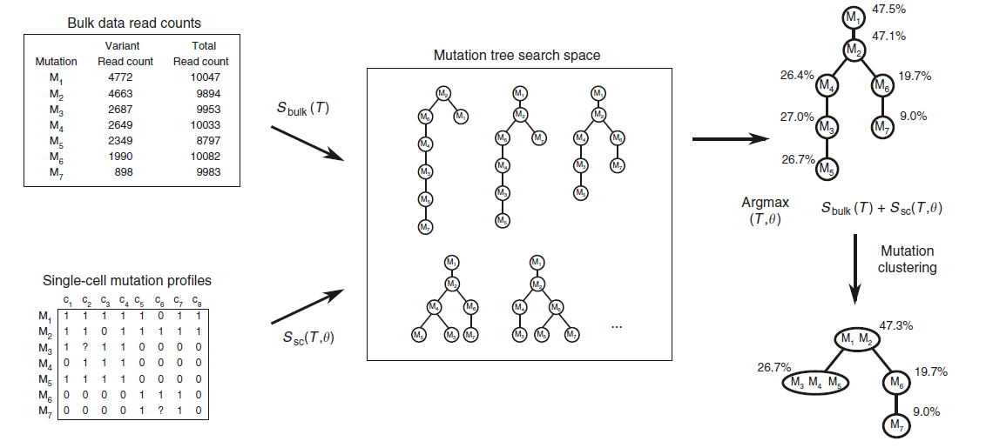



Find best tree T
The authors use Markov Chain Monte-Carlo (MCMC) approach to search the solution space to find a optimal tree T.
  Each step, we can either change the tree T or change the error profile
  For a tree-move, a new tree T’ is obtained by either:
    pruning/reattaching a subtree
    Swapping two subtrees
    Exchanging labels of two nodes
  For an error-move, a new is obtained.
  We move to the new state with probability of 1 (if the proposal probability of new state is higher), or with probability of the ratio of the two proposal probabilities.
* the author did not really explain the proposal probabilities q and how to calculate them.
Notes:
Also, they did not really mention anything about convergence of the algorithm, how likely the MCMC can find the optimal tree (given a simulated dataset).

Slide 13
Evaluation
Simulated dataset and real dataset (will only focus on the simulated one)
Measurements
  clustering accuracy (V-measure)
    Compared to ddClone, OncoNEM
  Phylogenetic inference accuracy (co-clustering)
    Compared to OncoNEM, SCITE
Notes:
V-measure -> a conditional entropy-based external cluster evaluation measure

Slide 14
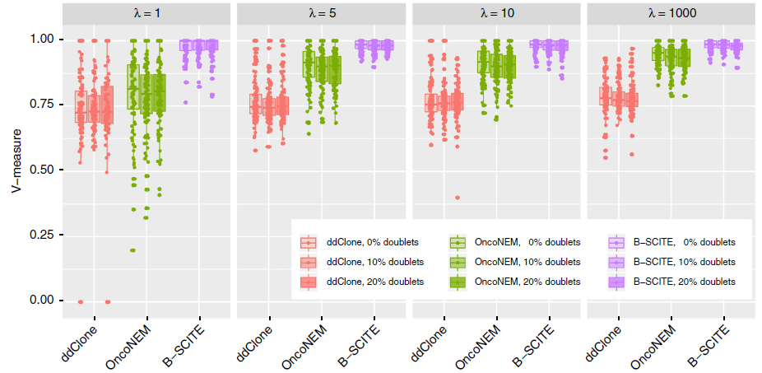
Results – simulated data - clustering accuracy
Notes:
Lambda is the sampling bias for SCS (large lambda is small bias -> draw cells from the clone with probability closer to their corresponding prevalence in the clone)
100 simulations, 10 nodes(clones), 50 mutations. 25 genotypes SCS, FP rate 10^-5, FN 0.2, NA rate 0.05, doublet rate 0/0.1/0.2. Coverage of bulk 10000

Slide 15
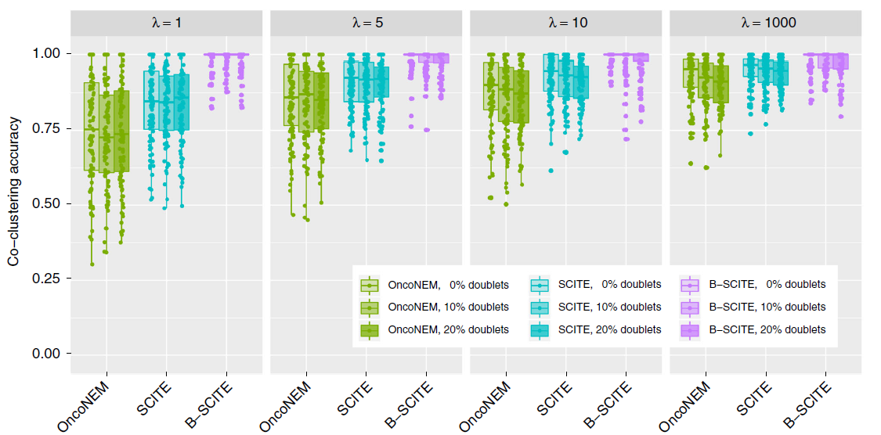
Results – simulated data - phylogeny inference
Notes:
Lambda is the sampling bias for SCS (large lambda is small bias -> draw cells from the clone with probability closer to their corresponding prevalence in the clone)
100 simulations, 10 nodes(clones), 50 mutations. 25 genotypes SCS, FP rate 10^-5, FN 0.2, NA rate 0.05, doublet rate 0/0.1/0.2. Coverage of bulk 10000

Slide 16
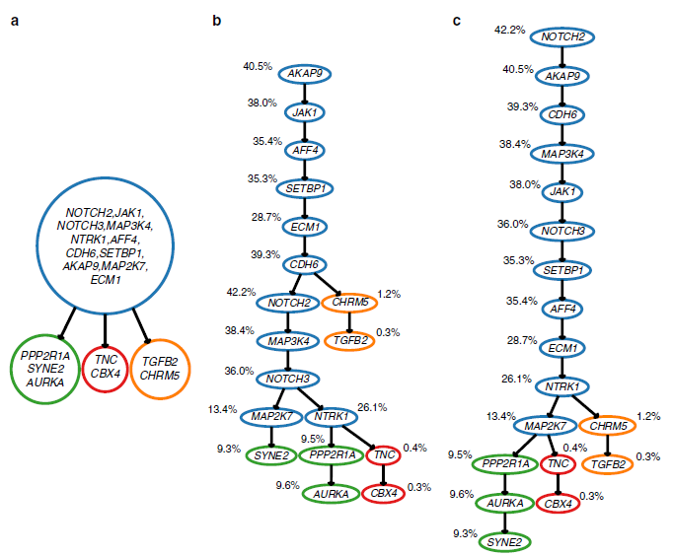
Results – real data - triple-negative breast cancer
The branching events from B-SCITE tree (c) is highly similar to the tree from the original study (a) than what the SCITE tree (b).

Slide 17
Takeaway
B-SCITE is a new method for tumor phylogenetic inference that utilizes both bulk sequencing and single-cell sequencing data.
It is shown to be more accurate and precise on both subclone inference and phylogenetic inference than methods compared to.
Real data tree inference shows high concordance to expert-generated trees.
It is robust to presences of copy number aberration and violation of the infinite sites assumption (Supplementary data).

Slide 18
Weakness
No runtime/memory usage comparison.
Few methods compared to.
No convergence analysis on MCMC.
Missing definitions for some variables.
Lack of analysis on single-cell data
  If we have very few SCS available (e.g. 5 single-cell profiles vs. 25 single-cell profiles).
  If the error profile is different (only shown a fixed profile in the main paper)

Slide 19
References
Malikic, S., Jahn, K., Kuipers, J. et al. Integrative inference of subclonal tumour evolution from single-cell and bulk sequencing data. Nat Commun 10, 2750 (2019). https://doi.org/10.1038/s41467-019-10737-5
10X genomics blog. https://www.10xgenomics.com/blog/single-cell-rna-seq-an-introductory-overview-and-tools-for-getting-started

Slide 20


