Slide 1
Efficient Projection onto the Perfect Phylogeny Model
Bei Jia, Surjyendu Ray, Sam Safavi, José Bento

Slide 2
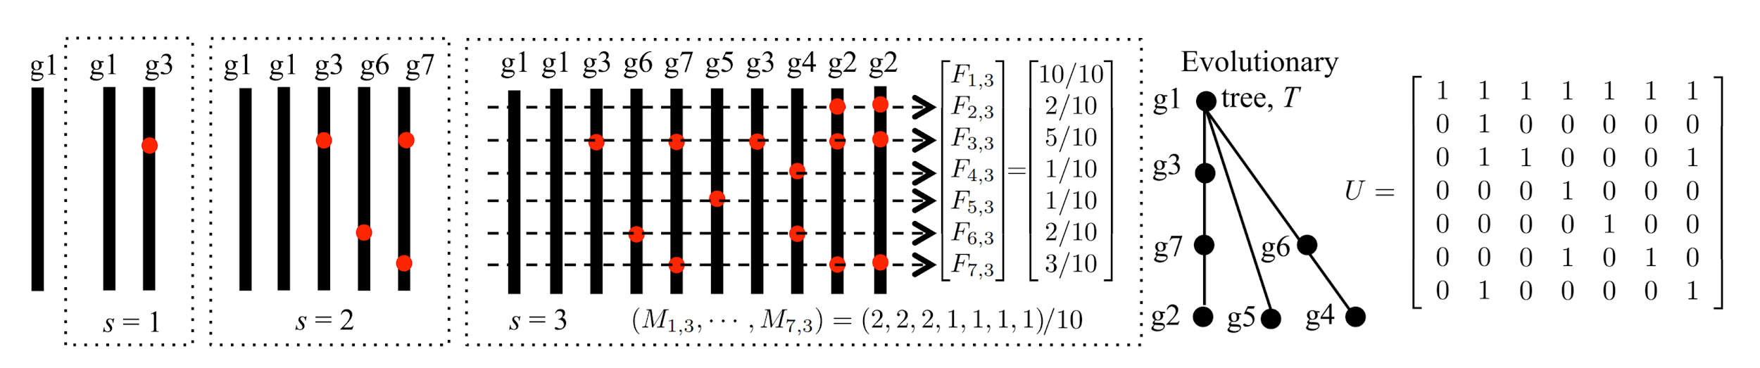
Review: Perfect Phylogeny Model
Assumption: same position in the genome only mutates once
F: frequency matrix, U: ancestry matrix, M: mixture matrix
F = UM
Problem: how do we get U and M from F?
Knowing U will give us the tree

Slide 3
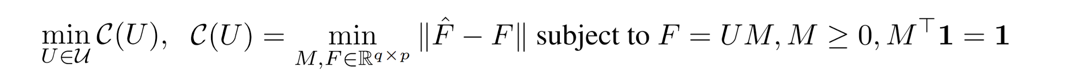
Inference Approach
We can consider the following optimization problem over F, U, M:
Basically, we want to find the U that permits the “best” F - the one closest to our observed values.

Slide 4
Contribution: General Idea
C(U) represents the “quality” of a proposed ancestry matrix U
We want to efficiently evaluate C(U)
Contribution of the paper: an algorithm to compute C(U) in O(pq^2) time
  q: length of the genome
  p: number of samples

Slide 5
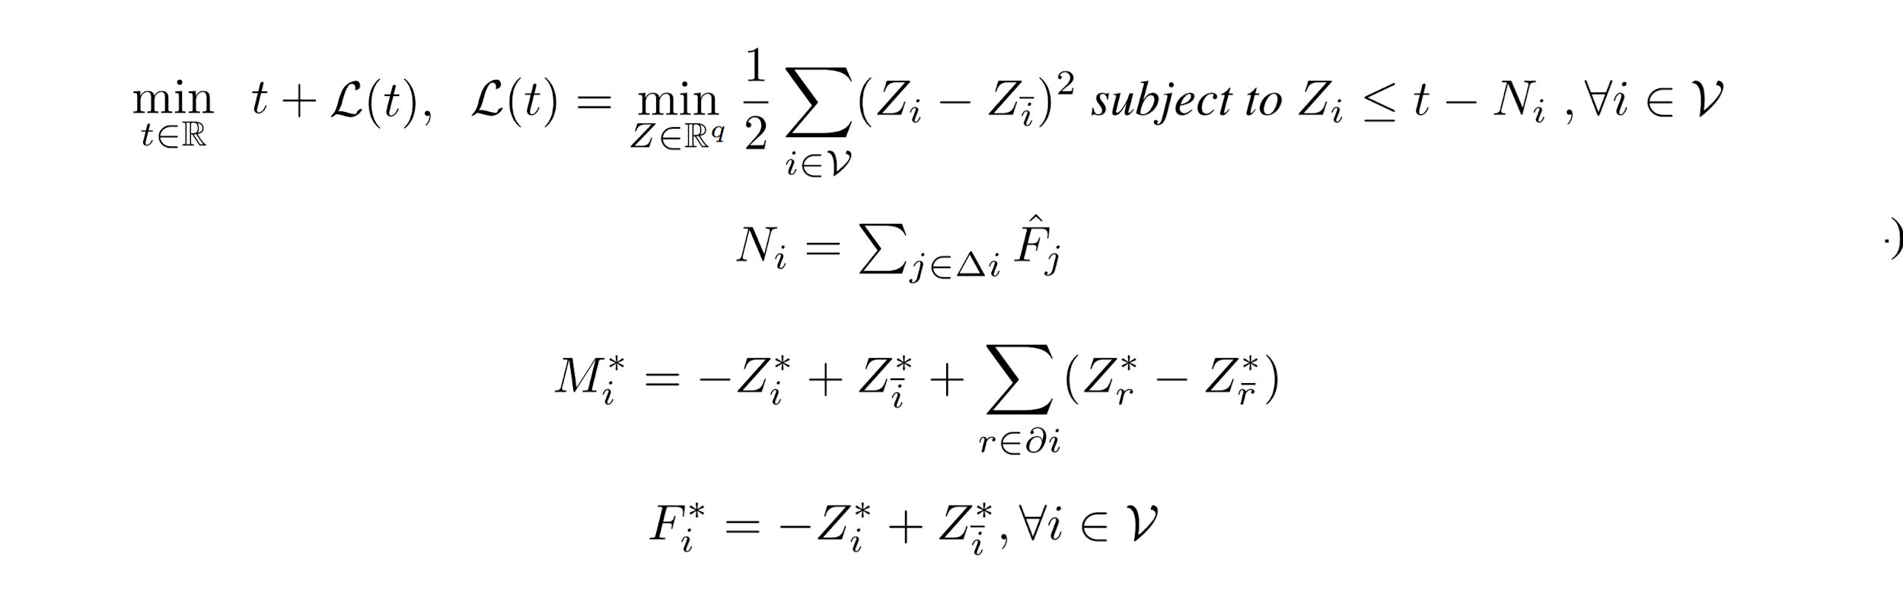
Alternate Formulation

Slide 6
The Algorithm
Basic idea: we look at Z*(t) and derivative L’(t) as t decreases
They are continuous piecewise linear between certain critical values of t
We find the unique t* where L’(t*) = -1
We can then recover Z*(t*), and then the unique minimizers M* and F*

Slide 7
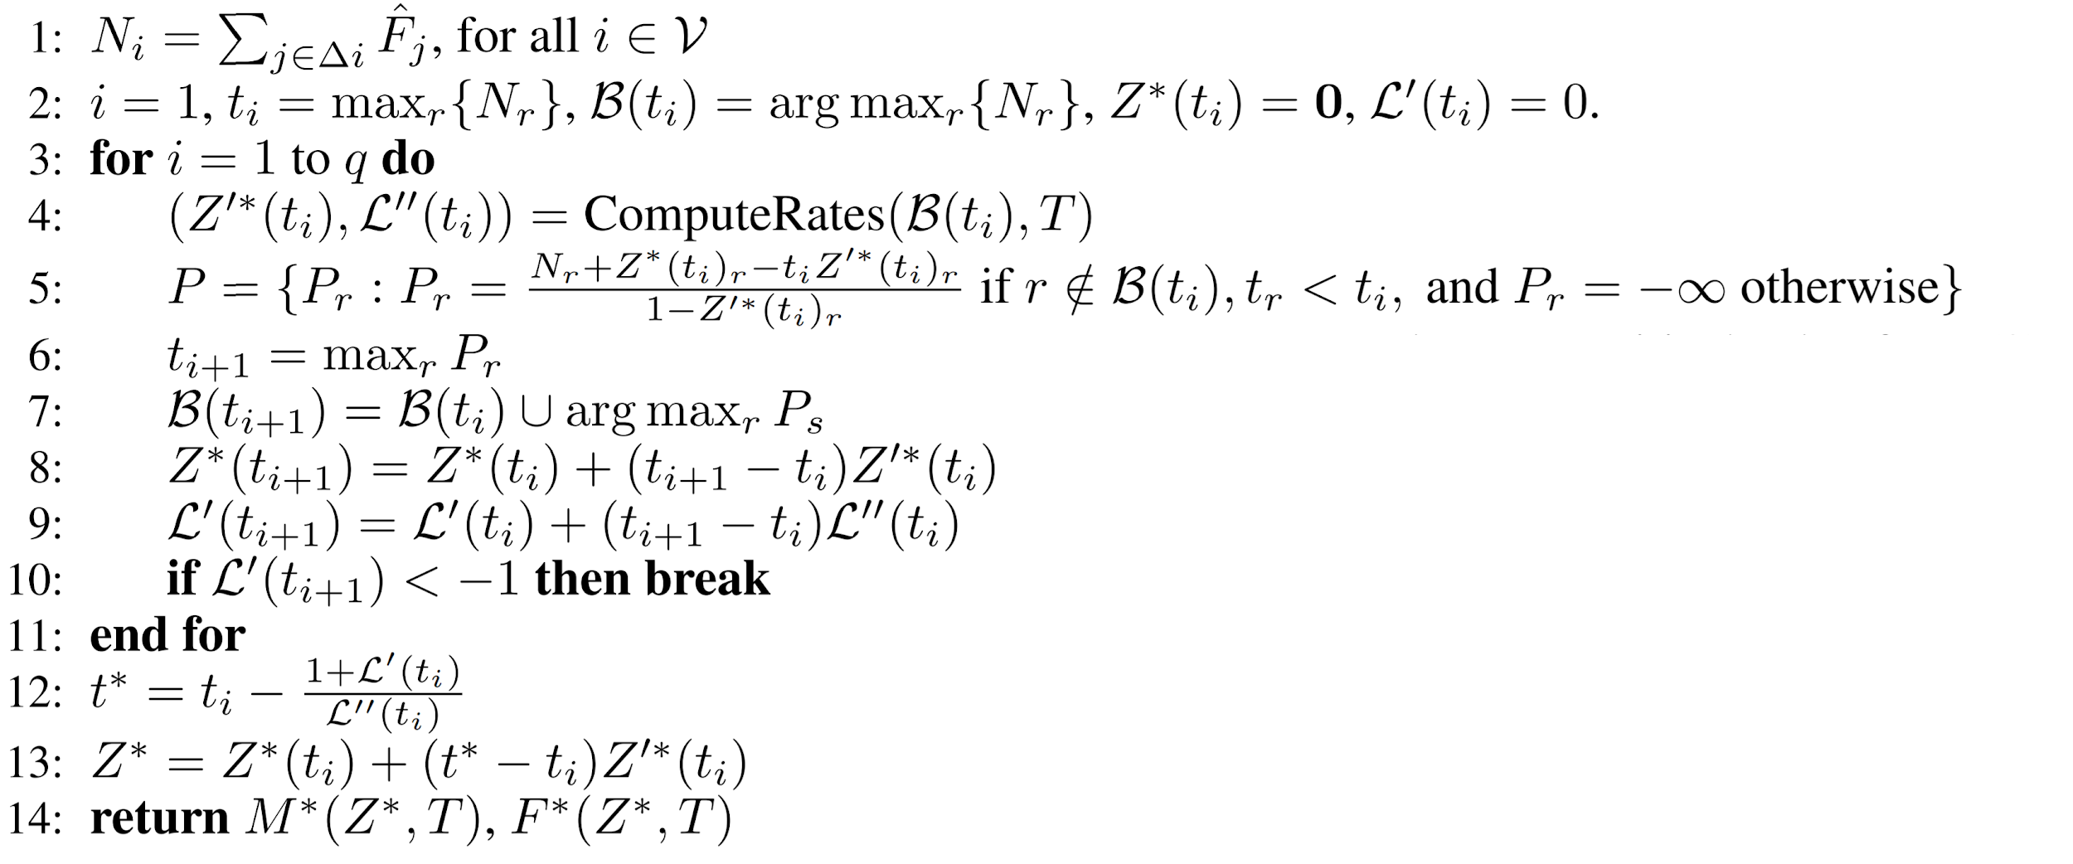
The Algorithm

Slide 8

The Algorithm
We can define the set of “fixed” variables - solution components on the boundary:
New variables become fixed at critical values of t
We can use B(t) as separation points between subtrees of our tree.

Slide 9
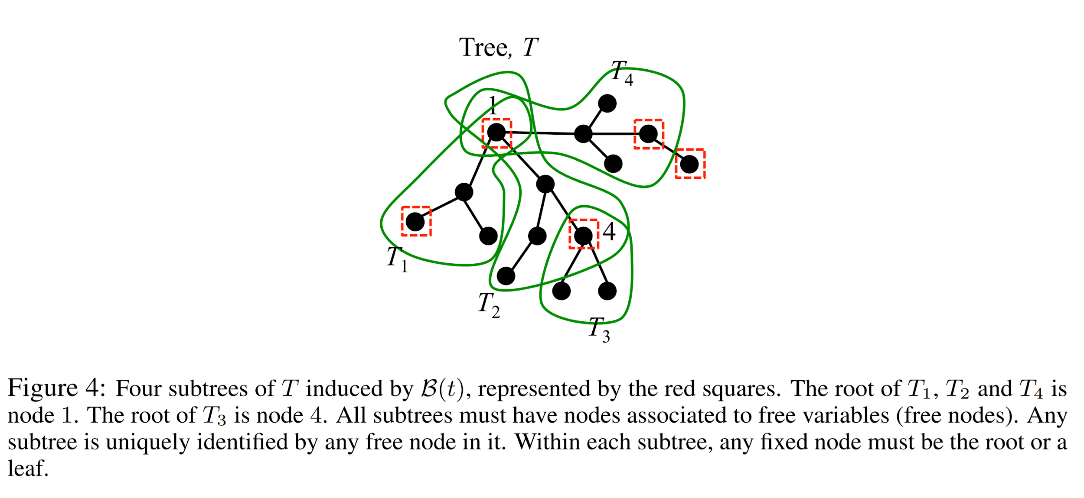
The Algorithm

Slide 10
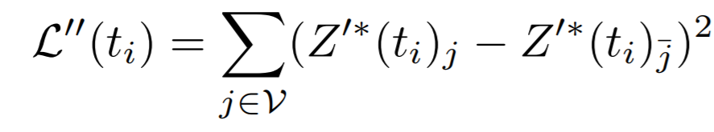
Computing the Rates
We need Z’*(ti) and L’’(ti)
L’’ is computed from Z’*:
We can use our fixed variables B(t) and their corresponding tree division to recursively solve for Z*

Slide 11
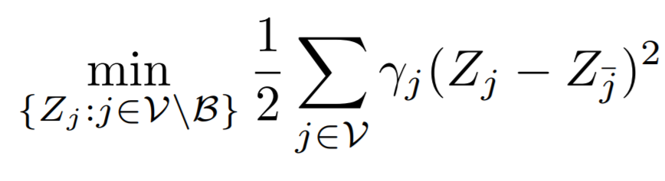
Computing the Rates
We can consider the (T, B, α, β, γ) problem:
For tree T, fixed set B, and Zj = αtj + βj, we look for
We want to solve the (T, B, 1, -N, 1) problem
Can be recursively obtained from smaller (T, B, α, β, γ) problems over subtrees
We take advantage of our subtree division and recurse from the root

Slide 12
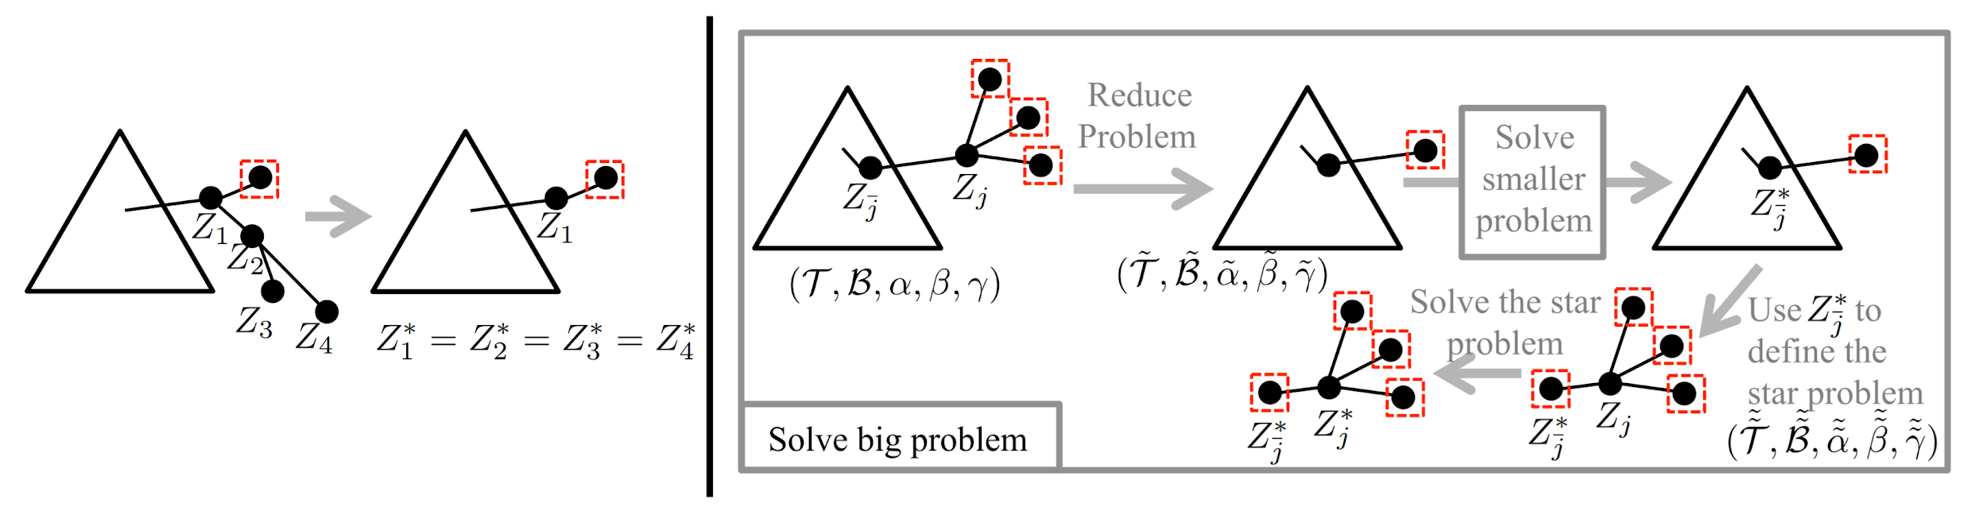
Computing the Rates

Slide 13
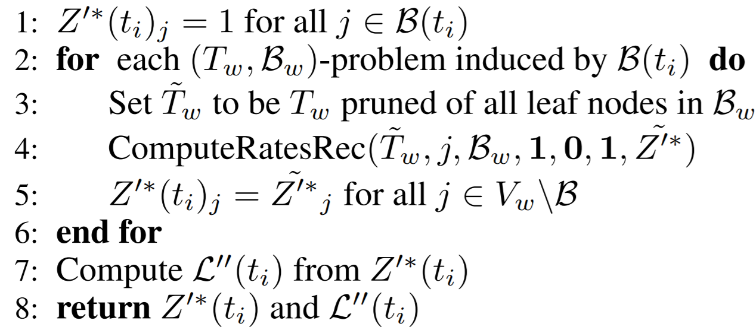
Computing the Rates

Slide 14
Results
Implemented on a NVIDIA Quad P5000 GPU
Performs a complete search over all trees
q = 10: 100 million trees in 8 minutes
q = 11: 2.5 billion trees in 2.5 hours

Slide 15
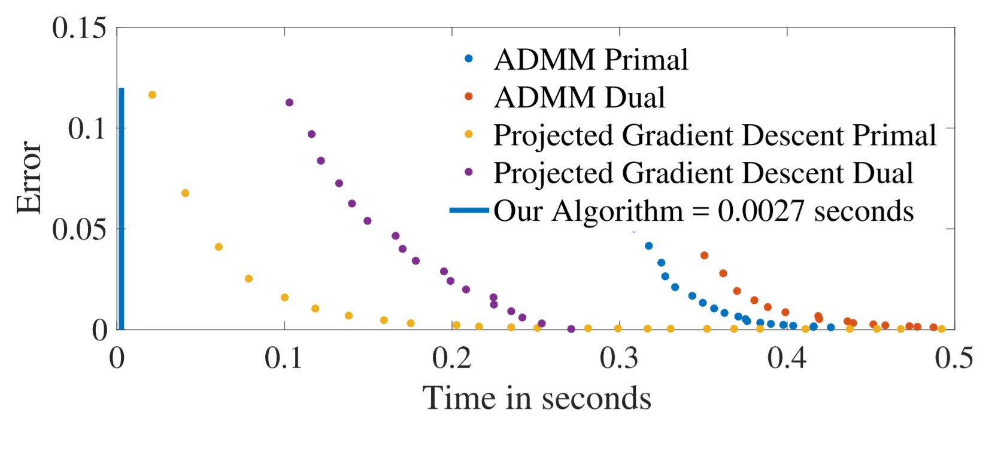
Results

Slide 16
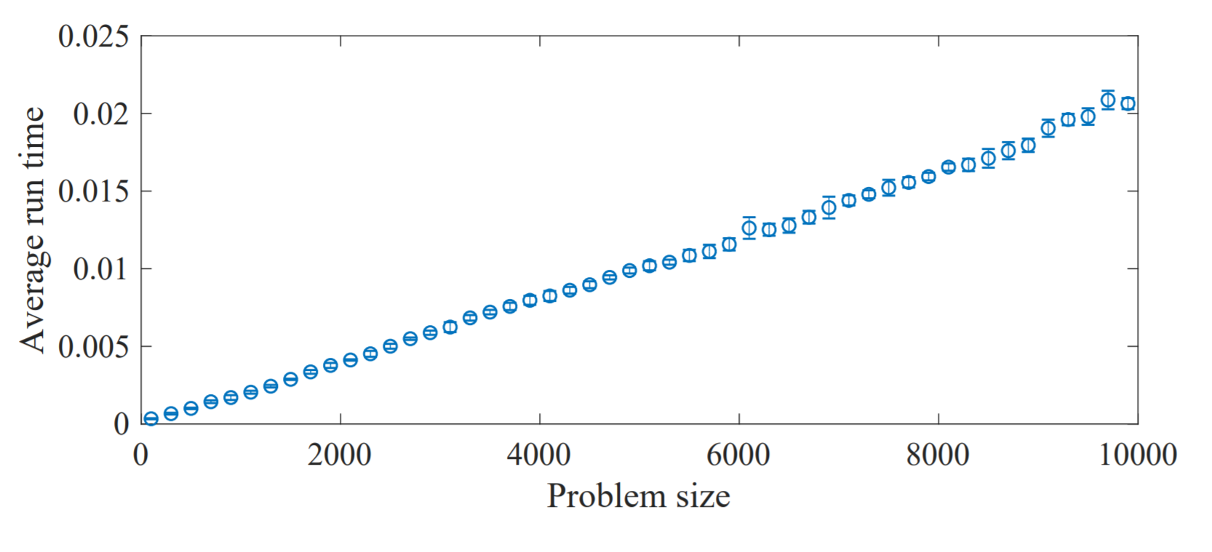
Results

