Slide 1
A neoantigen fitness model predicts tumour response to checkpoint blockade immunotherapy
Marta Łuksza, Nadeem Riaz, Vladimir Makarov, Vinod P. Balachandran, Matthew D. Hellmann, Alexander Solovyov, Naiyer A. Rizvi, Taha Merghoub, Arnold J. Levine, Timothy A. Chan, Jedd D. Wolchok & Benjamin D. Greenbaum
Presented by Nuraini Aguse

Slide 2
Content
Brief biology background
Introduction
Methods
Results
Conclusion

Slide 3
Brief biology background
Cancer cell
MHC class 1
Neoantigen (produced by certain mutations)
T-cell receptor (TCR)
T-cell
T-cells detect foreign cells and destroy them

Slide 4
Brief biology background
Cancer cell
MHC class 1
Neoantigen
T-cell receptor
T-cell
T-cells detect foreign cells and destroy them
Destroy this cell!

Slide 5
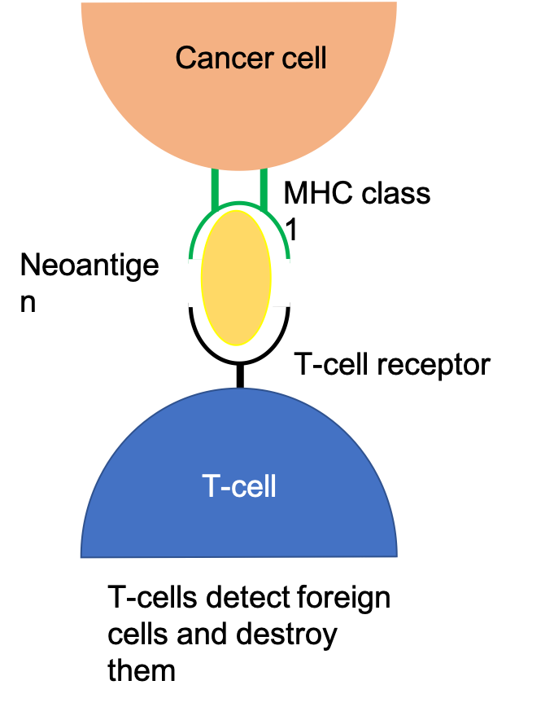
Introduction
Cancer patients who underwent immunotherapy respond differently to the treatment
Previous studies show link between number of neoantigens and immunotherapy response
But, due to heterogeneity of tumors, the neoantigen load does not provide sufficient information
Main biological question: How does the characteristicsof neoantigen predict immunotherapy response?
Approach – mathematical fitness model of tumor-immune interactions
This model predicts the evolutionary dynamics of cancer cell population after immunotherapy

Slide 6
Methods
Evolutionary dynamics of a cancer cell population in a tumor
The fitness of a cancer cell is its expected replication rate
The total population size is the sum over all clones
Evolved relative effective population size
n(τ) = N(τ) / N(0)
Initial frequency of clone α
X_{α} = N_{α}(0) / N(0)
Then, we obtain equation 1

Slide 7
Methods
Neoantigen recognition-based fitness cost for a tumor clone.
Fitness cost ⬄ recognition potential ⬄ likelihood that neoantigen is recognized by TCR
Fitness of a clone α is defined by maximum A x R of each neoantigen
Replacing F in equation 1, we get
Cancer cell
Max AxR

Slide 8
Methods
MHC amplitude (A)
Probability that neoantigen is displayed
More precise: the ratio of relative probability between mutant neoantigen and wild type
In terms of dissociation constants
After some adjustments

Slide 9
Methods
TCR recognition (R)
Probability that a neoantigen will be recognized by TCR
Align the neoantigen to epitopes that are known to be recognized by TCR
These epitopes are obtained from Immune Epitope Database and Analysis Resource (IEDB)
Probability R depends on the alignment score
Need to perform parameter training to determine a and k

Slide 10
Methods
Alignments to IEDB epitopes
TCR recognition (R)
Probability that a neoantigen will be recognized by TCR
Align the neoantigen to epitopes that are known to be recognized by TCR
These epitopes are obtained from Immune Epitope Database and Analysis Resource (IEDB)
Probability R depends on the alignment score
Need to perform parameter training to determine a and k

Slide 11
Methods
Parameter training
Select parameters that maximize the log-rank test scores of the survival analysis of patient cohorts
Patient cohort is split into high and low fitness groups
They used a cohort of 64 patients with melanoma to train parameters for another 103 patients with melanoma cohort and vice versa.
They uses the total score of both cohorts to train parameters for a cohort of 34 patients with lung cancer

Slide 12
Survival analysis score landscape as a function of model parameters

Slide 13
Methods
Model selection
Multiple other models are selected, all of them results in a loss of predictive power
Examples of models
A only
R only
Constant fitness across all neoantigens

Slide 14
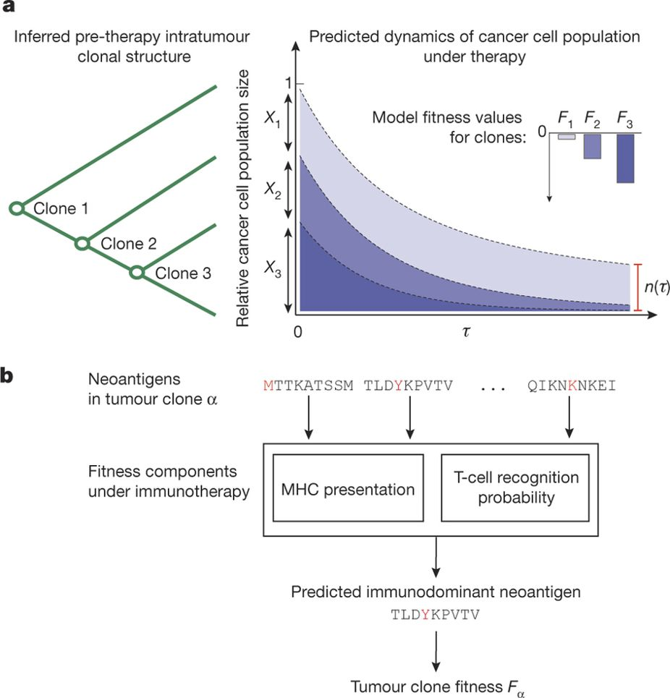
Recap
a, Clones are inferred from the genealogical tree of each tumour. We predict n(τ), the future effective size of the cancer cell population, relative to its size at the start of therapy (equation (1)) by evolving clones under the model over a fixed timescale, τ. Application of therapy can decrease the fitness of clones depending on their neoantigens. Clones with strongly negative fitness have greater loss of population size than more fit ones. b, Our model accounts for the presence of dominant neoantigens within a clone, α, by modelling presentation and recognition of inferred neoantigens, assigning fitness to a clone, F_{α}.

Slide 15
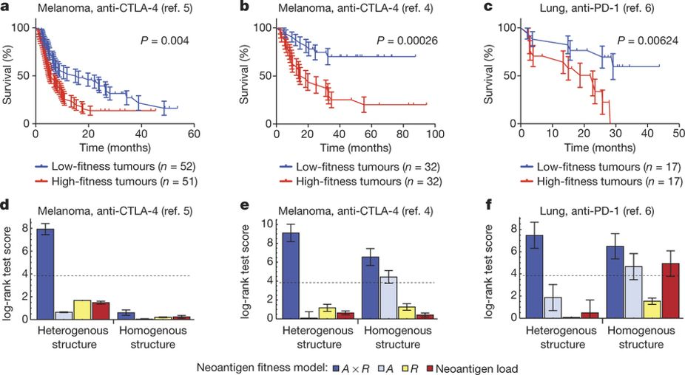
Results
Neoantigen fitness model is predictive of survival after checkpoint blockade immunotherapy

Slide 16
Results
Neoantigen fitness model is predictive of survival after checkpoint blockade immunotherapy

Slide 17
Results
Predicted evolutionary dynamics in cohorts

Slide 18
Conclusions
The model formalizes a method of determining what makes tumors immunologically different from its host
Immunological difference determines the tumor’s fitness
The model predicts the survivability of the patient based on the tumor’s fitness
The model can inform the choice of targets for tumor vaccine
The model can be improved by advances in predicting proteosomal processing and stability of neoantigen-MHC binding

