Slide 1
Patterns of somatic structural variation (SV) in human cancer genomes
By: Kelvin Sheng Pei Dong

Slide 2
Authors
Yilong Li, Nicola D. Roberts, Jeremiah A. Wala, Ofer Shapira, Steven E. Schumacher, Kiran Kumar, Ekta Khurana, Sebastian Waszak, Jan O. Korebel, James E. Haber, Marcin Imielinski, PCAWG Structural Variation Working Group, Joachim Weischenfeldt, Rameen Beroukhim, Peter J. Campbell & PCAWG Consortium

Slide 3
Overview
Background
Classification of SVs
Annotation of SV classes
Cycles of templated insertions
Local n-jumps and local-distant clusters
Genomic properties of SVs
Signatures of SV

Slide 4
Overview
Background
Classification of SVs
Annotation of SV classes
Cycles of templated insertions
Local n-jumps and local-distant clusters
Genomic properties of SVs
Signatures of SV

Slide 5
Structural variation (SV)
A key driver of cancer development
Genomic rearrangement that acts to amplify, delete, or reorder genomic segments that range in size from kilobases to whole chromosomes
Directs the tumor development through its effects on cancer genes either by
  Alternating gene copy number
  Disrupting tumor-suppressor genes
  Creating fusion genes
  Juxtaposing the coding sequence of one gene with the regulatory apparatus of another

Slide 6
Structural variant (SV)
Manifests as a ‘junction’ between two ‘breakpoints’ in the genome
  Breakpoint: The chromosomal position at which a DNA break is made
A change in copy number will generally occur across the breakpoint if only one side of the break is rescued by a SV
If both sides of a double stranded DNA break are rescued, a ‘reciprocal’ or ‘balanced’ SV will result, without substantial change in copy number

Slide 7
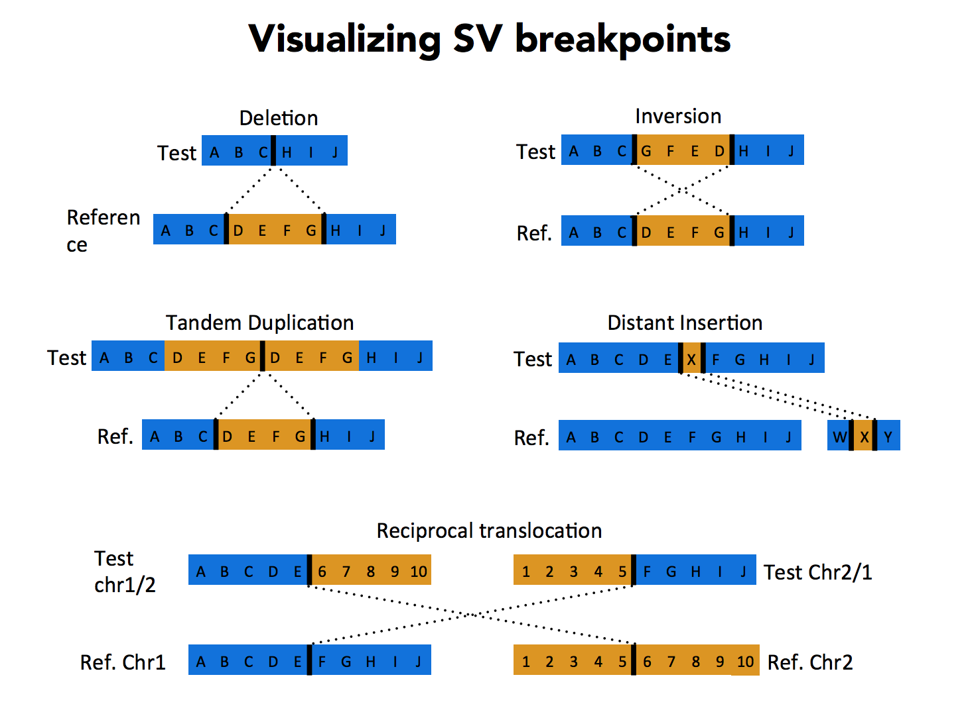
Image taken from: http://schatzlab.cshl.edu/teaching/2015/2015.AdvSeq.Structural_variants_Maria_Nattestad.pdf

Slide 8
Biological Problem: The landscape of SV in human cancer remains incompletely mapped and there are many complex structures that do not have formal description
Goal: Develop methods to group, classify and describe the patterns and signatures of SV in a large cohort of uniformly analyzed cancer genomes
  Using the data from Pan-Cancer Analysis of Whole Genomes (PCAWG) of ICGC and The Cancer Genome Atlas (ICGA)
  Consisting of whole-genome sequencing data from 2,658 cancers across 38 tumor types

Slide 9
Objectives
Propose a working classification scheme that encompasses known and newly identified classes of SVs
Develop methods for annotating the observed SVs in a given cancer genome, identifying a class of replication-based rearrangement processes that generate clusters of several SVs
Explore the size, activity and genome-wide distribution of classificable SV types across the cohort, using signature analysis to define how they correlate with patients

Slide 10
Overview
Background
Classification of SVs
Annotation of SV classes
Cycles of templated insertions
Local n-jumps and local-distant clusters
Genomic properties of SVs
Signatures of SV

Slide 11
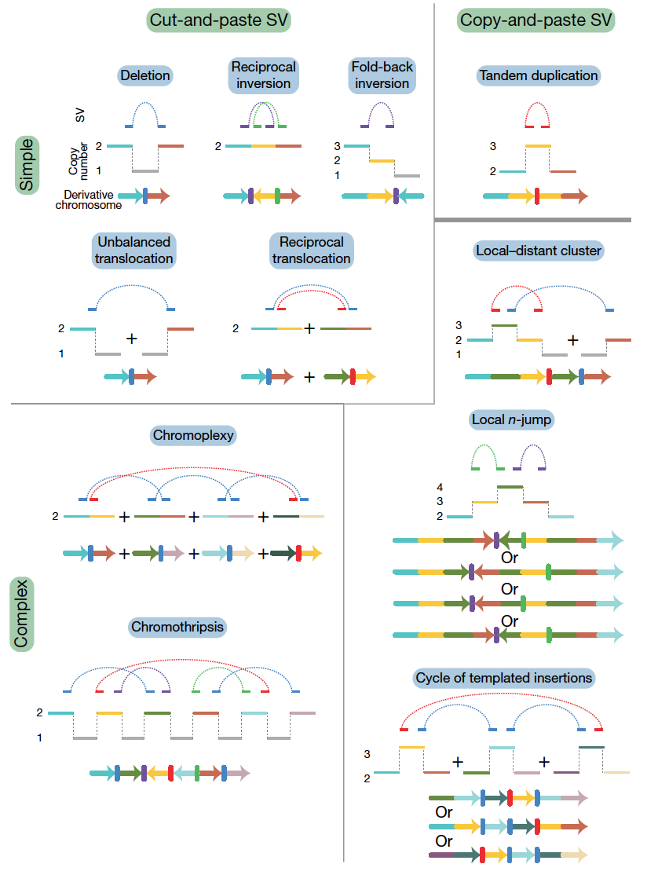
Categorize classes of SV
Based on two aspects:
Number of breakpoints involved
  simple or complex (more breakpoints means it is complex)
Whether the patterns are likely to arise from ‘cut-and-paste’ or ‘copy-and-paste’ rearrangement processes
Fig. 1

Slide 12
Two types of rearrangement processes
Cut-and-paste SV
  Generates a cluster of structural variants consistent with reshuffling or loss of extant genomic segments
Copy-and-paste SV
  Copies of genomic ‘templates’ are newly replicated or synthesized and inserted during the rearrangement process
Fig. 1

Slide 13
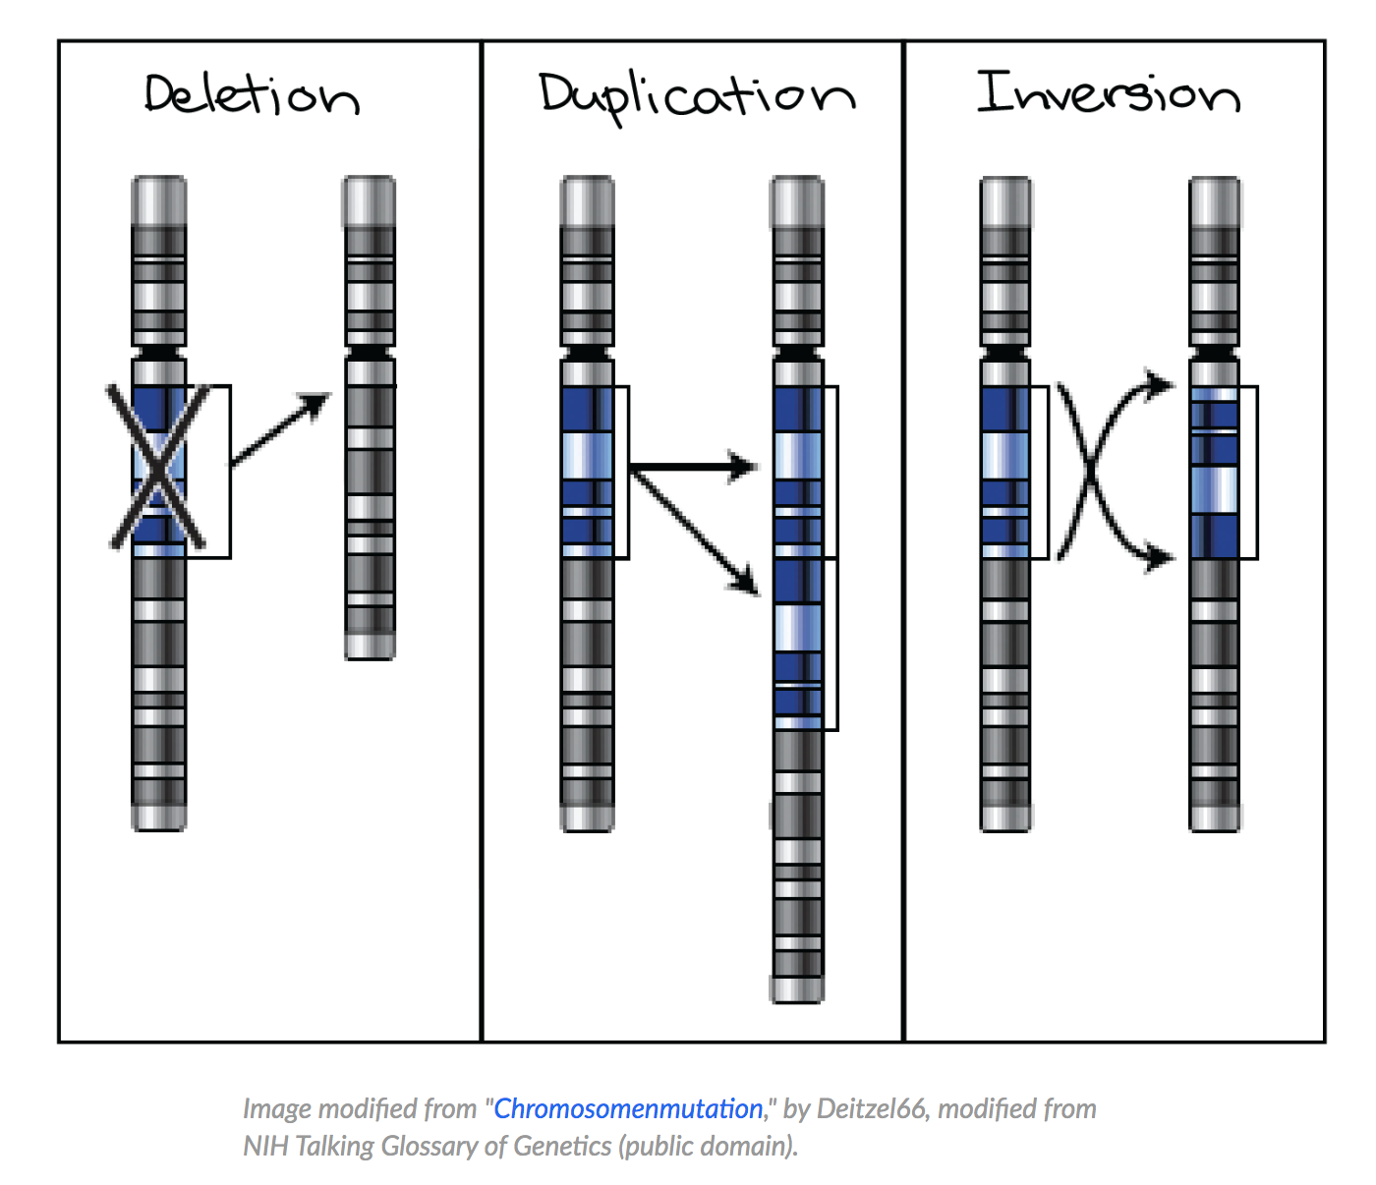
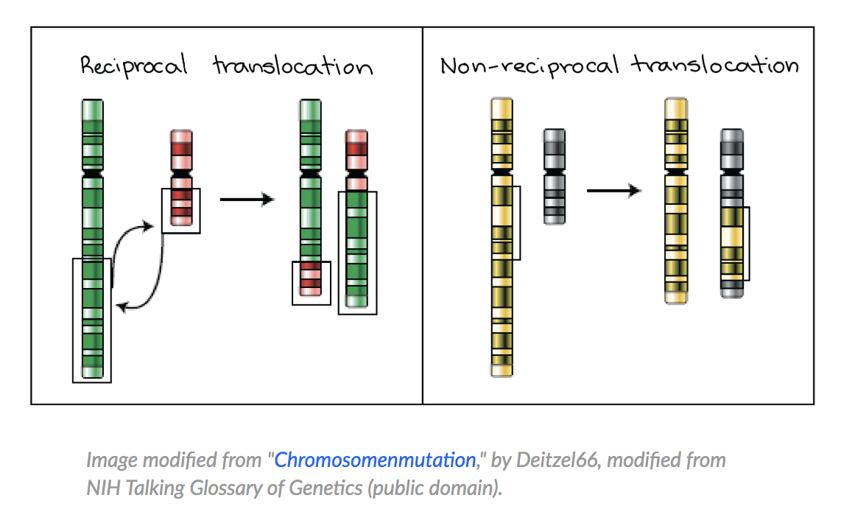
Image taken from: https://www.khanacademy.org/science/biology/classical-genetics/sex-linkage-non-nuclear-chromosomal-mutations/a/aneuploidy-and-chromosomal-rearrangements

Slide 14
Overview
Background
Classification of SVs
Annotation of SV classes
Cycles of templated insertions
Local n-jumps and local-distant clusters
Genomic properties of SVs
Signatures of SV

Slide 15
Annotation of SV classes
Analyzed 2,559 whole cancer genomes across 38 tumor types that passed the PCAWG quality control criteria:
  1 or more somatic SVs were detected in 2,429 tumors
SVs were identified using aberrantly mapping and/or split reads in paired-end sequencing data

Slide 16
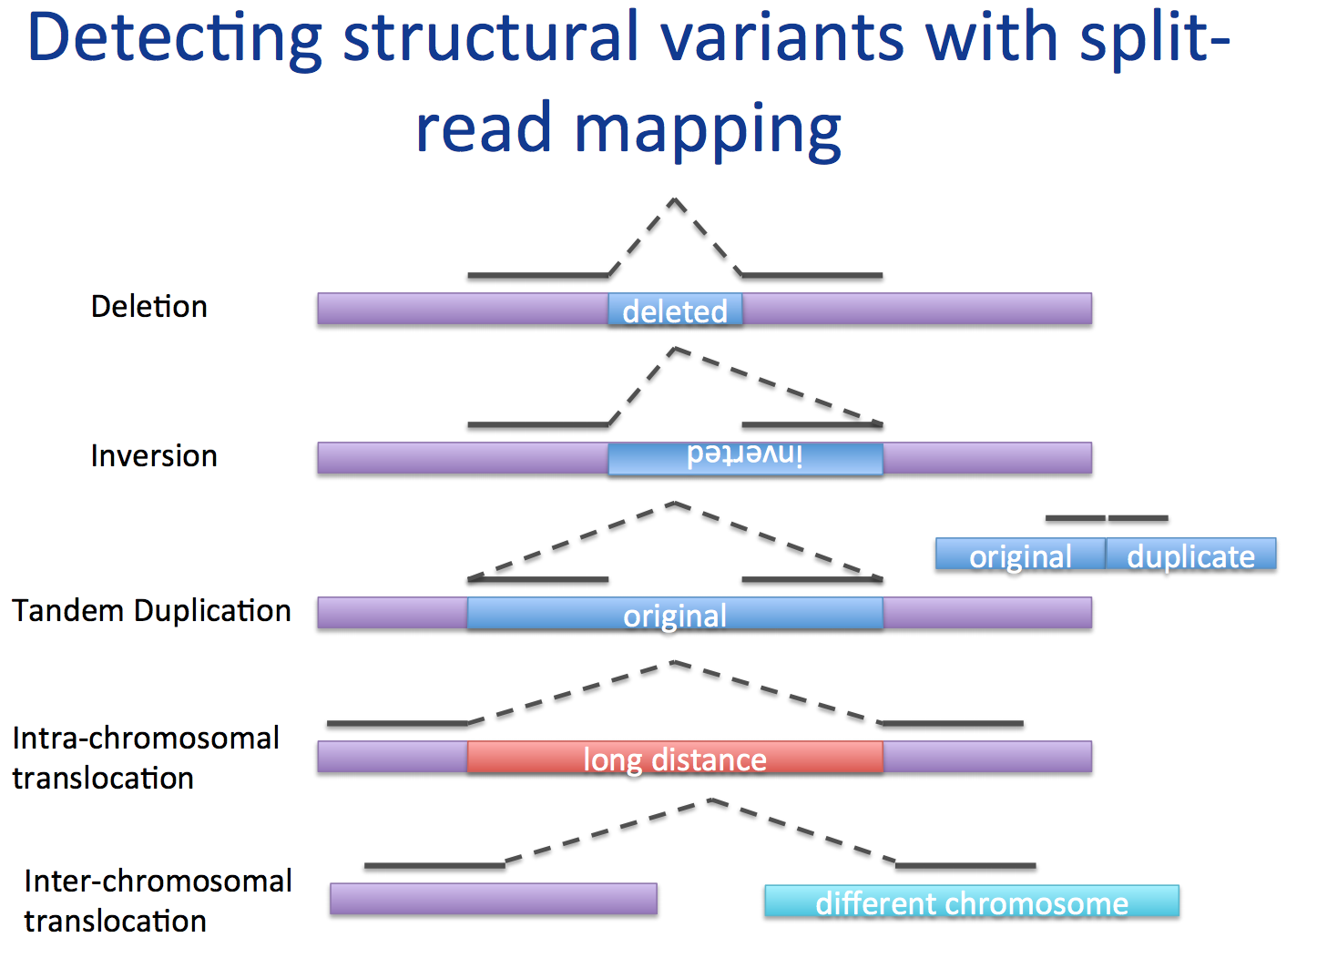
Image taken from: http://schatzlab.cshl.edu/teaching/2015/2015.AdvSeq.Structural_variants_Maria_Nattestad.pdf

Slide 17
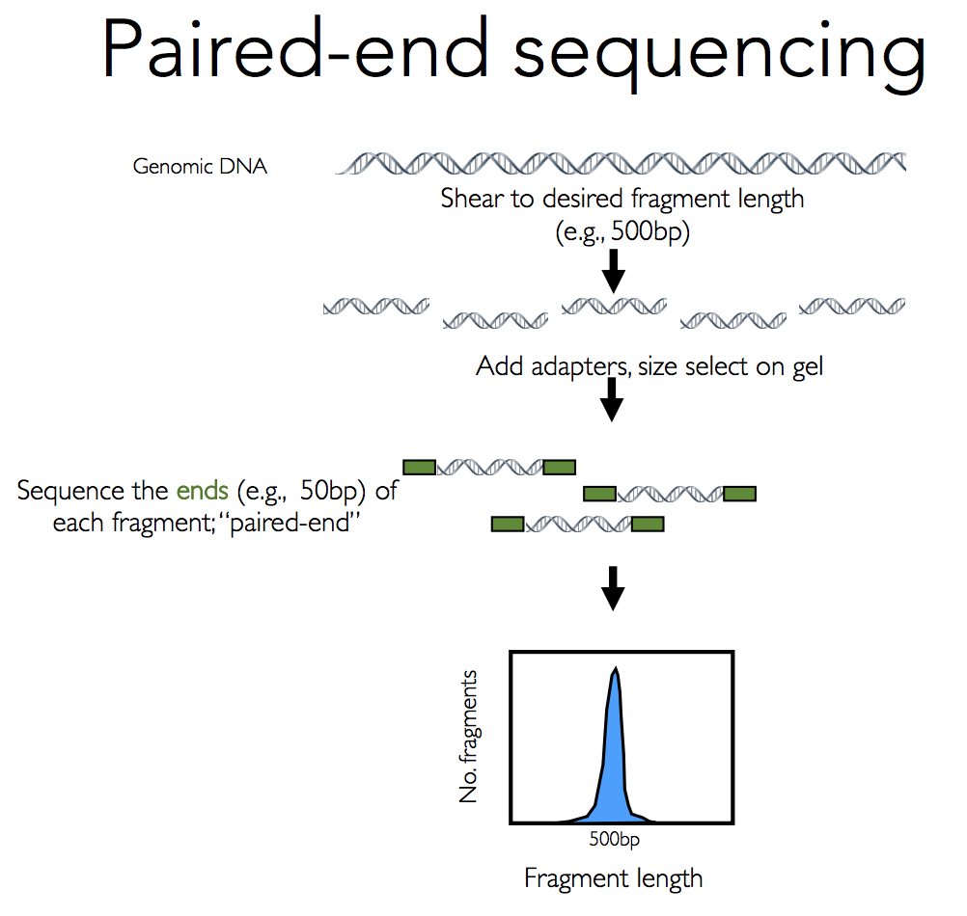
Image taken from: http://schatzlab.cshl.edu/teaching/2015/2015.AdvSeq.Structural_variants_Maria_Nattestad.pdf

Slide 18
Annotation of SV classes
Used the following 4 variant callers to identify somatically acquired SVs from matched tumor and germline whole genome sequencing data
  SvABA (Broad pipeline)
  DELLY (DKFZ pipeline)
  BRASS (Sanger pipeline)
  dRanger (Broad pipeline)
Acquired somatic SVs are merged in to a final call set using a graph-based algorithm to identify overlapping breakpoint junctions across algorithms
Validation of SV calls was carried out using manual inspection and pull-down with resequencing of breakpoints

Slide 19
Rearrangements are grouped into clusters
Reason for grouping:
  SVs from a given cancer are often highly clustered
Grouped based on:
  Proximity of breakpoints
  Overall number of events in that genome
  Size distribution of these events

Slide 20
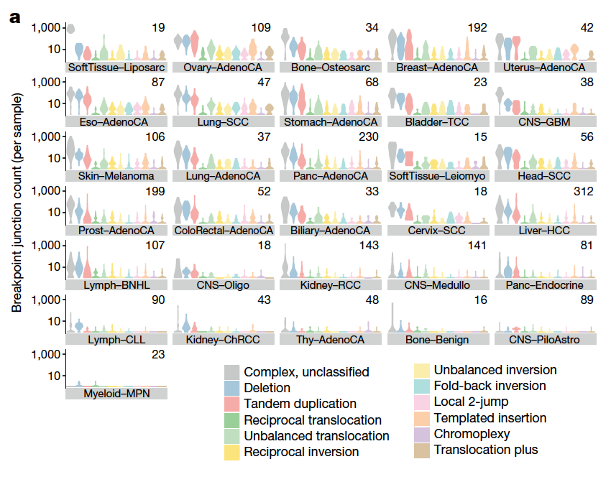
Frequency of SV classes across tumor types
Most common events:
Deletion
Tandem duplication
Unbalanced Translocation
Uncommon events:
Reciprocal translocation
Reciprocal inversion
Fig. 2

Slide 21
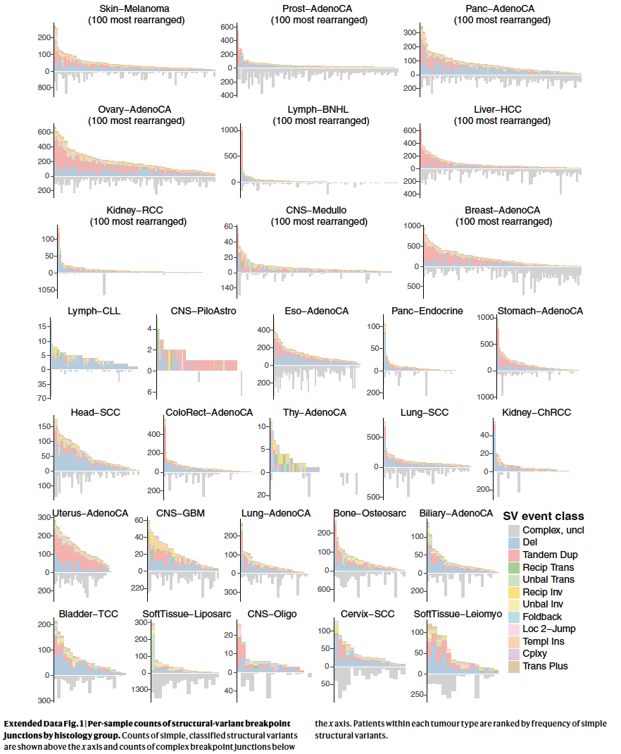
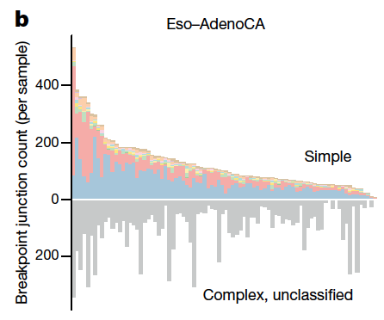
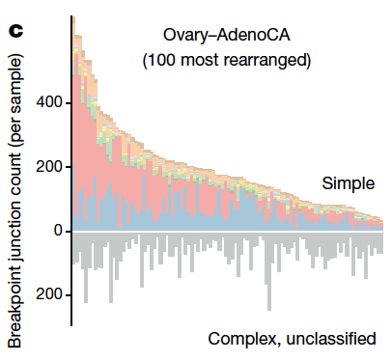
Fig. 2

Slide 22
Overview
Background
Classification of SVs
Annotation of SV classes
Cycles of templated insertions
Local n-jumps and local-distant clusters
Genomic properties of SVs
Signatures of SV

Slide 23
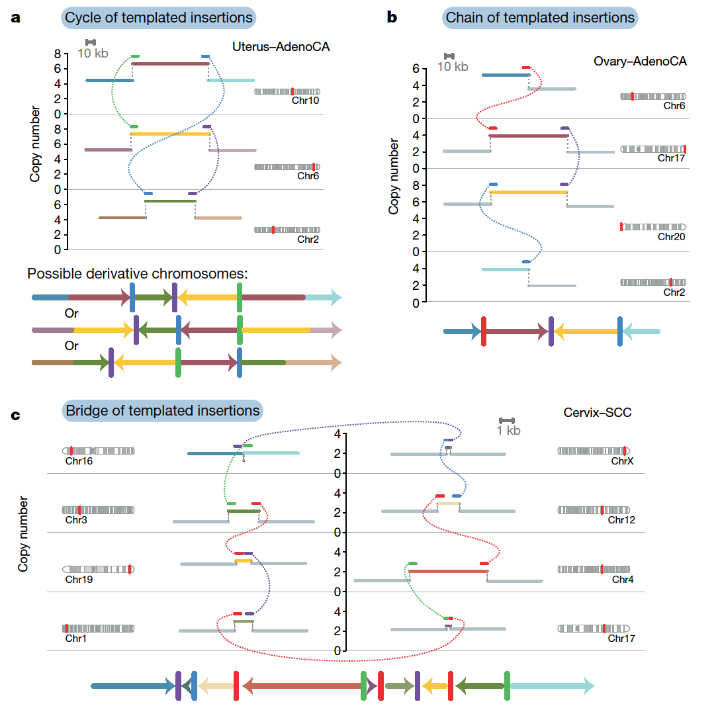
3 types of templated insertions
Defined based on whether or not the string of inserted segments returns to the original chromosome
Chains
  Strings of inserted segments that do not return
Bridges
  Strings of inserted segments that do return
  Leave a gap on the host chromosome
Cycles
  Rereplicate a segment on the host chromosome
Fig. 3

Slide 24
Overview
Background
Classification of SVs
Annotation of SV classes
Cycles of templated insertions
Local n-jumps and local-distant clusters
Genomic properties of SVs
Signatures of SV

Slide 25
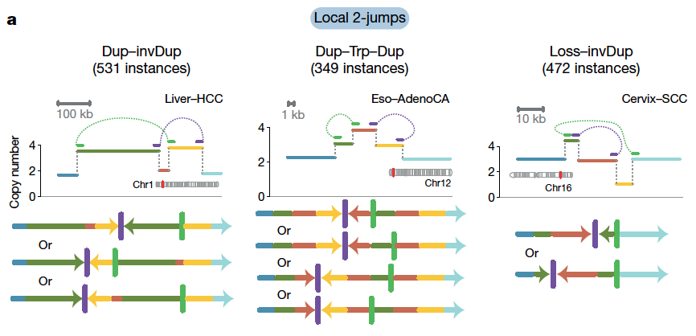
Created by 2 local rearrangements
Fig. 4
Notes:
Structures created by two local rearrangements that cannot easily be explained by simple structural-variant classes (which we call local 2-jumps).

Slide 26
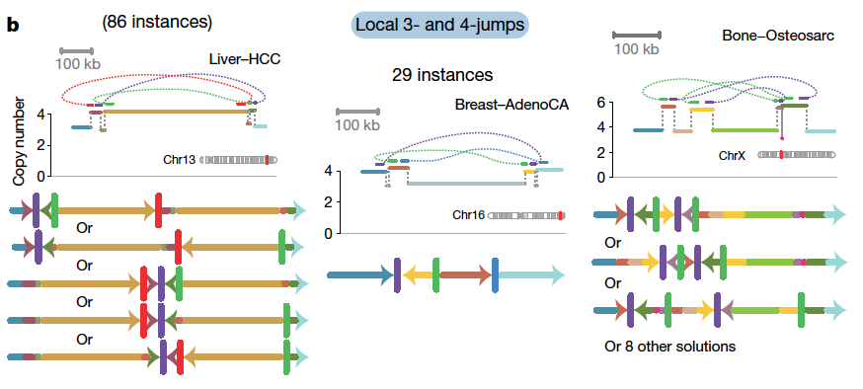
Created by 3 to 4 local rearrangements
Fig. 4
Notes:
Structures created by 3–4 local rearrangements that cannot easily be explained by simple structural variant categories.

Slide 27
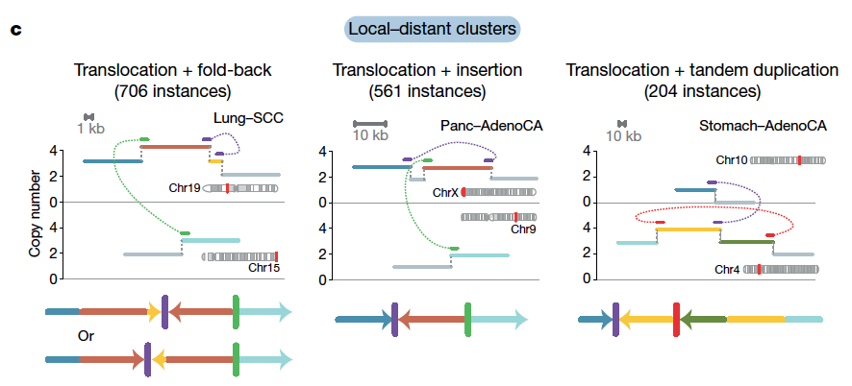
Created by 1 local rearrangement and 1 rearrangement that reaches elsewhere in genome
Fig. 4
Notes:
Structures created by one local rearrangement and one rearrangement that reaches elsewhere in the genome (local–distant clusters)

Slide 28
Overview
Background
Classification of SVs
Annotation of SV classes
Cycles of templated insertions
Local n-jumps and local-distant clusters
Genomic properties of SVs
Signatures of SV

Slide 29
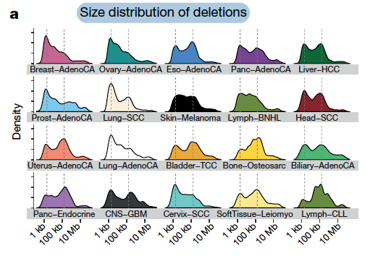
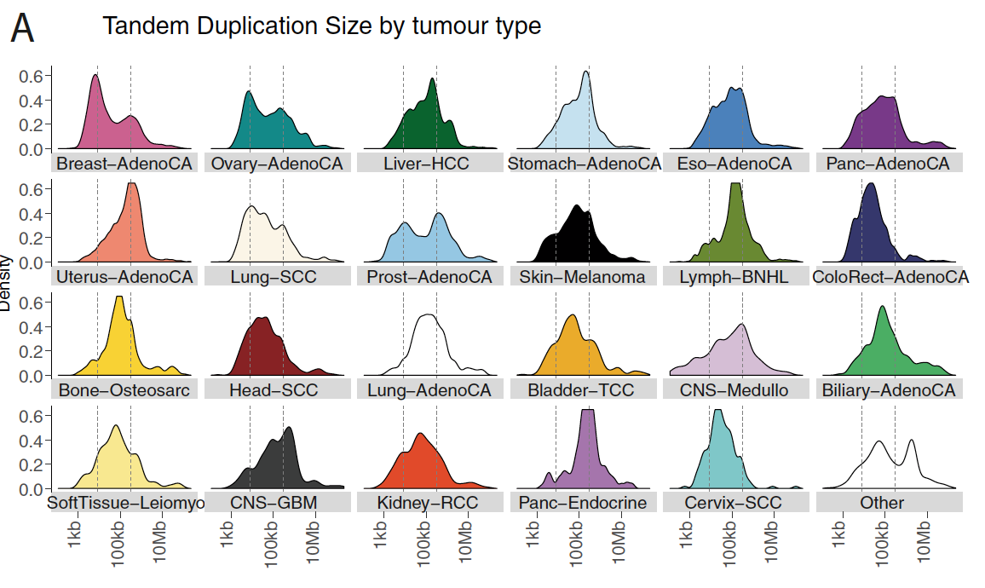
Genomic properties of SVs
Size of the tandem duplications and deletions often followed complex, multimodal distributions across tumor types
Fig. 5
Extended Fig. 6

Slide 30
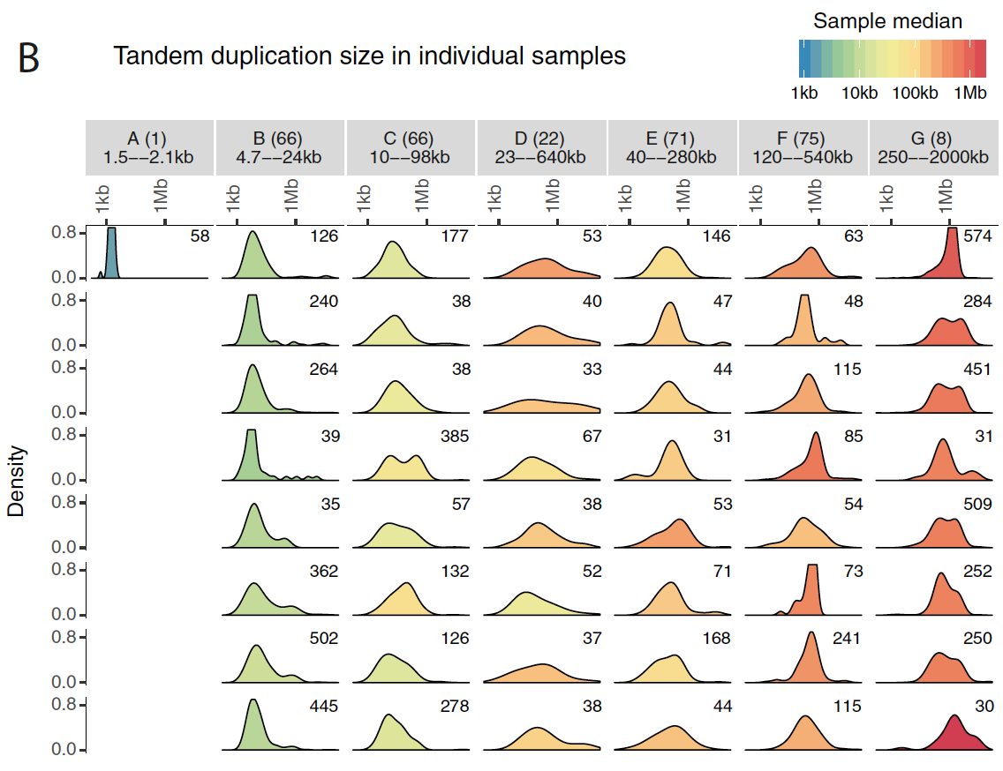
Individual patients tend to have a simpler, unimodal distribution of deletions or tandem duplications
This implies that the complexity seen in a given tumor type results from combining samples with different profiles
Extended Fig. 6

Slide 31
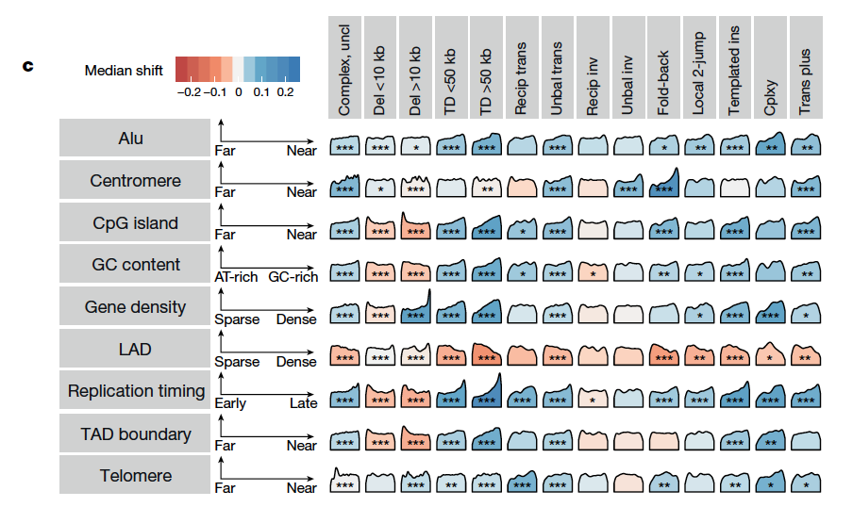
Replication timing
has the strongest association with the occurrence of SVs
Deletions occur in late-replicating regions
Tandem duplications and unbalanced translocations occur in early-replication regions
Fig. 5
Notes:
Associations between a subset of the genomic properties (rows) and classes of structural variant (columns).
Each density curve represents the quantile distribution of the genomic property values at
observed breakpoints compared to random genome positions.
Asterisks indicate a significant departure from uniform quantiles after multiple
hypothesis correction on a one-sided Kolmogorov–Smirnov test based on a
sample size of 2,559 genomes containing structural variants: *false-discovery
rate < 0.01, **false-discovery rate < 0.001, ***false-discovery rate < 10−6.
Cells with significant property associations are shaded by the magnitude of the shift
of the median observed quantile above (blue) or below (red) 0.5.
The interpretation of each property from left to right is indicated by the axes to the
right of the property label. Complex uncl, complex clusters unclassified; cplxy,
chromoplexy; del, deletion; inv, inversion; ins, insertion; LAD, lamina associated
domain; recip, reciprocal; TAD, topologically associated domain;
TD, tandem duplication; trans, translocation; unbal, unbalanced.

Slide 32
Individual patients with high number of deletions or tandem duplications had notable heterogeneity in the distribution of these SVs according to the replication timing:
For example:
Some had events that occurred predominantly in late-replicating regions
Some with events that occurred exclusively in early-replicating regions
Others were distributed more evenly

Slide 33
Overview
Background
Classification of SVs
Annotation of SV classes
Cycles of templated insertions
Local n-jumps and local-distant clusters
Genomic properties of SVs
Signatures of SV

Slide 34
Signatures of SV
The differences across patients in the size distribution of tandem duplication and deletion, together with the widely varying frequency and patterns of SV across tumor types and genome topology suggest that correlations across individual classes of SVs could similarity be learnt.

Slide 35
Signatures of SV
The set of SVs of each patient was divided into mutually exclusive categories:
Most frequent classes of SV (deletion and tandem duplication) were split into 11 categories according to size, replication timing, and occurrence at fragile sites
Other configurations of SVs (cycles, chains and bridges of templated insertions, local n-jumps, and local-distant clusters) and copy number changes seen >50 times in the cohort were included as further categories

Slide 36
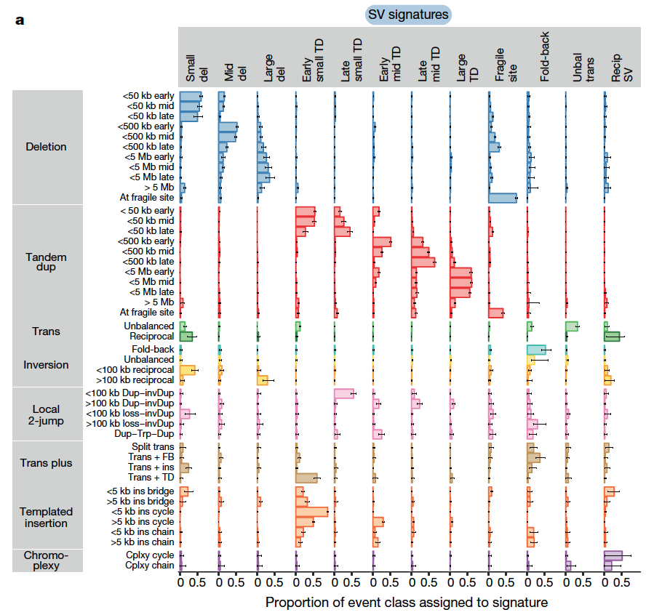
SV signatures in human cancers
12 most distinctive SV signature extracted by the Bayesian hierarchical Dirichlet process algorithm
Run on a sample size of 2,559 genomes containing SVs
Fig. 6
Notes:
Cycles, chains and bridges of templated insertions were particularly prominent in signatures of early-replicating tandem duplications
Local 2-jump were more closely associated with late-replicating tandem duplications

Slide 37
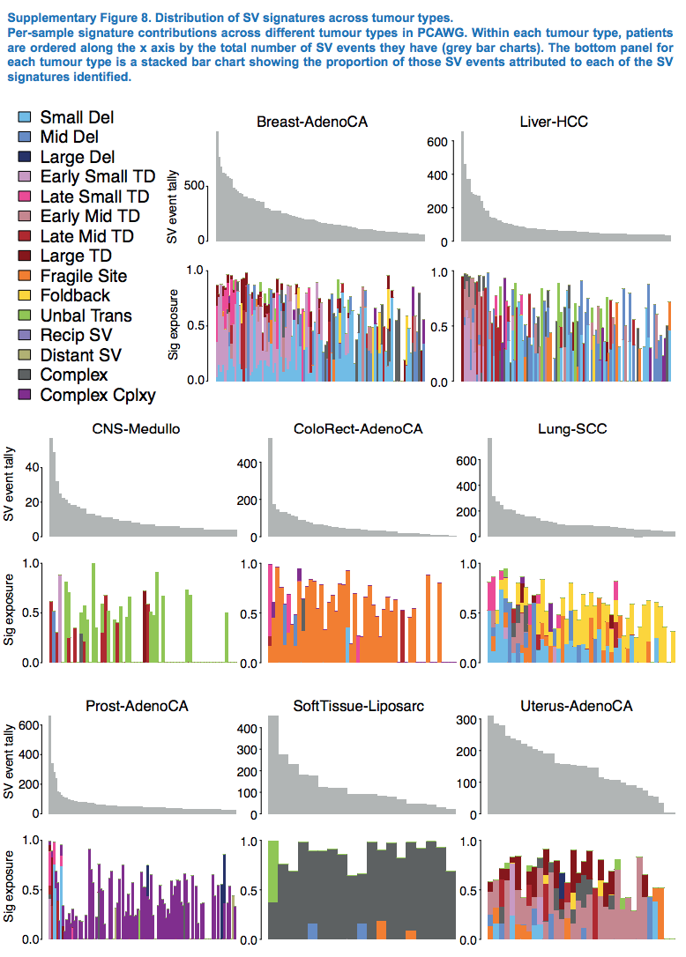
The SV signatures showed that the activities varied across the tumor types and among patients within a given tumor type

