Slide 1
The Evolutionary History of 2,658 Cancers
Jackie Oh (jmoh3)

Slide 2
Background
Little is known about the time at which mutations occur, boundary between normal evolution and cancer progression
Understanding the timeline of various cancers, timing at which certain mutations arise could help with early cancer detection

Slide 3
Key Questions:
Can we reconstruct the life history of a tumor?
What timing patterns are associated with copy number gains across different cancer types?
When do driver mutations typically occur in an individual’s lifetime?
How can we relate mutational time to chronological time?

Slide 4
1.
Can we reconstruct the life history of a tumor?

Slide 5
Timing SNVs
Goal: classify Single Nucleotide Variants (SNVs) by the time which they occurred into 4 categories:
Early clonal
Late clonal
Clonal
Subclonal

Slide 6
Clonal vs Subclonal mutations
Clonal mutations: present on one or more copies per tumor cell, occur before the most recent common ancestor (MRCA) of the tumor
Subclonal mutations: present on only a subset of tumor cells, occur after the MRCA of the tumor

Slide 7
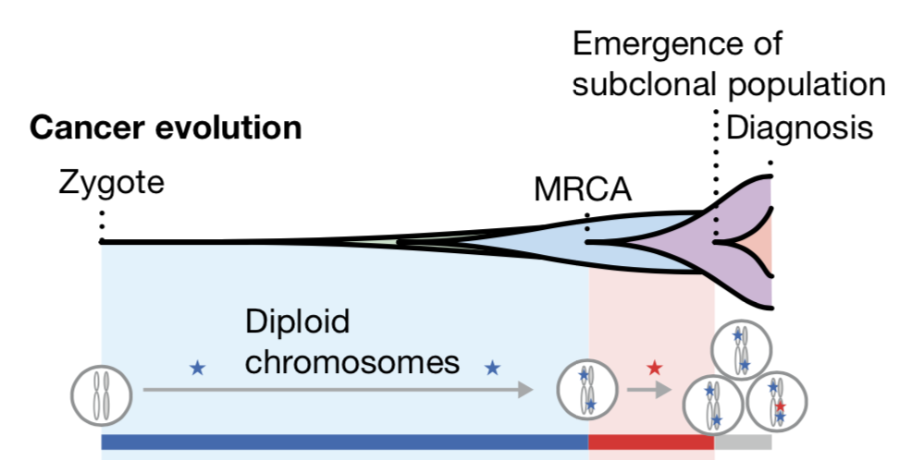
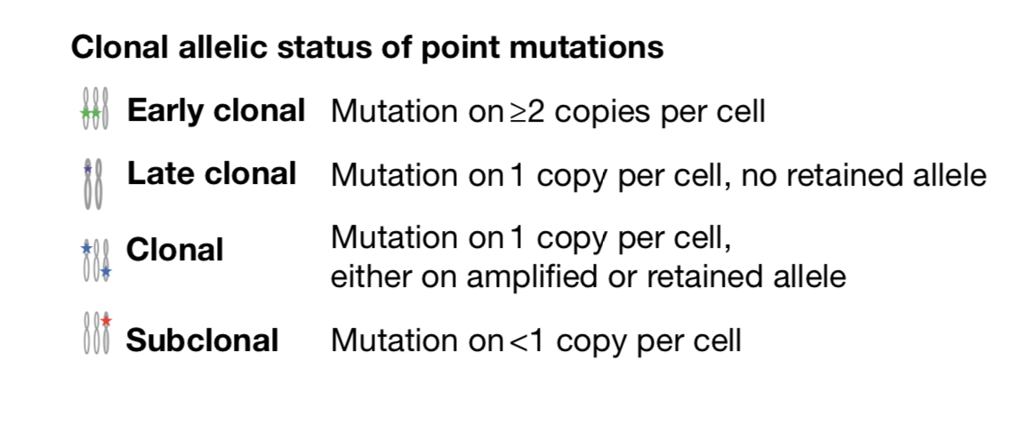
Clonal vs Subclonal mutations

Slide 8
Clonal mutations
How do we get a better timing estimate for clonal mutations?
Idea: distinguish between mutations that occur before a copy number gain, and mutations that occur after a copy number gain
Using this, we can distinguish some SNVs as early clonal or late clonal

Slide 9
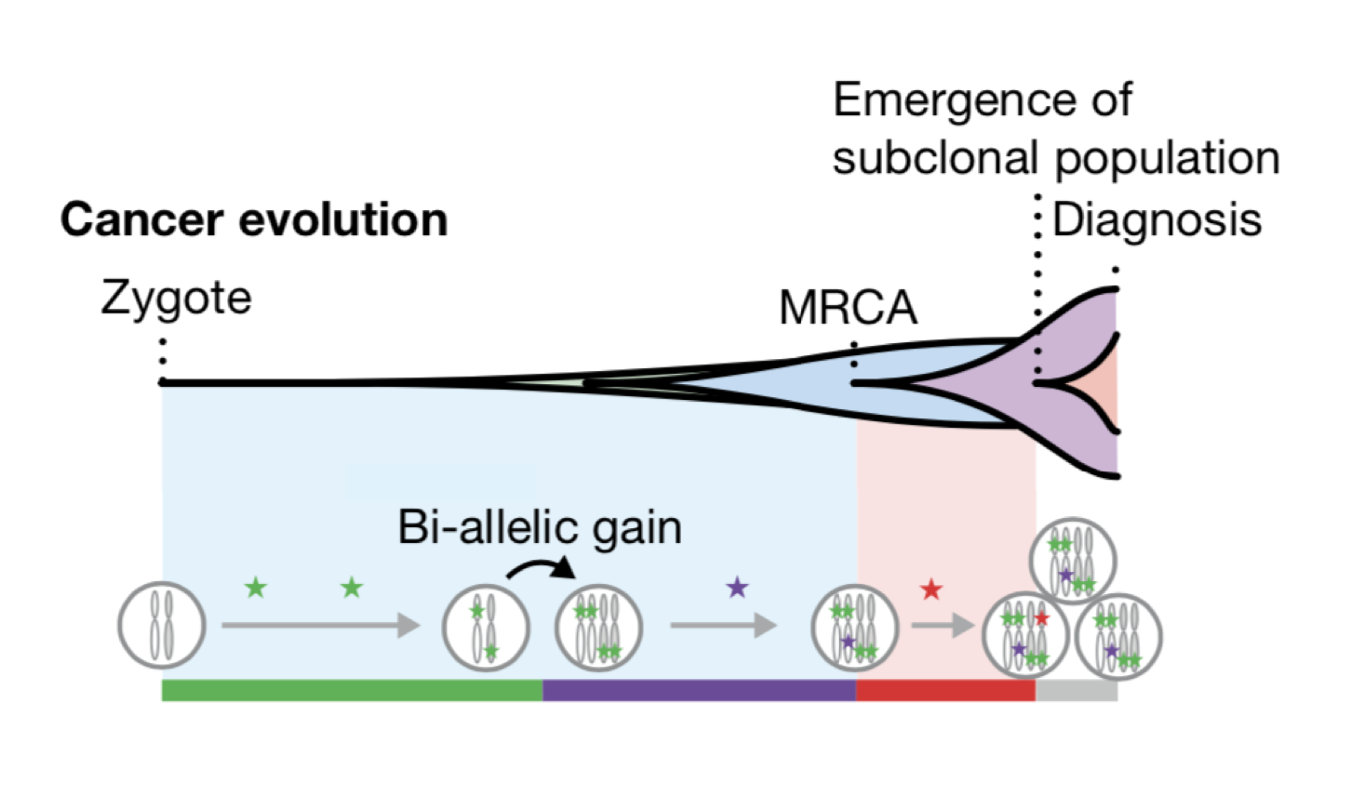
Early clonal vs Late clonal
Early clonal: present on 2 or more copies on each cell, occur before a copy number gain
Late clonal: present on 1 copy of each cell, occur after a copy number gain

Slide 10
Timing copy number gains
Don’t just want ordering, want an idea of the time of a mutation in relation to the individual’s lifespan
We can distinguish order for some clonal mutations using copy number gains, so if we know the time of the gain, then we can better determine the time of the SNVs

Slide 11
Timing copy number gains
Goal: Estimate the molecular time of copy number gains
Molecular time = time point at which gain happened during clonal evolution, measured as the time of occurrence relative to the number of clonal mutations

Slide 12
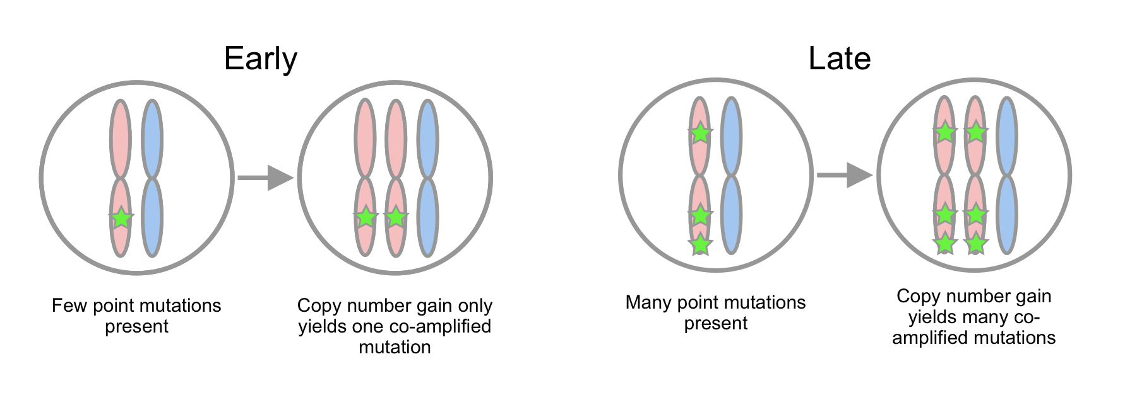
Timing copy number gains

Slide 13
Timing copy number gains
Used three different methods to calculate timing of copy number gains
  cancerTiming, MutationTimeR, and PhylogicNDT SinglePatientTiming
All methods used the following formula to relate VAF to underlying number of alleles carrying a mutation
Notes:
cancerTiming
Maximum Likelihood based approach
Used to time single gains (2 + 1), double gains (3 + 1), and copy neutral loss of heterozygosity (2 + 0)
Not recommended to be used on more complex copy number configurations, but the authors made the assumption that in regions of 2+2 in whole genome duplications, both regions were gained at the same time
MutationTimeR
They model the mutant read counts by a beta binomial distribution
Model inputs:
Copy number data
VAF data
Probability of clonal vs sub clonal (taken from sub clonal composition analyses)
Outputs: probability for each individual point mutation to belong to different copy number levels
Use EM algorithm to calculate these
The proportion of point mutations in different copy number states, in turn, defines the molecular timing of gains
PhylogicNDT SinglePatientTiming
Compute likelihood of mutational copy number (multiplicity)
Using multiplicity rates, clonal number copy number gains can be timed in mutational time and relative to one another

Slide 14
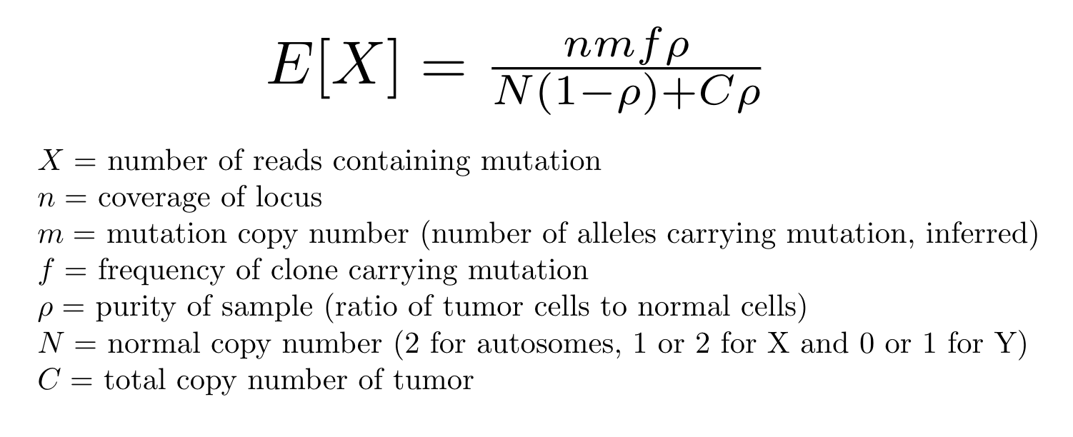
Timing copy number gains
All methods used this formula to relate VAF to underlying number of alleles carrying a mutation
Notes:
One way to think about it:
npf - the number of reads that come from cells that carry the mutation
m/(N(1-p)+Cp) - fraction of alleles that contain the mutation
If purity p = 1, and the mutation copy number is 2, and the total copy number is 3, ⅔ of the alleles contain the mutation

Slide 15
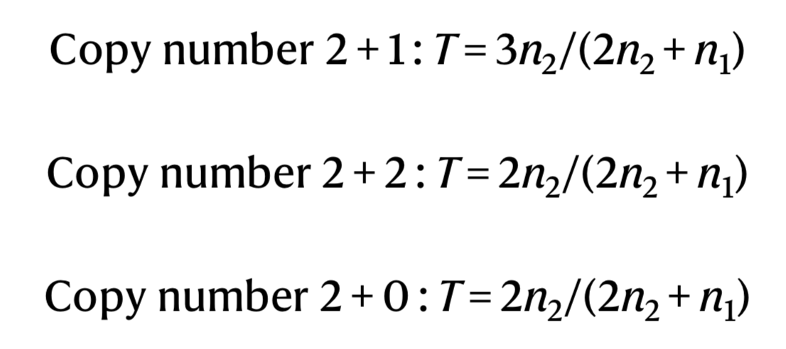
Timing copy number gains
Number of mutations n_{m} at each allelic copy number m informs the time at which the gain occurred
Formulae for gain depends on copy number configuration
Notes:
Won’t go into these in depth but general idea is that you’re looking at the number of co-amplified mutations in a region that has a gain, so for the top one, the mutations in the duplicated region multiplied by

Slide 16
Validation of timing for copy number gains
Simulate samples using PhylogicNDT - PhylogicSim TimingSimulator model, with similar characteristics to PCAWG dataset
Compare 3 timing methods against each other on PCAWG dataset and simulated dataset
Found that all 3 methods generally agreed with each other and ground truth for simulated data
Notes:
Simulated a bunch of samples using PhylogicNDT - PhylogicSim TimingSimulator model
Choose mutation rate at random from clonal mutation rates
Mutations randomly dispersed across genome
Using # mutations as clock, copy number events and driver mutations were added at corresponding time in pi space (?)
Then, chose number of subclones and subclonal mutation rate within each sample was chosen at random from distribution from all PCAWG samples
Purity also drawn from PCAWG samples
Fit coverage profiles from PCAWG samples in diploid regions to beta binomial distribution, then simulation drew coverage from this distribution
Finally, drew the alternate count for each simulated mutation from a binomial distribution, expected is weird equation that uses ccf, purity, ploidy, and multiplicity
Evaluated the 3 methods against each other on PCAWG and on simulated dataset, for which ground truth is known, and found that all methods agreed with each other and ground truth

Slide 17
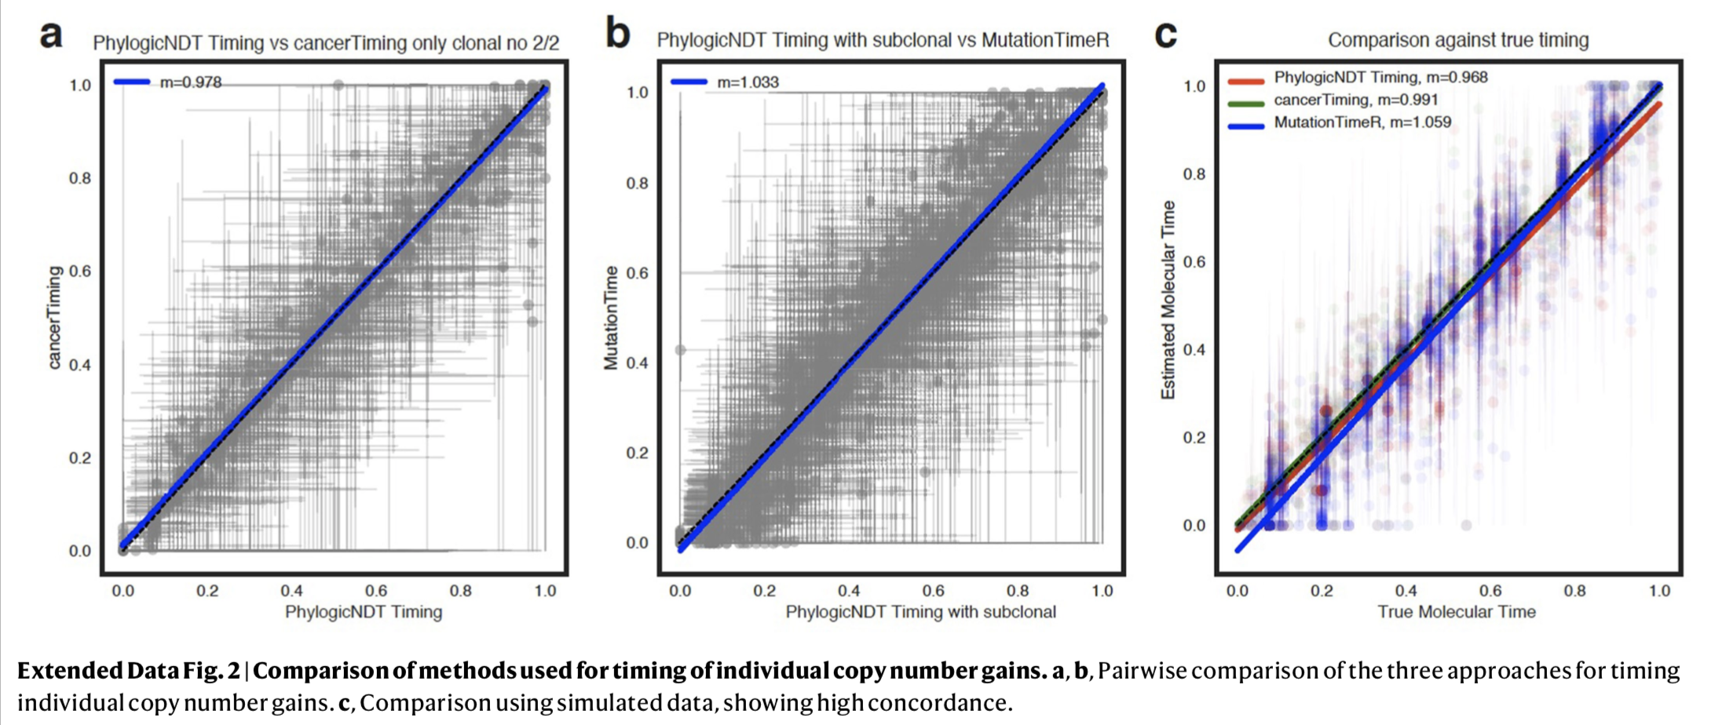
Validation of timing for copy number gains

Slide 18
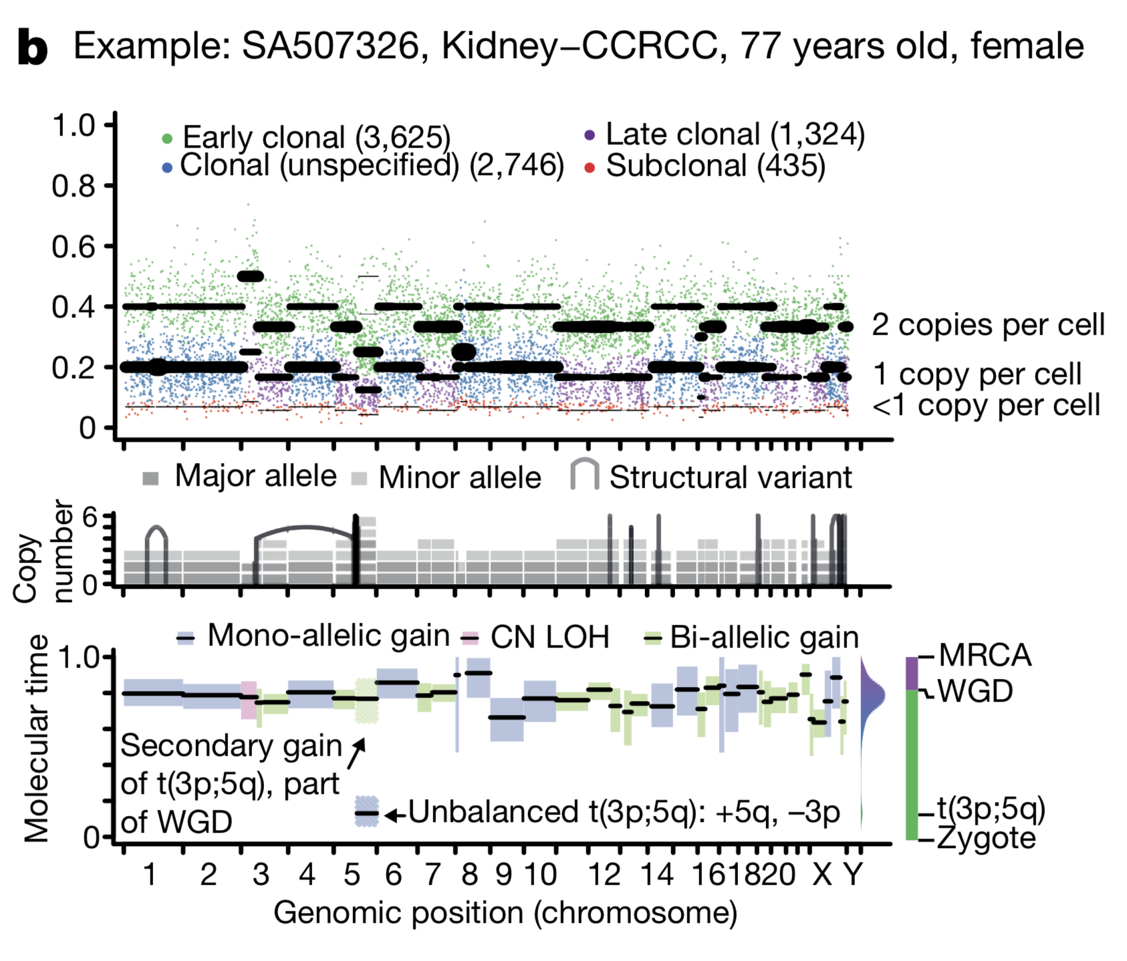
Example
Annotated point mutations in one sample based on VAF (top), copy number (CN) state and structural variants (middle), and resulting timing estimates (bottom).
Notes:
VAFs of somatic point mutations cluster around values imposed by purity for the sample, local copy number configuration, and identified subclonal populations
Gained chromosome arm 5q at an early molecular time as a part of an unbalanced translocation
This lesion often occurs in adolescence for this cancer type, so this makes sense
At later time point, whole genome duplication event occurred, duplicating all alleles in one event
This is why all copy number gains cluster around a single time point

Slide 19
2.
What timing patterns are associated with copy number gains across different cancer types?

Slide 20
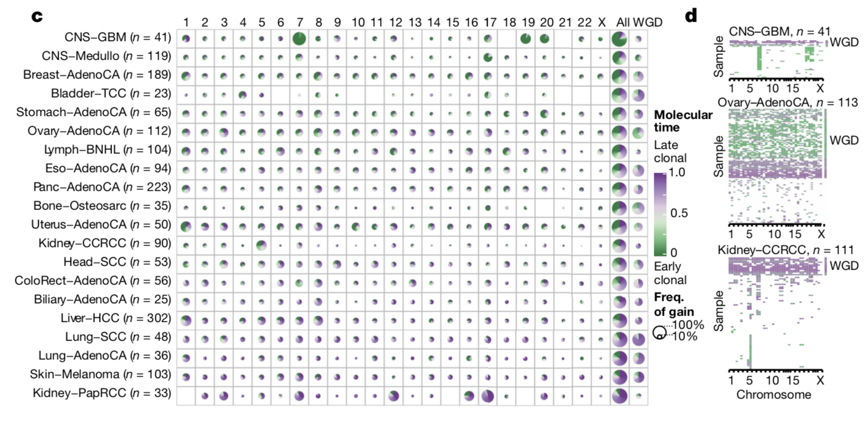
Molecular time distribution of gains
c - overview of molecular time distribution of copy number gains across cancer types, d - heat maps representing molecular timing estimates of gains on different chromosome arms (x axis) for individual samples (y axis) for selected tumor types
Notes:
Interesting things to note for figure c
Glioblastoma (CNS-GBM) has highly frequent gains on chromosome 7, 19, and 20 in the early clonal stages of molecular time
Cancer types seem to be sorted based on their proportion of early to late gains, so
Glioblastoma, Medulloblastoma, and Breast adenocarcinoma are seemingly characterized by early copy number gains
Lung adenocarcinoma, melanoma, and Kidney papillary renal cell carcinoma are characterized by late clonal gains
Interesting things to note for figure d:
Within individual samples, you can see that the gains all generally occur around the same time
Can observe the Glioblastoma (CNS-GBM) has highly frequent gains on chromosome 7, 19, and 20 in the early clonal stages of molecular time

Slide 21
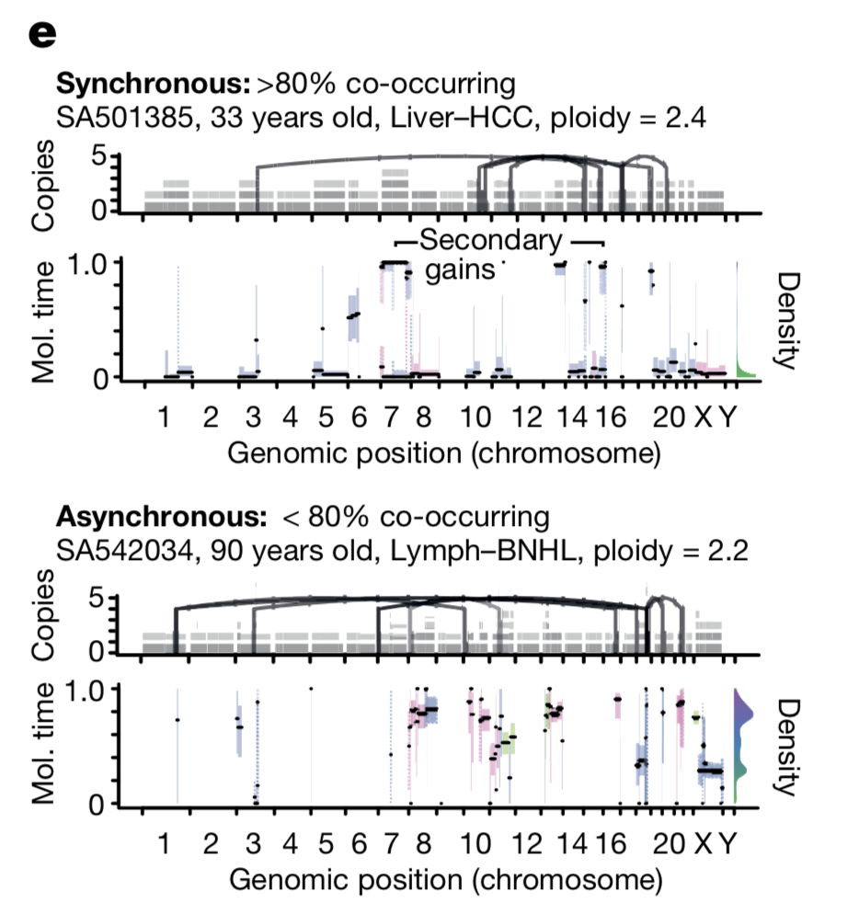
Molecular time distribution of gains
e - Temporal patterns of two near-diploid cases illustrating synchronous gains (top) and asynchronous gains (bottom)

Slide 22
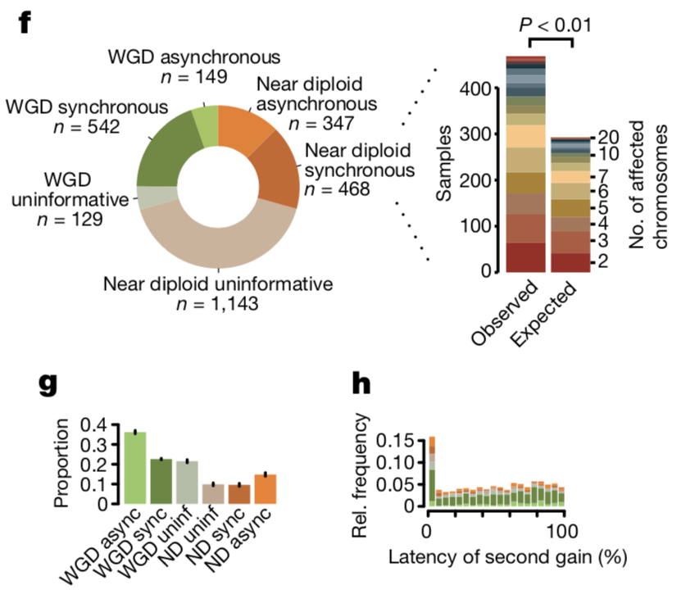
Molecular time distribution of gains
f - Left, distribution of synchronous and asynchronous gain patterns across samples, split by WGD status. Uninformative samples have too few or too small gains for accurate timing. Right, the enrichment of synchronous gains in near-diploid samples is shown by systematic permutation tests.

Slide 23
Molecular time distribution of gains
g - Proportion of copy number segments (n = 90,387) with secondary gains. Error bars denote 95% credible intervals. ND, near diploid. h - Distribution of the relative latency of n = 824 secondary gains with available timing information, scaled to the time after the first gain and aggregated per chromosome.

Slide 24
Key takeaways
Systematic differences in distributions for molecular timing of gains between different tumor types
Similar distributions in molecular timing for gains on chromosomes for one tumor type
Gains in the same tumor often appear to occur at a similar molecular time
  Suggests most copy number gains occur during punctuated bursts

Slide 25
3.
When do driver mutations typically occur in an individual’s lifetime?

Slide 26
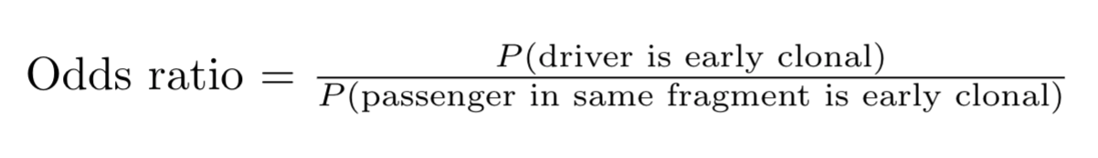
Timing of Driver Mutations
How likely is it for a driver mutation to be early vs late clonal or clonal vs subclonal compared to passenger mutations in the same region?
Found odds ratio of early vs late clonal and clonal vs subclonal calculated for driver mutations against distribution of all other mutations present in fragments with same copy number composition

Slide 27
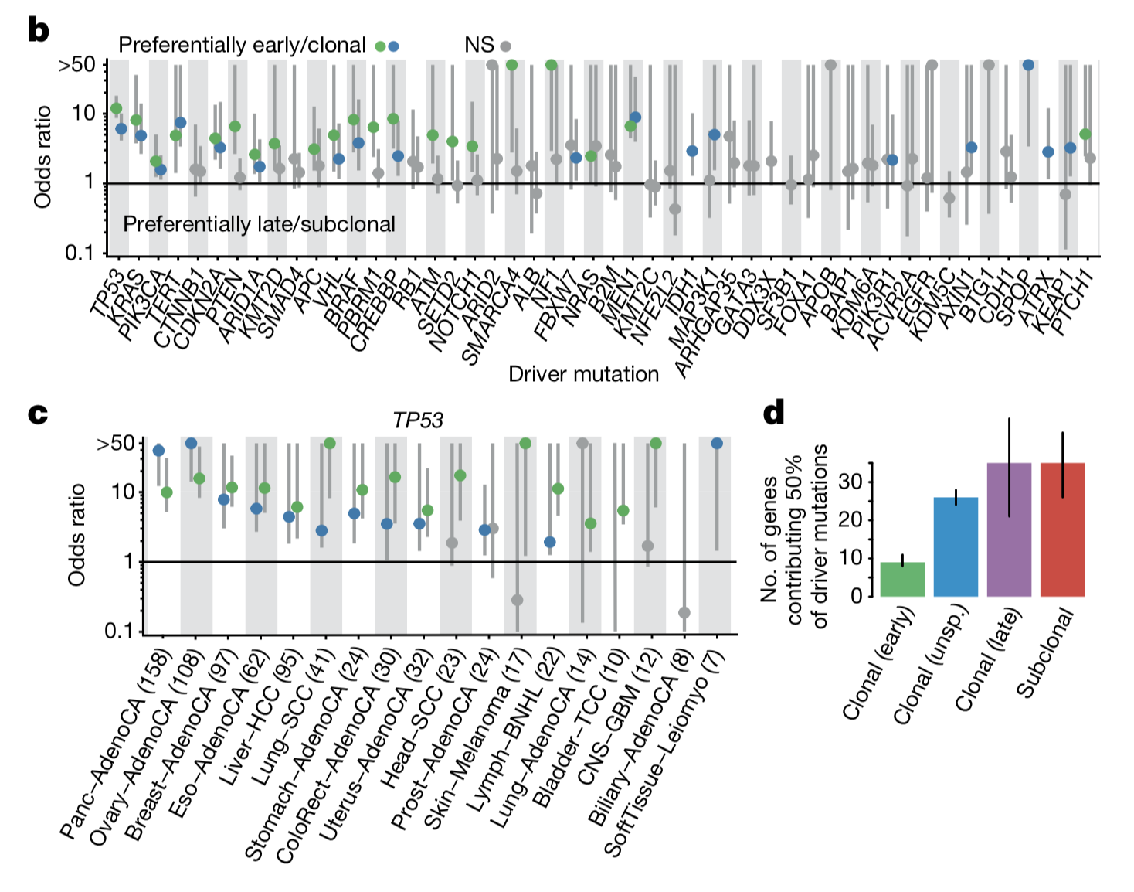
Molecular time distribution of drivers
b - Relative timing of the 50 most recurrent driver lesions using odds ratio of early vs late clonal mutation driver mutations vs background, c - Relative timing of TP53 mutations across cancer types, using same odds ratio as b, d - Estimated number of unique genes contributing 50% of all drivers in different timing epochs
Notes:
Figure b:
Common drivers typically occur in early stages
Figure c:
TP53: our favorite driver gene, provides instructions to make a tumor suppressor
Enriched in early clonal stages across cancer types
Figure d:
More diversity among driver mutations introduced at later stages of tumor development
Suggest that in general, very early events in cancer evolution occur in small set of common drivers, then more diverse variety of drivers fuel late tumor development
Consistent with previous studies of individual tumor types

Slide 28
Key takeaways
Common driver mutations tend to appear early, while rarer driver mutations tend to appear later in tumor development
There are typical orderings to time at which drivers occur in different cancers

Slide 29
4.
How can we relate mutational time to chronological time?

Slide 30
Chronological time estimates
If mutation rate was constant, we could just multiply molecular time by the age at diagnosis to get the chronological time of a mutation
However, mutation rate does vary
Instead of using all mutations when calculating mutational time, could count only endogenous mutations whose rate varies less over time - CpG > TpG mutations

Slide 31
Chronological time estimates
Assume that CpG > TpG mutation rate is constant until a point in time at which mutation rate accelerates
Model different scenarios of CpG > TpG mutation rate to time WGD and MRCA of tumor

Slide 32
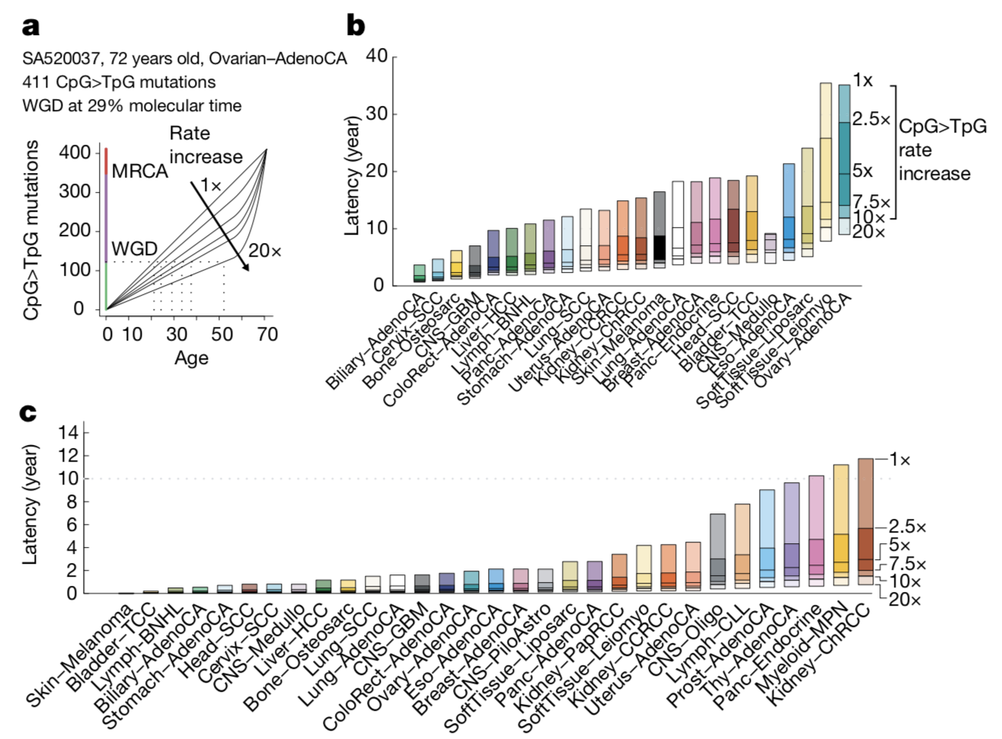
Chronological time estimates
a - Mapping of molecular timing estimates to chronological time under different scenarios of increases in the CpG>TpG mutation rate. A greater increase before diagnosis indicates an inflation of the mutation timescale.
Notes:
Under many different scenarios of rate increase, WGD occurred at least 10 years before time of diagnosis
MRCA was relatively recent

Slide 33
Chronological time estimates
b - Median latency between WGDs and the last detectable subclone before diagnosis under different scenarios of CpG>TpG mutation rate increases for n = 569 non-hypermutant cancers with at least 100 informative SNVs, low tumour in normal contamination and at least five samples per tumour histology.
Notes:
For some cancers, typical latency between WGD and time of diagnosis is very large, 10+ years

Slide 34
Chronological time estimates
c - Median latency between the MRCA and the last detectable subclone before diagnosis for different CpG>TpG mutation rate changes in n = 1,921 non-hypermutant samples with low tumour in normal contamination and at least 5 cases per cancer type.
Notes:
For some cancers, typical latency between MRCA and time of diagnosis is fairly large, 1-2+ years

Slide 35
Key takeaways
Timescales found were supported by fact that progression of most known precancerous lesions to carcinomas usually spans many years
Could use timescales to help detect tumors in cancer types without detectable premalignant conditions

