Slide 1
High-Coverage Whole-Genome Analysis of 1220 Cancers Reveals Hundreds of Genes Deregulated by Rearrangement-Mediated Cis-Regulatory Alterations
Yiqun Zhang, Fengju Chen, Nuno A. Fonseca, Yao He, Masashi Fujita, Hidewaki Nakagawa, Zemin Zhang, Alvis Brazma, PCAWG Transcriptome Working Group, PCAWG Structural Variation Working Group, Chad J. Creighton, & PCAWG Consortium
Slides by Arnav Sankaran

Slide 2
Overview
Investigation
Somatic structural variation's effect on gene expression
Is there upregulation of the gene?
Determine if there is a correlation
Results
Key cancer genes’ expressions are effected by nearby SVs
TERT, MDM2, CDK4, ERBB2, CD274, PDCD1LG2, and IGF2
Gene expression usually increases

Slide 3
Dataset
PCAWG whole genomes project
Whole genome sequencing
From ICGC and TCGA datasets
Reanalyzed to align to human genome (hs37d5)
2658 cancer cases
38 tumor types
1220 cases had gene expression profiles
Investigation is performed on these elements of the dataset

Slide 4
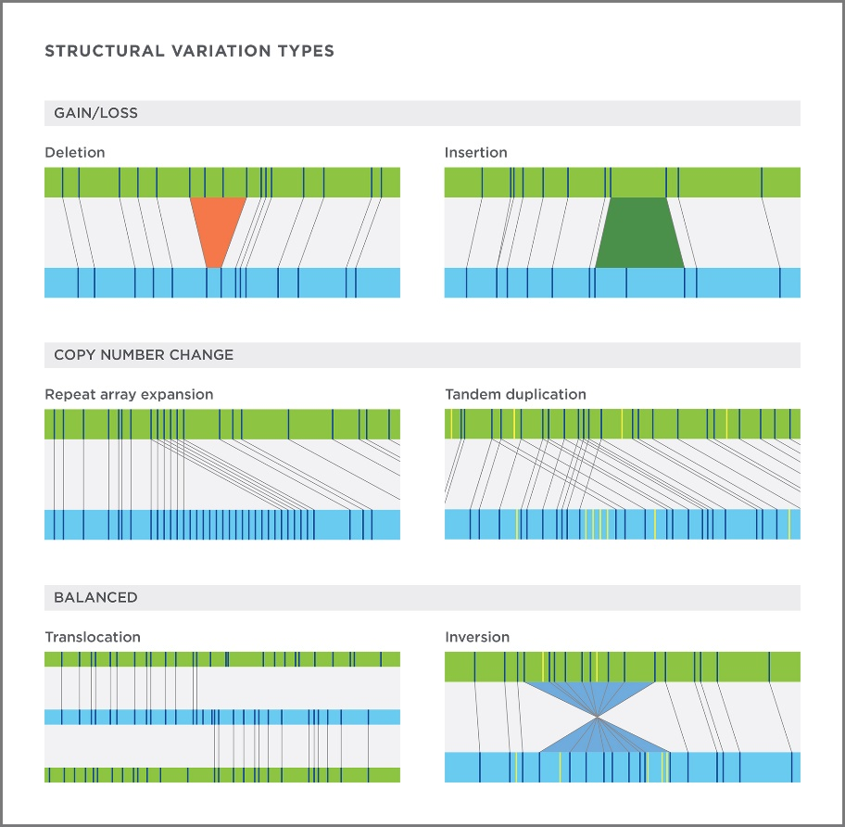
Somatic Structural Variant
Variant
Mutations that arise through rearrangements, duplications, or deletions of segments of DNA
Breakpoint
See image
https://bionanogenomics.com/wp-content/uploads/2017/07/Technology_supportGraphic_SV_TYPES_revised.jpg

Slide 5
Gene Expression & Upregulation
Expression
Process of transcribing DNA into mRNA
More mRNA leads to increased protein translation
Upregulation
The increased transcribing of DNA into mRNA
Upregulation is relative to healthy cells
log2((gene expression) / (healthy gene expression))
This often is one of the initiators of tumor growth

Slide 6
Gene Promotors & Enhancers
Promotor
A region of DNA which leads to the transcription of coding regions
Upregulation is often a result of mutations in the promotor
Enhancer
A region of DNA which can be bound by a protein
When bound transcription increases and causes upregulation

Slide 7
SV Breakpoint Analysis
Consider SV breakpoints that are close to the gene
SV Event Location | # of significant genes
0 – 20kb downstream | 302
Within the Gene | 518
0 – 20kb upstream | 384
20 – 50kb upstream | 416
50 – 100kb upstream | 496

Slide 8
SV Breakpoint Analysis
SV event effect on regulation
95% of genes expression changes were upregulation
# of genes identified is significant; not due to randomness
Random data yielded only ~30 “significant” genes
Significant genes were found even further away
Including in both upstream and downstream directions

Slide 9
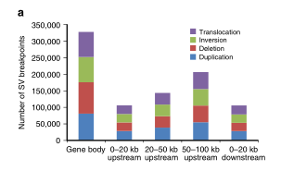
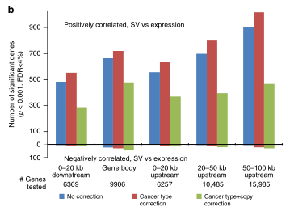
SV Breakpoint Analysis
Distance from gene doesn’t impact distribution

Slide 10
Key Driver Genes Significant Regions
Genes
Increased expression
TERT, MYC, MDM2, CDK4, ERBB2, CD274, PDCD1LG2, IGF2
Decreased expression
PTEN, STK11, KEAP1, TP53, RB1, SMAD4
These are likely tumor suppressant genes

Slide 11
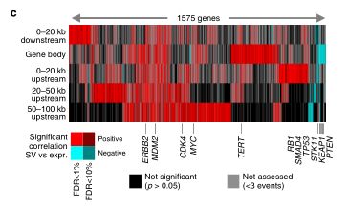
Key Driver Genes Significant Regions
Locations
Greatly vary falling into all the buckets described earlier
Specific genes tend to more affected by some buckets

Slide 12
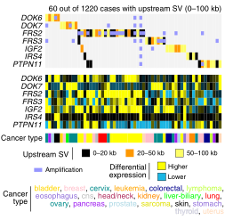
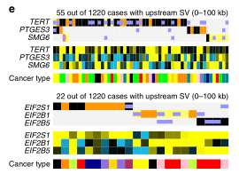
SV Event Impact on Cancer Cases
Observed SV events impact significant portion of cases
2-5% of cases across all type of cancer
“SVs involving the above categories of genes would potentially impact a substantial fraction of cancer cases, e.g., on the order of 2–5% of cases across various type”
– Page 4

Slide 13
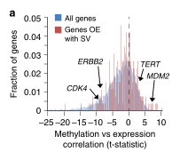
DNA Methylation vs Gene Expression
Expectations
Inverse trend between DNA methylation and gene expression
Observations
Expectations hold when considering
full 8256 gene dataset
Weaker inverse trend for set of 263
genes with SV event

Slide 14
Clinical Impact
Personalized medicine
Traditionally focusses on mutations in coding regions
New understanding about the impact of genomic rearrangements
Now possible due to whole genome sequencing
Enhances ability to understand individual cancer cases
Allow clinicians to provide better treatment for the individual
Brings us closer to fully personalized treatments for cancer

Slide 15
Study Limitations
Correlation vs causation
Focuses on SV and gene expression correlation
Does not investigate the exact causation process
There are many possible causation explanations
Enhancer hijacking
Topological associating domains disruption

Slide 16
Future Work
Understand the exact causation process
Investigate why this correlation exists
Determine if there is a single causation process
Maybe different genes produce the same correlation for different reasons
Might be possible to set of causes and classify genes into buckets

Slide 17
Related Work
Chromatin folding domain disruptions
“Disruption of chromatin folding domains by somatic genomic rearrangements in human cancer”
Paper from Tuesday
Some (small percentage) TAD boundary changes modify gene expression
Can SVs cause those disruptions to TADs?
This might be one causation explanation

Slide 18
Related Work
Somatic SV impact on DNA methylome
“Global impact of somatic structural variation on the DNA methylome of human cancers”
Genes and associated CpG islands which have a nearby somatic SV are observed to have altered expression and DNA methylation
Association is generally promotor-associated
Overall a DNA methylation decrease is associated with cancer
Zhang, Y., Yang, L., Kucherlapati, M. et al. Global impact of somatic structural variation on the DNA methylome of human cancers. Genome Biol 20, 209 (2019). https://doi.org/10.1186/s13059-019-1818-9

Slide 19
Open Questions
How far away from a gene can an SV be and still be impactful to the expression of the gene? How can we determine that the change in expression was not caused by another SV that was closer?

Slide 20
Open Questions
There are a lot of factors, some of which are unknown, that play into gene expression. Is it reasonable for us to do a follow-up causation study?

Slide 21
Open Questions
Since proving direct biological causation is difficult, let’s borrow from the deep learning paper and take a computation inference approach. Let SVs be the input features and the outputs be the gene expression changes. Would this help us better infer the subset of SVs that impact gene expression?

